Slide 1
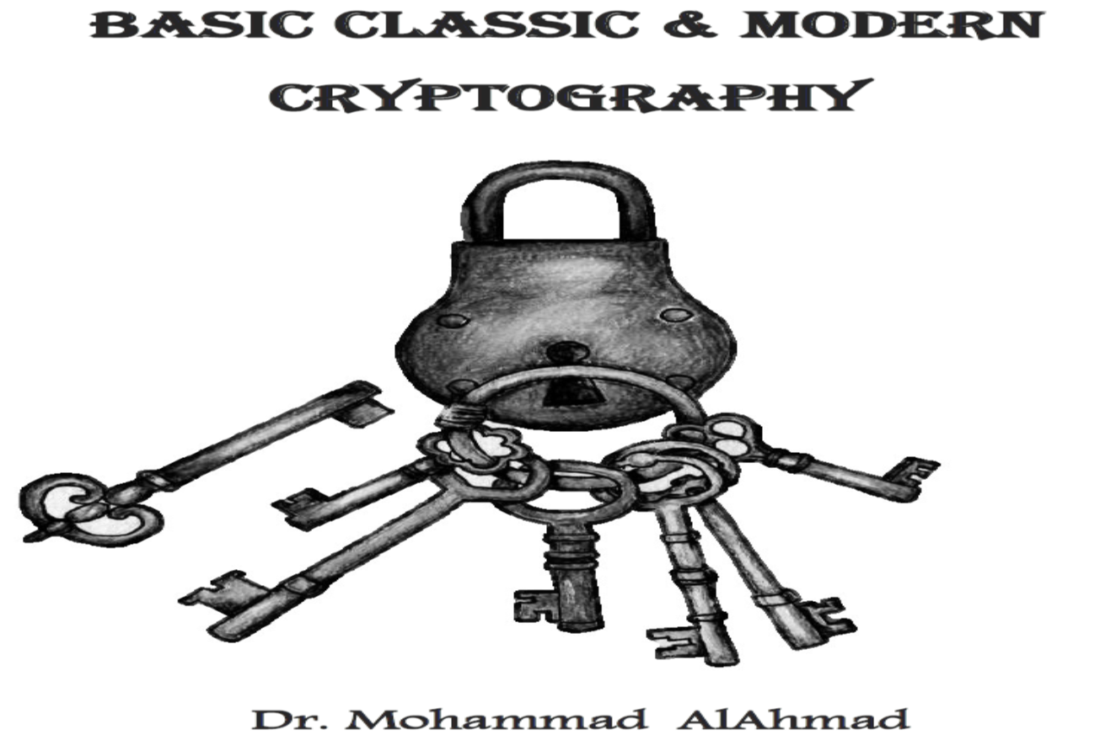
Chapter 4: Chapter 7:
MODERN CRYPTOGRAPHY ALGORITHEM(ASYMMETRIC ENCRYPTION

Slide 2
MODERN CRYPTOGRAPHY ALGORITHEM (ASYMMETRIC ENCRYPTION)
Chapter 7:
“The only truly secure system is one that is powered off ,cast in a block of concrete and sealed in a lead-lined room with armed guards”
(Gene Spafford)

Slide 3
Chapter 7:
MODERN CRYPTOGRAPHY ALGORITHEM
(ASYMMETRIC ENCRYPTION)
Objectives
The learning objectives of this chapter are:
Definition of asymmetric encryption of modern cryptography.
Understand the public key encryption concept.
Understand the RSA encryption scheme.
Understand the digital signature algorithm scheme.
Understand the public key infrastructure.

Slide 4
7.1 INTRODUCTION
In 1976, Whitfield diffie ,martin Hellman and ralph merkle have given the birth of asymmetric encryption that changes the concept of modern cryptography
The idea: finding a cryptosystem that computationally infeasible to determine the encryption key and decryption key.
The property of using different public and private keys in both ends gains the name of asymmetric encryption scheme.
Public key cryptosystem is a trapdoor one way function.
Means for example Ali cannot decrypt the message he encrypted and intended to send it to Imad. Why?

Slide 5
7.2 PUBLIC KEY ENCRYPTION
Asymmetric (Public-Key) encryption process uses two pair of keys to encrypt and decrypt the message.
Encrypt
Message
Using Ali Private key
+
Imad Public key
Sami
(bad)
Does not know
key “k”
Decrypt
Message
Using Imad
Private key
+
Ali Public key
y
Ali
(good)
Knows key “k”
Internet
(unsecure Channel)
Imad
(good)
Knows key “k”
x
y
y
x

Slide 6
6.2 SYMMETRIC KEY ENCRYPTION
Process:
There are two keys for each side; public and private keys. We call them key pair.
The private key is known only to your computer.
The public key is given by your computer to any computer that wants to communicate with it.
The key pair is based on random prime numbers.
The key pair are mathematically related. E.g. the public key is generated from the private key.

Slide 7
6.2 SYMMETRIC KEY ENCRYPTION
Example:
Ali wants to send message m to Imad.
Both Ali and Imad must have public encryption keys and private decryption keys. Ali and Imad must share their public keys.
Ali encrypts the message m using his private key and Imad’s public key.
Ali send the message m and then Imad receives the message m.
Imad decrypts the message m using his private key and Ali’s public key.

Slide 8
7.2 PUBLIC KEY ENCRYPTION
Advantages of asymmetric encryption:
No need for a prior secure communication to exchange the keys.
Send encrypted messages to everyone (convenience).
Private key is kept secret (secrecy).
Can provide a method for digital signatures (message authentication).
Provides for nonrepudiation.
Disadvantages of asymmetric encryption:
It is slow and uses more computer resources.
Certification authority problems.
Notes:
Many public key systems use a third party to certify the reliability of public keys. For instance, if you were to encrypt sensitive corporate data to send to your attorney's computer, you'd want to be sure that the computer you were sending it to was really tied to his law firm. The third party, called a certification authority, digitally signs their public key, turning it into a digital certificate, so that you can be sure it's safe to use. However, if the certification authority gets compromised, the criminal that did it could issue false certificates and fool people into sending data to the wrong place. This has already happened.
Provides for message authentication: Public key encryption allows the use of digital signatures which enables the recipient of a message to verify that the message is truly from a particular sender.

Slide 9
7.3 RSA ALGORITHM
RSA or Ron Rivest , Adi Shamir and Len Adleman is a public key cryptosystem and most widely used algorithm today.
RSA is a block cipher in which that plaintext and the cirphertext are integers between 0 and n-1 for some n.

Slide 10
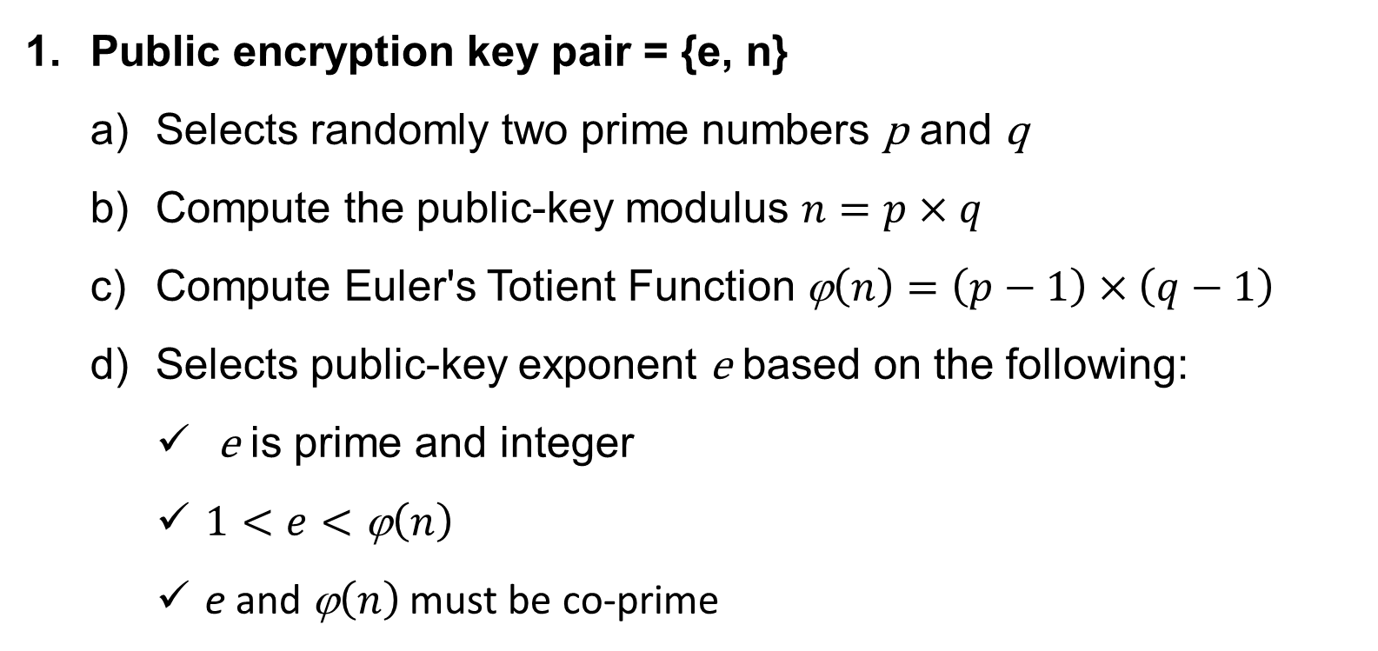
7.3 RSA ALGORITHM
RSA method (Keys generation):
Public encryption key pair = {e, n}
Selects randomly two prime numbers p and q
Compute the public-key modulus $n=p×q$
Compute Euler's Totient Function ϕ$\left(n\right)=\left(p−1\right)×\left(q−1\right)$
Selects public-key exponent e based on the following:
e is prime and integer
$1<e<\text{ϕ}\left(n\right)$
e and ϕ$\left(n\right)$ must be co-prime

Slide 11
7.3 RSA ALGORITHM
RSA method (Keys generation):
Private decryption key pair = {d, n}
Compute private-key exponent d using modular arithmetic (Extended Euclidean Algorithm):
$e×d=1 \left(mod\text{ϕ}\left(n\right)\right)$ , $where d<\text{ϕ}\left(n\right)$
Make sure the value of d is an integer.
Keys generation must be done twice from sender and receiver sides if they need to exchange messages.

Slide 12
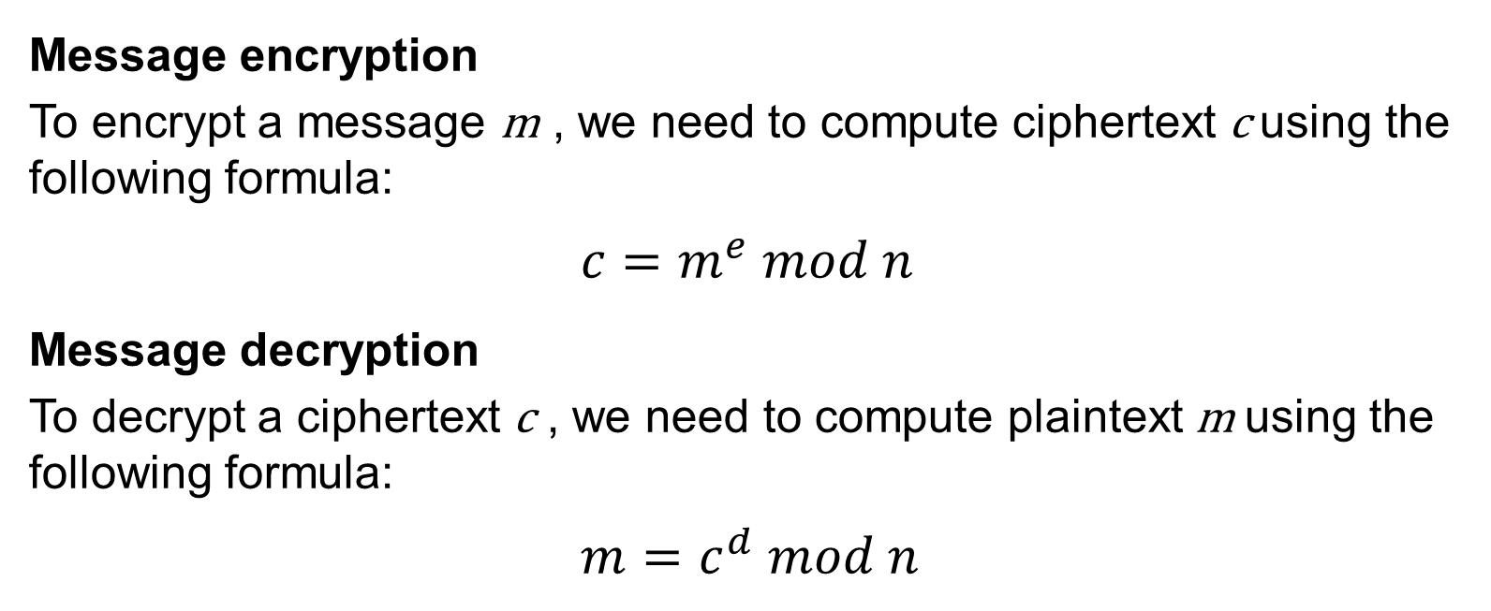
7.3 RSA ALGORITHM
RSA method (Encrypting/Decryption):
Message encryption
To encrypt a message m , we need to compute ciphertext c using the following formula:
$${ c=m}^{e} mod n$$
Message decryption
To decrypt a ciphertext c , we need to compute plaintext m using the following formula:
$${m=c}^{d} mod n$$

Slide 13
7.3 RSA ALGORITHM
*Some several attacks are possible and applicable to RSA algorithm and concluded as follows:
Brute force: this involves trying all possible private keys.
Mathematical attacks: there are several approaches, all equivalent in effort to factoring the product of two primes.
Timing attacks: these depend on the running time of the decryption algorithm.
Chosen ciphertext attacks: this type of attack exploits properties of the RSA algorithm.

Slide 14
Chapter 7:
MODERN CRYPTOGRAPHY ALGORITHEM(ASYMMETRIC ENCRYPTION
7.4 DIGITAL SIGNATURE ALGORITHM
Digital signature is a mathematical scheme used to validate the authenticity of the sender ,message and signer of the document identity .
Furthermore it is not a scanned signature of user and attached into a document .digital signatures arevcommonly used in web-commrece financial transactions and other cases where it is crucial to detect alteration and tampering of a message or a document

Slide 15
7.4 DIGITAL SIGNATURE ALGORITHM
The digital signature starts by generating a hash digest of a specific message than private key of the sender will be encrypted [signs] along with the hash digest to produce the digital signature for that message and send it to the receiver by using his/her public key at the receiver side the receiver private key will be used to view the document also a new hash digest will be generated to compare it with the document’s attached hash digest to ensure the two values are the same .
Consequently digital signature is impossible to forge due to security mechanisms involved more precisely digital signature ensures the data integrity of the message by using a proper hash function also it provides non-repudiation, which means the signer[sender] cannot claim he/she did not sign the message since his/her private key included in that document .

Slide 16
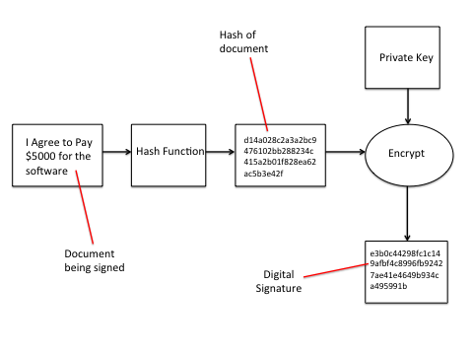
7.4 DIGITAL SIGNATURE ALGORITHM

Slide 17
Chapter 7:
MODERN CRYPTOGRAPHY ALGORITHEM(ASYMMETRIC ENCRYPTION
7.5 PUBLIC KEY INFRASTRUCURE
[PKI] as the set of hardware, software, people, policies, and procedures needed to create, manage , store, distribute, and revoke digital certificates based on asymmetric cryptography. The principal objective for developing a PKI is to enable secure, convenient and efficient acquisition of public keys .

Slide 18
7.5 PUBLIC KEY INFRASTRUCURE
*These elements are as follows:
End entity: A generic term used to denote and susers
Certification authority [CA] : the issuer of certificates and [usually] certificate revocation lists [CRLs] it may also support a variety of administartive functions although these are often delegated to one or more registration authorities
Registration authority [RA]: An optional component that can assume a number of administrative functions from the CA the RA is often associated with the end entity registration process but can assist in a nummber of other areas as well

Slide 19
7.5 PUBLIC KEY INFRASTRUCURE
CRL issuer: an optional component that a CA can delegate to publish CRLs
Repository: A generic term used to denote any method for storing certificates and CRLs so that they can be retrieved by end entities [Stallings & Brown;2008]

Slide 20
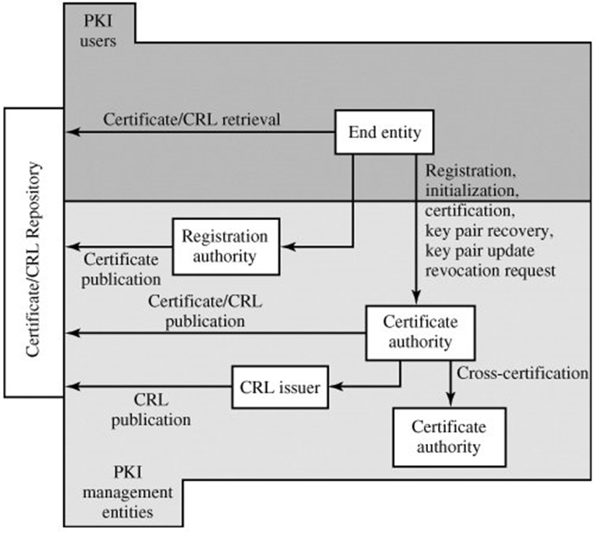
7.5 PUBLIC KEY INFRASTRUCURE

