Slide 1
Chapter 6:
Modern cryptography algorithms

Slide 2
MODERN CRYPTOGRAPHY ALGORITHMS
Chapter 6:
“securing a computer system has traditionally been a battle of wits: the penetrator tries to find the holes, and the designer tries to close them.”
(Gosser)

Slide 3
Chapter 6:
MODERN CRYPTOGRAPHY ALGORITHMS
Objectives
The learning objectives of this chapter are:
Definition of symmetric encryption of modern cryptography algorithm.
Understand the hash function concept.
Understand the message authentication code concept.
Understand the stream cipher and block cipher schemes.
Understand the advance encryption standard scheme.

Slide 4
The big picture
Modern Cryptography
Symmetric
Asymmetric

Slide 5
6.1 INTRODUCTION
Modern cryptography is a new terminology that describes the present cryptography and can stops the tampering of digital information.
It is mainly subdivided into two main branches: symmetric encryption and asymmetric encryption.
In encryption process, a key specifies the particular transformation of plaintext into ciphertext. Where, in decryption process, the key specifies the particular transformation of ciphertext into plaintext.
Notes:
That means, the sender and the sender should hold the same secret key which cannot be revealed to anyone
.Also, these secret pair of keys should be exchanged securely and safely.

Slide 6
6.2 SYMMETRIC KEY ENCRYPTION
Symmetric (Secret-Key) encryption process uses an identical pair of keys to encrypt and decrypt the message.
Sami
(bad)
Does not know
key “k”
y
Encrypt
Message
Using key “k”
x = y
Decrypt message using key “k”
y= x
Internet
(unsecure Channel)
Ali
(good)
Knows key “k”
x
y
y
x
Imad
(good)
Knows key “k”
Communication Over an Unsecure Channel (symmetric encryption scheme)

Slide 7
6.2 SYMMETRIC KEY ENCRYPTION
Advantages of symmetric encryption:
Simple
Fast
Uses less computer resources
Disadvantages of symmetric encryption:
Key management over large network.
Key distribution (needs a secure channel for secret key exchange).
Origin and authenticity of message cannot be guaranteed.

Slide 8
6.2 SYMMETRIC KEY ENCRYPTION
Examples of modern symmetric algorithms:
DES, 3DES, Blowfish, Twofish, RC4, AES … etc.
Advanced Encryption Standard (AES/Rijndael)
Why does Rijndael becomes the AES standard for National Institute of Standards and Technology (NIST)?
Security ➔ timing attack
Performance ➔ consistence on different hardware and software
Efficiency ➔ low memory, less power and high speed
Ease of implementation ➔ no need for extra hardware ➔ less cost
Flexibility ➔ suitable to large range of hardware
Notes:
AES based on the authors’ names “Joan Daemen and Vincent Rijmen”.
On Jan. 2, 1997, the National Institute of Standards and Technology (NIST) published a request for comments for the “Development of a Federal Information Processing Standard for Advanced Encryption Standard”.
Fifteen AES candidate algorithms were announced in August, 1998.
Five finalists were chosen on August 9, 1999: Mars, RC6, Rijndael, Serpent and Twofish.
Rijndael was selected as the Advanced Encryption Standard on Nov, 26, 2001.
Today AES is the encryption standard used around the world, for ex, bank transactions, email accounts accessing ... .etc.

Slide 9
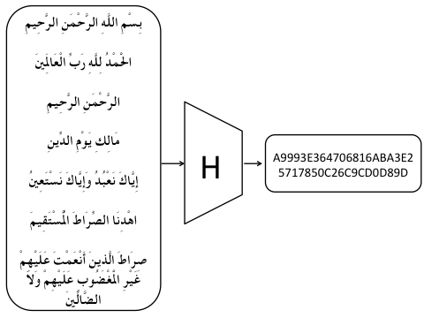
6.3 HASH FUNCTIONS
A cryptographic hash function H is an algorithm that takes an arbitrary length of message as an input {0, 1 }‘ and produces a fixed length of an output {0, 1 }“ called message digest ( also called an imprint, digital fingerprint, hash code, hash result, hash value, or simply hash).

Slide 10
6.3 HASH FUNCTIONS
Implementation in the modern cryptography:
Digital signature
Password protection
One-time password
Message authentication code
Digital time stamp
Public key encryption
This versatility earned them the nickname “Swiss army knife of cryptography”.

Slide 11
6.3 HASH FUNCTIONS
Properties of hash function :
Let x be a message
h be the hash function
h(x) be the value of the hash function
The hash function h must have the following properties:
Compression
Ease of computation
Pre-image resistance
Collision
2nd pre-image resistance
Collision resistance

Slide 12
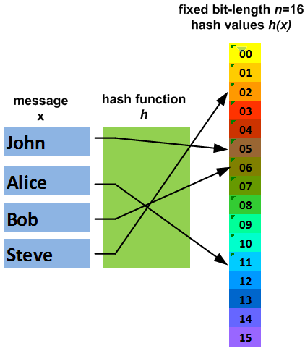
6.3 HASH FUNCTIONS
Property-1 :
Compression: h maps message x of random bit-length to outputs h(x) of a fixed bit-length n.

Slide 13
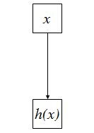
6.3 HASH FUNCTIONS
Property-2:
Ease of computation (efficiency): For a given message x it is easy to compute the value of h(x) from x.
It makes both hardware and software implementations practical.

Slide 14
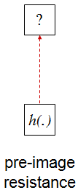
6.3 HASH FUNCTIONS
Property-3:
Pre-image resistance (one-way hash function): For a given hash value y, it should be computationally infeasible (difficult) to find an input x such that h(x) = y .
Pre-image means the origin of the message before hashing.
If a hash function doesn’t support this property then it can be vulnerable to pre-image attack.

Slide 15
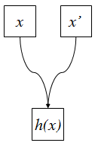
6.3 HASH FUNCTIONS
Understanding collision:
Collision (hash collision): Sometimes two or more messages hash/map to the same hash values.
This is not a property!

Slide 16
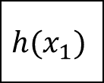
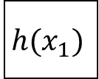
6.3 HASH FUNCTIONS
Property-4:
2nd pre-image resistance (weak collision resistance): For a given message x₁ and a hash value h(x₁) it should be infeasible (difficult) to find another message x₂ where x₁ ≠ x₂ such that h(x₁)=h(x₂).
$$h(x_{1})$$
$$?$$
If a hash function doesn’t support this property then it can be vulnerable to 2nd pre-image attack.
$$h(x_{1})$$

Slide 17
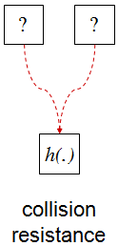
6.3 HASH FUNCTIONS
Property-5:
Collision resistance (strong collision resistance): It should be infeasible (difficult) to find two different messages x₁ and x₂ such that h(x₁)=h(x₂).
If a hash function doesn’t support this property then it can be vulnerable to Birthday Paradox.
Birthday paradox is a brute force attack that trying to find collisions by accident.
Notes:
It is related to a problem in information theory called “The Birthday Problem”.
There is an interesting example to understand the term in the link below:
http://www.britannica.com/EBchecked/topic/477530/probability-theory/32766/The-birthday-problem

Slide 18
6.3 HASH FUNCTIONS
Weak and strong hash functions:
2nd Pre-image resistance
Pre-image resistance
Collision resistance
Compression
2nd Pre-image resistance
Efficiency
Pre-image resistance
Compression
Weak hash function
Efficiency
h(x)
Strong hash function
Notes:
It is related to a problem in information theory called “The Birthday Problem”.
There is an interesting example to understand the term in the link below:
http://www.britannica.com/EBchecked/topic/477530/probability-theory/32766/The-birthday-problem

Slide 19
6.3 HASH FUNCTIONS
Algorithms in hash function:
MD2, MD4, MD5
SHA-0, SHA-1, SHA-2 and SHA-3
Block cipher in CBC mode.
MD stands for Message Digest
SHA stands for Secure Hash Algorithm

Slide 20
6.3 HASH FUNCTIONS
About MD5:
It is the fifth revision of the message algorithm developed by R.LRivest of RSA laboratories.
It can take any arbitrary length of input and produces a 128-bit as a hash digest.
It considered broken because in 2004 a theoretical collision was proven.

Slide 21
6.3 HASH FUNCTIONS
About SHA-1:
SHA-1 was published in 1995 by NIST along with NSA.
It takes an arbitrary length of a message as an input and produces 160-bits as a hash digest.
In 2005, security flaws and mathematical weakness were identified:
Collision resistance
Pre-image resistance
2nd pre-image resistance
Notes:
National Security Agency (NSA)
SHA-0 was published in 1993 by NIST. Starting from 1998, security flaws and mathematical weakness were identified:
SHA-0 and SHA-1 had same security weakesses.

Slide 22
6.3 HASH FUNCTIONS
About SHA-2:
In 2001, SHA-2 designed by NSA and published by NIST.
It was derived from SHA-1 including significant changes.
It has four versions with hash digest 224, 256, 384 and 512-bits.
Today, SHA-2 still considered a secure hash function algorithm.
Notes:
National Security Agency (NSA)

Slide 23
6.3 HASH FUNCTIONS
About SHA-3:
In October, 2012, SHA-3 designed by Guido Bertoni, Joan Daemen, Michael Peeters, and Gikked Van Assche, building upon Radio Gatun.
Keccak algorithm won NIST competition and became SHA-3 algorithm.
It uses different/new hash function construction design than SHA-1 and SHA-2.
Notes:
National Security Agency (NSA)
The Keccak algorithm (pronounced "ket-chak") is the work of Guido Bertoni, Joan Daemen, Michael Peters, and Giles Van Assche.
It was submitted as an SHA-3 candidate in October 2008.
The name Keccak comes from Kecak, a Balinese dance

Slide 24
6.3 HASH FUNCTIONS
List of popular hash functions:
Algorithm | Rounds | Internal Size | Output Size
MD2 | 864 | 384 | 128
MD4 | 48 | 128 | 128
MD5 | 64 | 128 | 128
RIPEMD-160 | 80 | 160 | 160
SHA-0 | 80 | 160 | 160
SHA-1 | 80 | 160 | 160
SHA-256/224 | 64 | 256 | 256/224
SHA-512/384 | 80 | 512 | 512/384
SHA-3 | 24 | 1600 | 224/256/384/512

Slide 25
6.3 HASH FUNCTIONS
Hash function is one way and compact:
One way: means the hash value h(m) is not reversible ➔ It is impossible to get m from h(m).
Compact: means any input data size produces fixed output data size.
Hash function and data integrity:
If a single bit alteration in message M, it will yield to totally different digest.

Slide 26
6.3 HASH FUNCTIONS
An example of using hash function in password protection:
Registration process | Login process
A user enters selected a password. Server hashes the password and save the hash value in variable x. Password removed from the system. | The user enters the password. The server hashes the entered password and save the hash value in variable y. The server compares x and y; if y ≠ x ➔ wrong password if y = x ➔ correct password

Slide 27
6.4 MESSAGE AUTHENTICATION CODE
A Message Authentication Code (MAC) is a hash function method that uses a session symmetrical key to detect any accidental or intentional modification of data when transfer between one computer to another.
Session key is a random generated key for the encryption and decryption process.
It is designed especially for applications to detect message tampering and forgery.

Slide 28
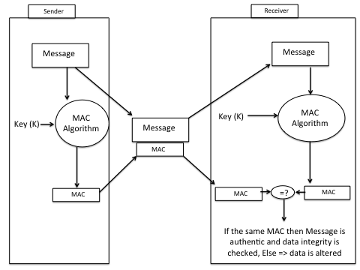
6.4 MESSAGE AUTHENTICATION CODE

Slide 29
6.4 MESSAGE AUTHENTICATION CODE
The process of the MAC algorithm:
Sender calculates the hash digest of the message then apply the secret key K to it to produce MAC value (sometimes called tag).
The message along with the calculated MAC send to the receiver.
Independently, the receiver calculates a new MAC value by using the symmetric secret key (K) and generate new hash digest.
If the attached MAC with original message matches the new calculated MAC ➔ the message is authenticated and integrity verified.

Slide 30
6.4 MESSAGE AUTHENTICATION CODE
About MAC:
In MAC scheme, both sender and receiver should agree on the same symmetric secret key to initiate communications.
Additionally, MAC does not provide non-repudiation property due to the use of symmetric secret key.
Example-1, if a user send a message to a receiver, later on, he/she can deny sending this message.
Example-2, if an adversary can verify a MAC value, then he/she is capable of generating other messages.

Slide 31
STREAM CIPHERS AND BLOCK CIPHERS
Modern Cryptography
Symmetric
Asymmetric
Stream Cipher
Block Cipher

Slide 32
6.5 STREAM CIPHERS
Stream cipher encrypts a small block of data (usually of size one bit or one byte) at a time and uses different keys to encrypt each block.
Example:
01101100 plaintext 11100000 ciphertext
10001100 key 10001100 key
11100000 ciphertext 01101100 plaintext
Encryption process Decryption process

Slide 33
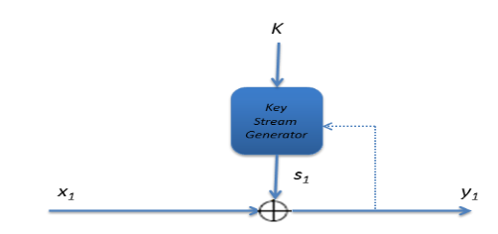
6.5 STREAM CIPHERS
There are two types of stream ciphers:
Synchronous stream cipher: the ciphertext depends only on the key.
Asynchronous stream cipher: the key depends on the ciphertext.
Notes:
The figure depicts the synchronous stream cipher if the dotted line is omitted.
the same figure depicts the asynchronous stream cipher if dotted line is presented.

Slide 34
6.5 STREAM CIPHERS
Example of a stream cipher:
RC4 is one popular example of stream cipher scheme.
RC4 is designed in 1987 by Ron Rivest for RSA Security.
It uses a variable length of key size with one byte oriented operation.
RC4 algorithm is based on random permutation (transposition).

Slide 35
6.6 BLOCK CIPHERS
Block cipher encrypts the entire plaintext at a time with the same key. It divides message into large fixed blocks.
In practice, some of the block cipher algorithms use a block length size of 64-bits (8-bytes) such as DES or 3DES.
Most block ciphers algorithms today use a block length size of 128-bits (16-bytes) such as AES.

Slide 36
6.6 BLOCK CIPHERS
Operation mode:
To encrypt a message using block ciphers we need a mode of operation. There are five modes/standards:
ECB (Electronic Code Book)
CBC (Cipher-Block Chaining)
CFB
OFB
CTR

Slide 37
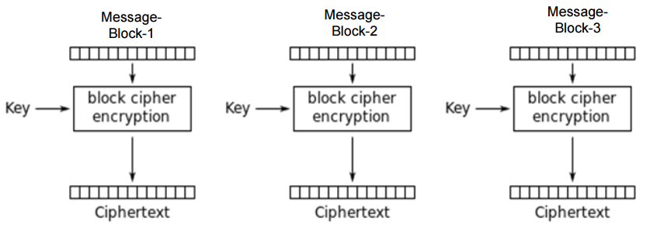
6.6 BLOCK CIPHERS
ECB (Electronic Code Book) mode of operation

Slide 38
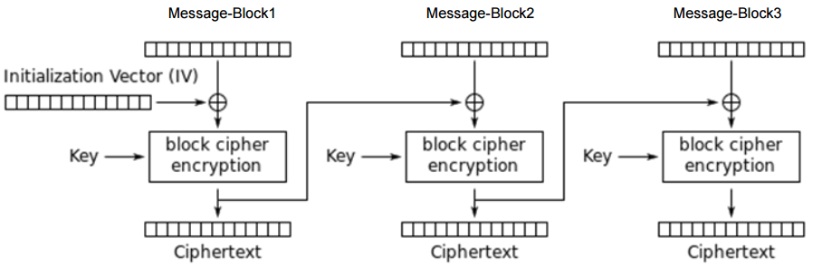
6.6 BLOCK CIPHERS
CBC (Cipher-Block Chaining) mode of operation

Slide 39
6.6 BLOCK CIPHERS
Padding schemes for block ciphers:
To perform encryption with a block cipher in ECB or CBC mode the length of the input to be encrypted must be an exact multiple of the block length B in bytes.
If the length of the data to be encrypted is not an exact multiple of B, it must be padded to make it so.
There are many techniques for padding. It is up to the sender and receiver to agree on the technique used. Examples;
OneAndZeroes
PKCS5
ANSI X9.23

Slide 40
6.6 BLOCK CIPHERS
OneAndZeroes:
Add a single padding byte of value 0x80 and then pad the balance with enough bytes of value zero to make the total length an exact multiple of 8 bytes.
If the single 0x80 byte makes the total length an exact multiple then do not add any zero bytes.
After decrypting, strip off all trailing zero bytes and the 0x80 byte.
It is recommended in NIST 800-38a [BCMO].

Slide 41
6.6 BLOCK CIPHERS
Examples of OneAndZeroes padding for block length N = 8:
Message size | Message | Message in blocks of 8 bytes | # Blocks
3 bytes | FDFDFD | FDFDFD0505050505 | 1
7 bytes | FDFDFDFDFDFDFD | FDFDFDFDFDFDFD01 | 1
8 bytes | FDFDFDFDFDFDFDFD | FDFDFDFDFDFDFDFD0808080808080808 | 2

Slide 42
6.6 BLOCK CIPHERS
Some comparisons between stream ciphers and block ciphers are as follows:
Block ciphers are widely used in the Internet over the stream cipher, for ex, AES algorithm.
Stream ciphers tend to be used in fast and small applications, for ex, cell phones.

Slide 43
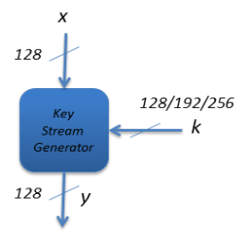
6.7 ADVANCED ENCRYPTION STANDARD
Advance encryption standard (AES):
Was published by NIST in 2001.
AES is a symmetric block cipher that requires a block length of 128-bits.
It supports a key length of 128, 192 and 256-bits.

Slide 44
6.7 ADVANCED ENCRYPTION STANDARD
AES in an iterated cipher, the number of rounds depends on the key length:
Key length | # of rounds
128-bits | 10
192-bits | 12
256-bits | 14

Slide 45
Summery
Have considered:
Definition of symmetric encryption of modern cryptography algorithm
Understanding the hash function concept.
Understanding the message authentication code concept.
Understanding the stream cipher scheme.
Understanding the block cipher scheme.
Understanding the advance encryption standard scheme.

