Slide 1
Chapter 2:
INTRODUCTION OF CRYPTOGRAPHY

Slide 2
INTRODUCTION OF CRYPTOGRAPHY
Chapter 2:
“If you want total security, go to prison. There you're fed, clothed, given medical care and so on. The only thing lacking... is freedom.”
Dwight D. Eisenhower

Slide 3
Chapter 2:
INTRODUCTION OF CRYPTOGRAPHY
Objectives
The learning objectives of this chapter are:
Definition of cryptology, cryptography & cryptanalysis.
Describe the basic concept of classical cryptography.
Describe the basic concept of modern cryptography.
Definition of cryptanalysis.
To understand how many bits are enough to secure a cryptosystem.

Slide 4
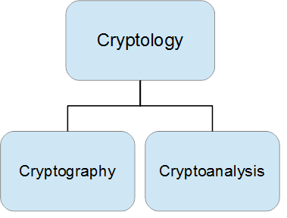
2.1 INTRODUCTION
Cryptology is a branch of mathematics that encompasses both cryptography and cryptanalysis.
The practitioners of cryptology are called cryptologists.

Slide 5
2.1 INTRODUCTION
Cryptography is the science of studying the information security.
Cryptographer studies the techniques needed to achieve and protect the information between any communication channels.
The person engages in cryptography is called cryptographer.
Cryptanalysis is the science of violating the information security.
Cryptanalyst studies the techniques needed to understand the meaning of secret information and attempts to break them.
The person engages in cryptanalysis is called cryptanalyst.

Slide 6
2.2 CLASSICAL CRYPTOGRAHY
Classical cryptography is the old methods of achieving the science of hiding and revealing of the information. It is mainly depends on the symmetric key encryption. Symmetric key encryption uses the same key at the sender and the recipient.

Slide 7
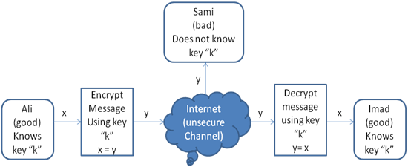
2.2 .1 BASICS
The message format names used in cryptography are concluded below:
- x called the plaintext
- y called the ciphertext
- k called the key
- The set of all possible keys called the key space

Slide 8
2.2.2 SIMPLE EXAMPLE OF CLASSICAL CRYPTOGRAPHY
Example 2.1. let:
A → m
B → s
C → x
…..
Now, if we want to encrypt the plaintext ABBC, the ciphertext will be mssx. To decrypt the message, we have to do it in the reverse way.

Slide 9
2.2.2 SIMPLE EXAMPLE OF CLASSICAL CRYPTOGRAPHY
Example 2.2. let:
K → z
O → f
P → w
…..
Now, if the ciphertext is fwfz, then the plaintext is OPOK.
Is it possible to break such a ciphertext without knowing the key conversion?

Slide 10
2.3 MODERN CRYPTOGRAPHY
Modern cryptography is the new terminology that describes the needed protection for computer systems today.
It basically depends on:
Complicated mathematical theories
Set of rules which needs a huge knowledge of cryptanalysis to analyze and break.

Slide 11
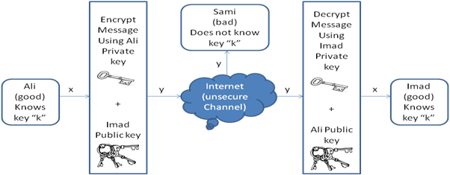
2.3.1 BASICS
Modern cryptography can be classified into two main types: symmetric and public-key (asymmetric) cryptosystems.
Communication Over an Unsecure Channel (asymmetric encryption scheme)

Slide 12
2.3.1 BASICS
Symmetric vs. Asymmetric:
The major drawback is the key distribution problem. That means, how can two end users lives faraway from each other obtain the secret-key securely.
But with asymmetric encryption scheme, each user has its own public and private key.

Slide 13
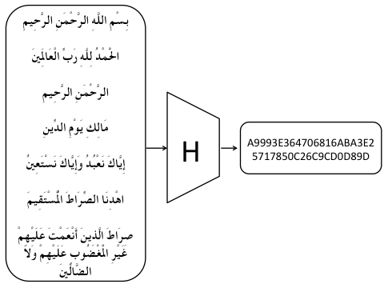
2.3.2 SIMPLE EXAMPLE OF MODERN CRYPTOGRAPHY
Example of modern cryptography is cryptographic hash function.
It is an algorithm that takes an arbitrary length of message as an input {0, 1}* and produce a fixed length of an output called message digest {0, 1}^{n} (sometimes called an imprint, digital fingerprint, hash code, hash result, hash value, or simply hash).

Slide 14
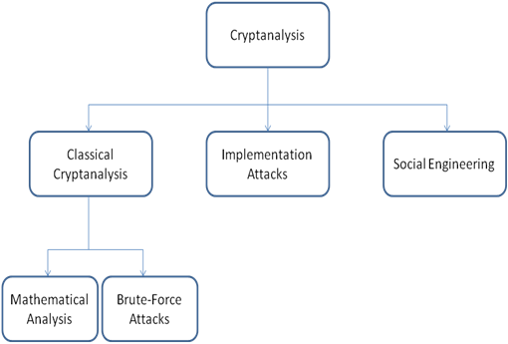
2.4 CRYPTANALYSIS
Cryptanalysis refers to the science of violating the information security. It studies the techniques needed to understand the meaning of secret information and attempts to break them.

Slide 15
2.4 CRYPTANALYSIS
Implementation attacks are attacks where the attacker can have physical access to the cryptosystems such as fingerprint biometric devices.
Social engineering attacks are attacks where the attacker uses human interaction (social skills) to obtain or compromise information about an organization or its computer systems.

Slide 16
2.4 CRYPTANALYSIS
In classical cryptanalysis, the plaintext is recovered from the ciphertext, or alternatively, recovering the key k from the ciphertext.
Mathematical analysis exploits and analyzes the internal structure of the cryptographic design to find the weaknesses of that design and attack them (e.g. structural analysis).

Slide 17
2.4.1 HOW MANY KEY BITS ARE ENOUGH
Brute-force attack treats the cryptographic design as a black box and attacks it trying all possible keys.
Brute-force attack along with the speed of the CPUs today altogether answer the question, how many key bits are enough today?
The question here, does the key length matter here?

Slide 18
2.4.1 HOW MANY KEY BITS ARE ENOUGH
For a symmetric crypto system, if the mathematical, implementation, social engineering attacks works, then, a large key space does not help.
The key lengths for symmetric and asymmetric crypto systems are different. For example, a 160-bits symmetric key roughly provides the security of 1024-bits RSA (asymmetric algorithm) key.

Slide 19
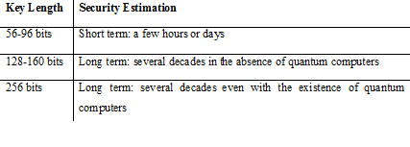
2.4.1 HOW MANY KEY BITS ARE ENOUGH
The following table estimates the time successful to break a symmetric crypto system using brute-force attack.

Slide 20
2.4.1 HOW MANY KEY BITS ARE ENOUGH
Moore’s law: computing powers double every 18 months while the cost stay constant.
This law has an influence in cryptography.
Example, today, if we need to break a ciphertext in one month with a computer worth $1,000,000, then, the cost for breaking the cipher will be $500,000 in 18 months, $250,000 in 3 years, and $125,000 in 4.5 years and so on.

Slide 21
Summary
Have considered:
Definition of cryptography.
Describtion the basic concept of classical cryptography.
Describtion the basic concept of modern cryptography.
Definition of cryptanalysis.
Understanding how many bits are enough to secure a cryptosystem.

