Slide 1
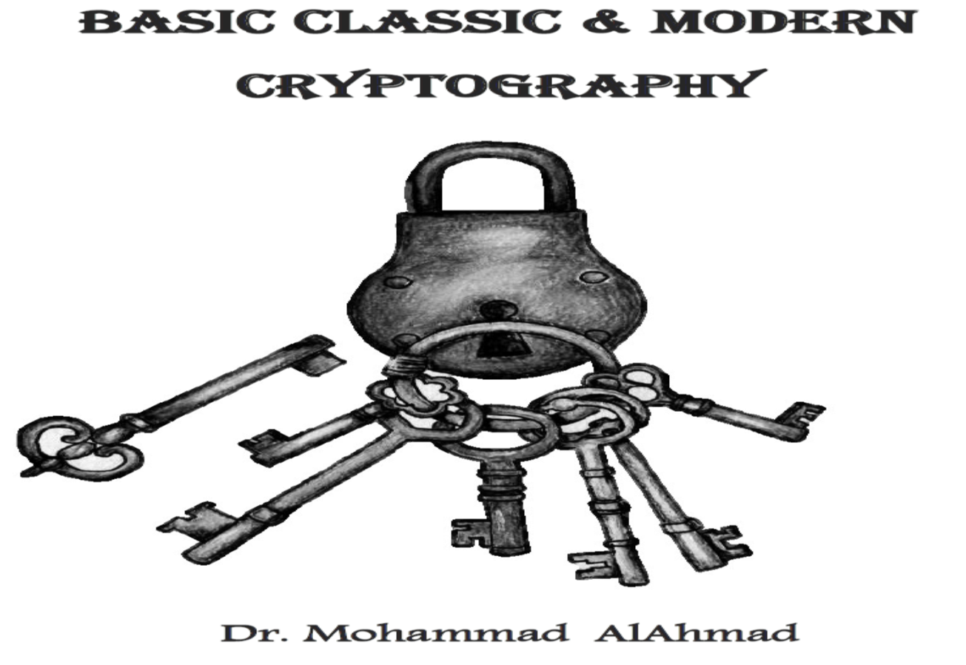
Chapter 1:
PRELIMINARIES

Slide 2
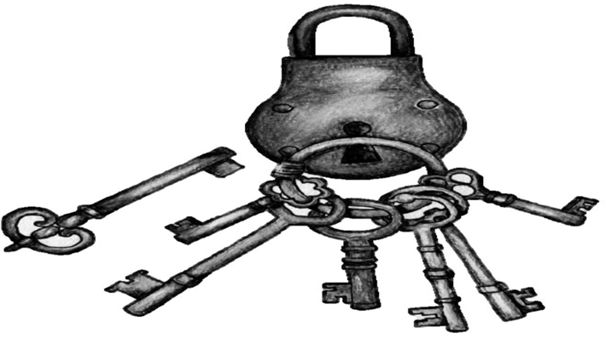
Symbol Keys Guide
Symbol | Description
 | Topic and subtopics include a tutorial
 | Video material
 | Assignment included in topic and subtopics
 | Class activity
 | Bonus question

Slide 3
PRELIMINARIES
Chapter 1:
“Let us not look back in anger or forward in fear, but around in awareness.” (James Thurber)
Notes:
James Thurber was an American cartoonist best known for his contributions to The New Yorker magazine.

Slide 4
Objectives
The learning objectives of this chapter are:
Definition of computer security.
Describe the triad security requirements of confidentiality, integrity and availability.
Understand terminologies used in computer security.
Describe the computer security principles
Describe the honeypot security network.

Slide 5
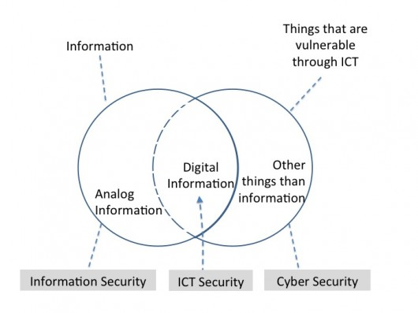
The Big Picture
https://ccis.no/cyber-security-versus-information-security/
Notes:
Cyber comes from Cybernetics which is the science of communications and automatic control systems in both machines and living things.

Slide 6
1.1 INTRODUCTION OF COMPUTER SECURITY
What is Computer Security? The protection afforded to an automated information system in order to attain the applicable objectives of preserving the integrity, availability, and confidentiality of information system resources (includes hardware, software, firmware, information/data, and telecommunications).

Slide 7
1.1 INTRODUCTION OF COMPUTER SECURITY
The word “protection” relies on the “90/10” rule:
10% of “protection” are technical.
90% of “protection” relies on computer users “YOU” and how to adhere to good practices.
Notes:
Based on NIST (National Institute of Standards and Technology)

Slide 8
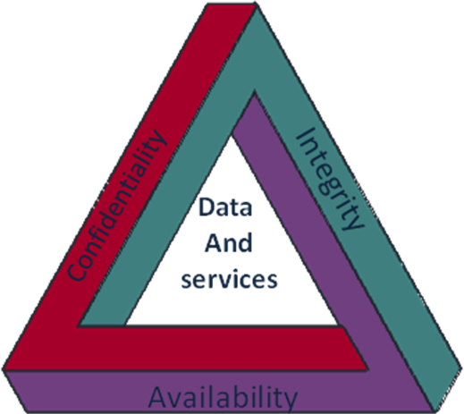
1.2 COMPUTER SECURITY CONCEPTS
What is CIA?
✗
✓
CIA Triad
Notes:
CIA is a civilian foreign intelligence service of the United States federal government, tasked with gathering, processing and analyzing national security information from around the world.

Slide 9
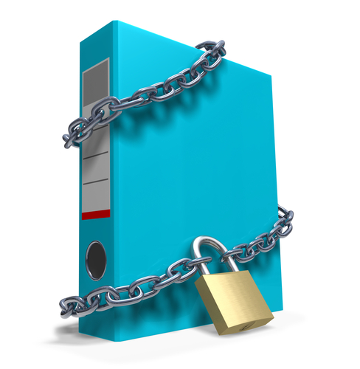
1.2 COMPUTER SECURITY CONCEPTS
Confidentiality:
Preserving authorized restrictions on information access and disclosure, including means for protecting personal privacy and proprietary information.
A loss of confidentiality is the unauthorized disclosure of information.
Notes:
Information that is not public knowledge (such as certain financial data.

Slide 10
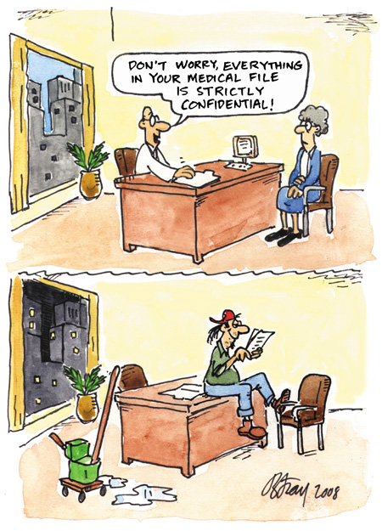
1.2 COMPUTER SECURITY CONCEPTS
Confidentiality examples:
Individual files are locked and secured.
Support workers do not tell other people what is in a client’s file unless they have permission from the client.
Clients’ medical details are not discussed without their consent.

Slide 11
1.2 COMPUTER SECURITY CONCEPTS
Integrity:
Guarding against improper information modification or destruction, including ensuring information non-repudiation and authenticity.
A loss of integrity is the unauthorized modification or destruction of information.

Slide 12
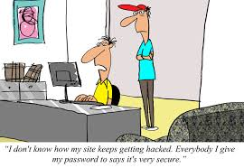
1.2 COMPUTER SECURITY CONCEPTS
“ I don’t know how my site keeps getting hacked. Everybody I give my password to says it’s very secure.”
Integrity examples:
Protection from user errors.
Protection from unauthorized modification on a database.
Track record for any data modification.

Slide 13
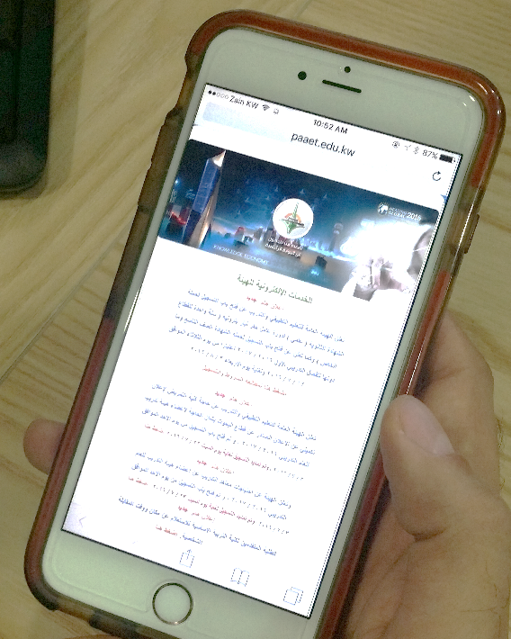
1.2 COMPUTER SECURITY CONCEPTS
Availability:
Ensuring timely and reliable access to and use of information.
A loss of availability is the disruption of access to or use of information or an information system.

Slide 14
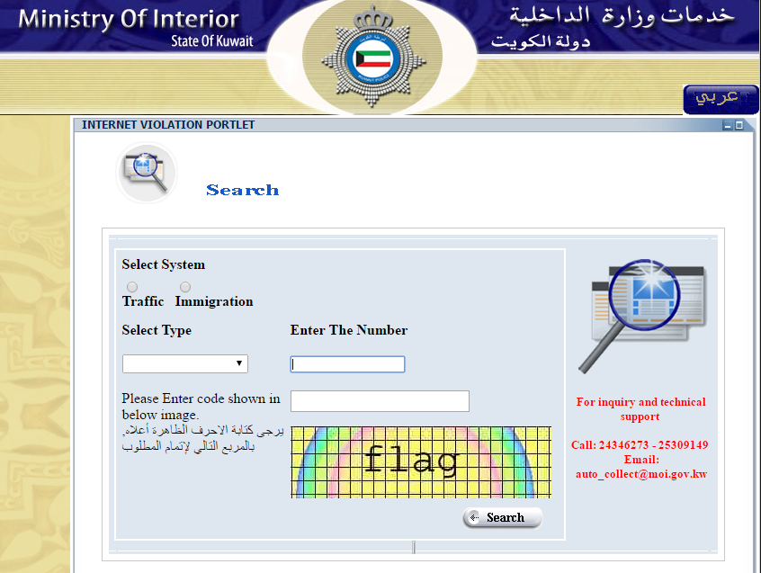
1.2 COMPUTER SECURITY CONCEPTS
Availability example:
Traffic fines e-payment system in the airport must be highly available.

Slide 15
1.2 COMPUTER SECURITY CONCEPTS
Some security concepts are needed to present the complete picture (FIPS, 2004) and (Shirey, 2003):
Authenticity: The property of being genuine and being able to be verified and trusted.
Confidence in the validity of a transmission, a message, or message originator. This means verifying that users are who they say they are and that each input arriving at the system came from a trusted source.

Slide 16
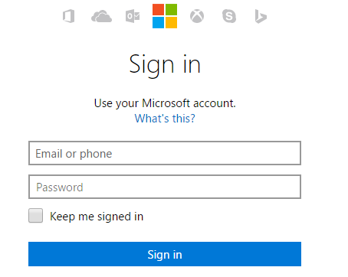
1.2 COMPUTER SECURITY CONCEPTS
Authenticity examples:
A legitimate user with valid user name and password can access an email system.

Slide 17
1.2 COMPUTER SECURITY CONCEPTS
Accountability: The security goal that generates the requirement for actions of an entity to be traced uniquely to that entity. In other words, the obligation of an individual or organization to account for its activities and accept responsibility for them.
This supports non-repudiation, deterrence, fault isolation, intrusion detection and prevention, and after-action recovery and legal action.

Slide 18
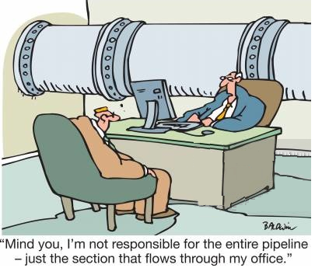
1.2 COMPUTER SECURITY CONCEPTS
Accountability examples:
The policy statement that all employees must avoid installing outside software on a company-owned information infrastructure.
The person in charge of information security should perform periodic checks to be certain that the policy is being followed.

Slide 19
1.2 COMPUTER SECURITY CONCEPTS
Non-repudiation: The property where the signer (sender) cannot claim he/she did not sign/send the message since his/her private key included in that document.
It is the verification of the identities of individuals or companies who are participating in telecommunications sessions.
There are two types:
Non-repudiation of origin.
Non-repudiation of receipt.

Slide 20
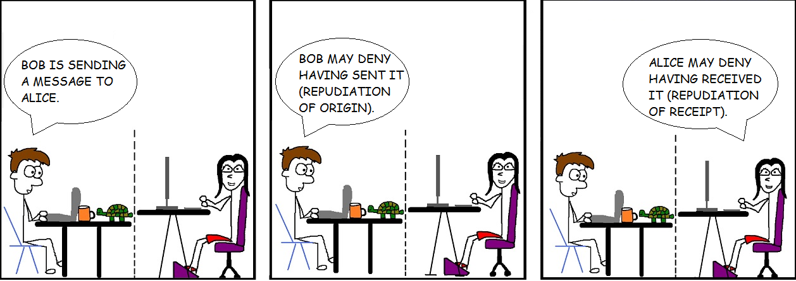
1.2 COMPUTER SECURITY CONCEPTS
Non-repudiation example:
Specific protocols have been designed in order to generate evidences for non-repudiation of origin (NRO) (for Bob), and non-repudiation of receipt (NRR) (for Alice).

Slide 21
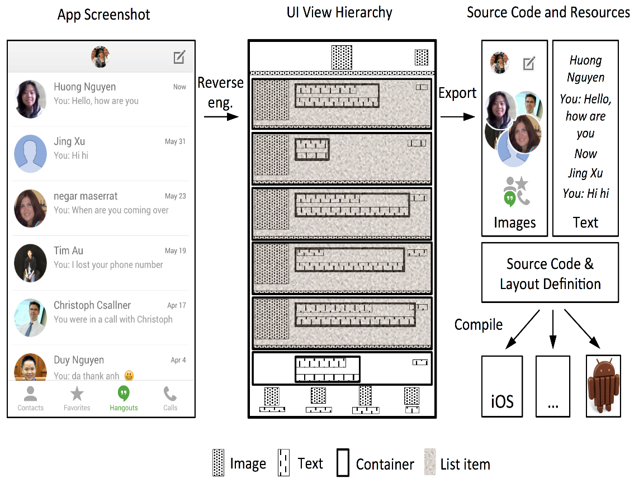
1.2 COMPUTER SECURITY CONCEPTS
Adversary (threat agent) : An entity that attacks, or is a threat to, a system.
Example: A hacker can analyze and reverse engineer a mobile app's code, then can modify it to perform some hidden functionality.

Slide 22
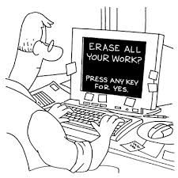
1.2 COMPUTER SECURITY CONCEPTS
Attack: An assault on system security that derives from an intelligent threat; that is, an intelligent act that is a deliberate attempt (especially in the sense of a method or technique) to evade security services and violate the security policy of a system.
Examples:
Viruses (electronic/logical)
Damaging system board (physical)

Slide 23
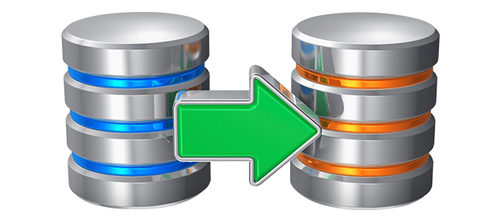
1.2 COMPUTER SECURITY CONCEPTS
Countermeasure: An action, device, procedure, or technique that reduces a threat, a vulnerability, or an attack by eliminating or preventing it, by minimizing the harm it can cause, or by discovering and reporting it so that corrective action can be taken.
Example: Backup (system/software/data )

Slide 24
1.2 COMPUTER SECURITY CONCEPTS
Vulnerability: A flaw or weakness in a system’s design, implementation, or operation and management that could be exploited to violate the system’s security policy.
Examples:
Non-updated Windows OS.
Heartbleed Bug.

Slide 25
1.2 COMPUTER SECURITY CONCEPTS
Threat: A possible for violation of security, which exists when there is a circumstance, capability, action, or event, that could breach security and cause harm. That is, a threat is a probable danger that might exploit vulnerability.
Example: A hacker can exploit a non-updated Windows 10. [Microsoft Security Bulletin MS16-094 – Important - Security Update for Secure Boot (3177404)]

Slide 26
1.2 COMPUTER SECURITY CONCEPTS
System Resources (Assets): Any resources or things of value that are owned by an entity to produce cash/value.
Examples:
Data contained in an information system.
Service provided by a system.
System capability (i.e., processing power or communication bandwidth.
An item of system equipment (i.e., a system component hardware, firmware, software, or documentation).
A facility that houses system operations and equipment.

Slide 27
1.2 COMPUTER SECURITY CONCEPTS
Risk: An expectation of loss expressed as the probability that a particular threat will exploit a particular vulnerability with a particular harmful results.
It can be defined as a function of assets, threats and vulnerabilities using the following formula:
$Risk=Assets×Threats ×Vulbnerabilities$

Slide 28
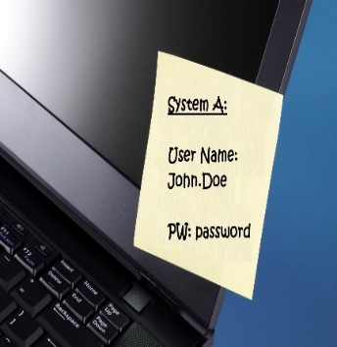
1.2 COMPUTER SECURITY CONCEPTS
Security Policies: A set of rules and practices that specify or regulate how a system or organization provides security services to protect sensitive and critical system resources.
Examples:
Not allowing any one to install software in company’s PC.
Don’t leave your password written in a stick note on your desk.

Slide 29
1.3.1 CRYPTOGRAPHIC TOOLS
They are sequences of processes, or rules, used to encipher and decipher messages in a cryptographic system.
“Modern” cryptography consists of various cryptography algorithms and tools.
Example: Advanced Encryption Standard (AES)

Slide 30
1.3.2 AUTHENTICATION
Authentication is the process that making sure of the identity of all parties.
Example: If Ali uses his computer to send a message to Imad’s computer, Imad’s can ensures that Ali sent the message by using authenticity property.
See Authenticity (Slide-13)

Slide 31
MORE ON AUTHENTICATION
You can be authenticated on the basis of:
something you know, e.g. (password, ID number, … etc.)
something you hold, e.g. (keys, cards, … etc.)
who you are, e.g. (face, finger prints, iris patterns, DNA, … etc.)
what you do, e.g. (handwriting, gait analysis, … etc.)
where you are, e.g. (based on your location- GPS)

Slide 32
1.3.3 ACCESS CONTROL
Access control is a method or mechanism that control who can access resources and to whom should be granted.

Slide 33
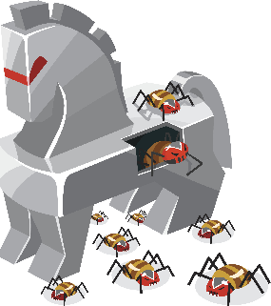
1.3.4 MALICIOUS SOFTWARE
Malicious software (malware): It is unwanted software that intended to harm computer system.
It can delete, modify or add unwanted software not approved by the user.
Examples:
Trojans: Hide themselves within seemingly harmless programs or try to trick you into installing new software.

Slide 34
1.3.4 MALICIOUS SOFTWARE
Examples continued:
Viruses: A virus is a program or piece of code that is loaded onto your computer without your knowledge and runs against your needs.
Worms: Stand-alone malicious programs that can self-replicate and propagate via computer networks, without human help.

Slide 35
1.3.4 MALICIOUS SOFTWARE
Examples continued:
Spyware: A type of software used to infect devices in order to secretly obtain data without the user's permission.
User’s data can be private information, Internet interaction, passwords … etc. .
It can also affect the computer’s performance by installing additional software, redirecting web browser searches, change computer settings, … etc. .

Slide 36
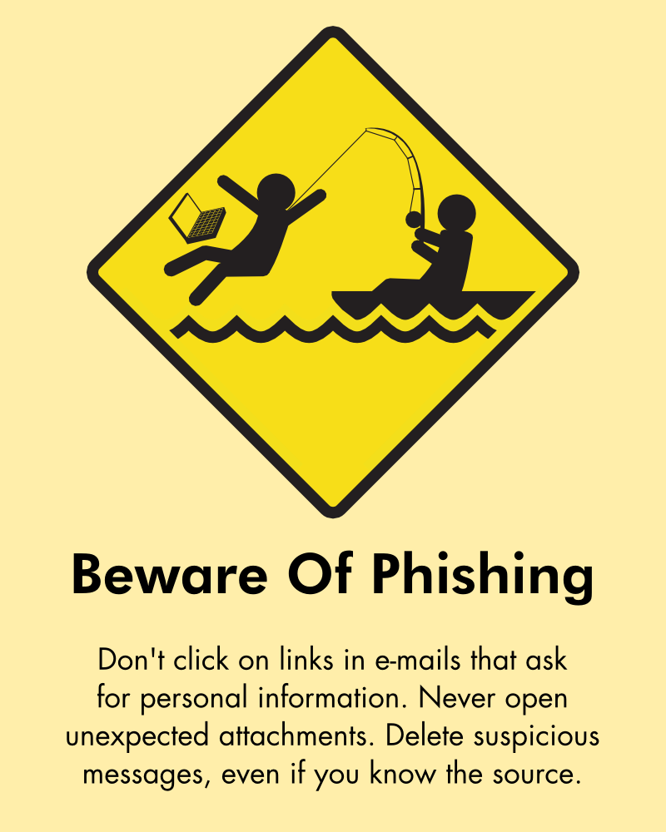
1.3.5 OTHER FORMS OF ATTACKS
Phishing: is an attempt by the attacker to acquire sensitive information such as credit card information, bank account information, social security number or a username from the legitimate user by sending him/her an email or by calling him/her.

Slide 37
1.3.5 OTHER FORMS OF ATTACKS
Pharming: Redirects users to fake websites to misdirect the users to steal their account information.
This is done bye changing the DNS settings.
DNS File Entry
212.43.1.110 www.google.com
192.168.2.1

Slide 38
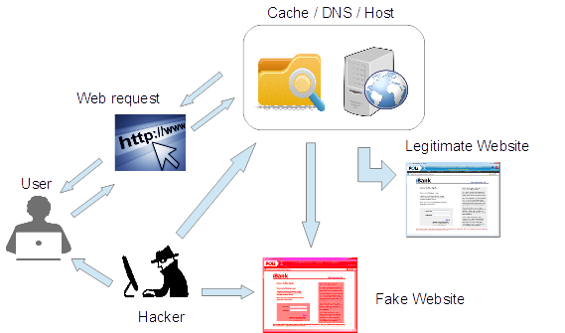
1.3.5 OTHER FORMS OF ATTACKS
Pharming illustrated scenario:

Slide 39
1.3.5 OTHER FORMS OF ATTACKS
Denial of service (DoS) : is an attack to prevent the legitimate users to use the network resources by flooding the network with useless traffic.
Example: ICMP Echo Request (ping) packets, generally sends packets as fast as possible without waiting for replies (band width consumption).
Notes:
DoS ➔ Availability
Internet Control Message Protocol (ICMP)

Slide 40
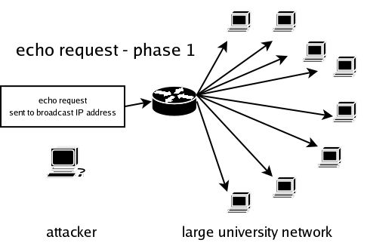
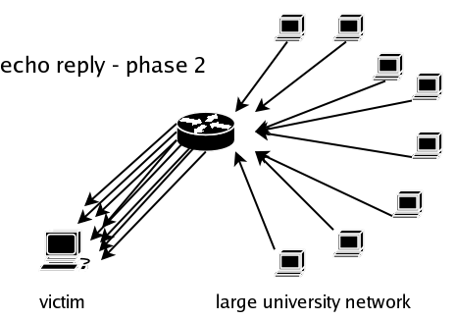
1.3.5 OTHER FORMS OF ATTACKS
ICMP (Ping) Flood scenario:

Slide 41
1.3.5 OTHER FORMS OF ATTACKS
Logic bombs: Malware piece of a code intentionally added to software system additional to the software system functional purpose. It can be also a process or a task.
Example:
DarkSeoul malware:
It affected several customers of the ISP LG U+ and caused their networks to fail.
It disables popular South Korean antimalware products.

Slide 42
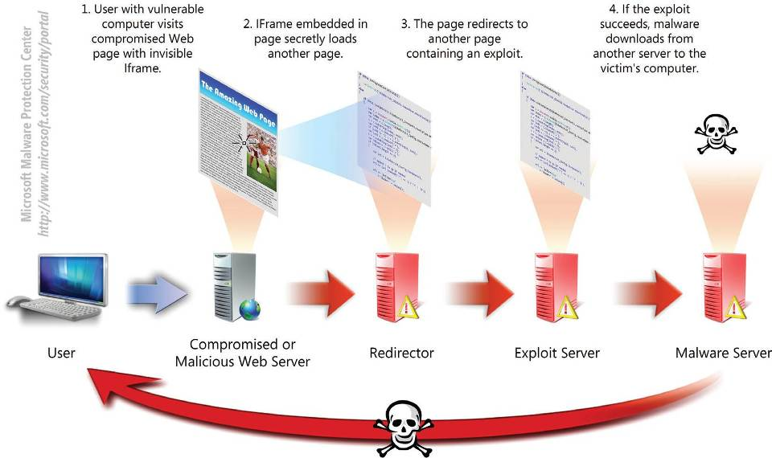
1.3.5 OTHER FORMS OF ATTACKS
Drive by download attack: Is a malware delivery attack triggered when the user views and visits the website.
Notes:
An IFrame (Inline Frame) is an HTML document embedded inside another HTML document on a website.
The IFrame HTML element is often used to insert content from another source, such as an advertisement.

Slide 43
1.3.6 INTRUSION DETECTION PREVENTION (IDPS) SYSTEM
Intrusion Detection System (IDS) DESCRIPTION
IDS is the process of observing proceedings happening in an information technology or network and analyzing them for indications of attacks.
Attacks can be specified as:
Attempt to conduct unauthorized behavior, or
Avoid the security techniques of a hardware or network.

Slide 44
1.3.6 INTRUSION DETECTION PREVENTION (IDPS) SYSTEM
Intrusion Prevention System (IPS) DESCRIPTION
It is the next generation of IDS.
Consists of activities that deter an intrusion.
Can detect an intrusion and also prevent that intrusion from successful attack.

Slide 45
1.3.6 INTRUSION DETECTION PREVENTION (IDPS) SYSTEM
IDPS implementation advantages:
Prevents problem behaviors by increasing risk of discovery and punishment for system cyber-attacks.
Identifies intruders and other security violations that are not prevented by other security measures.
Detects preambles to attacks (network probes and other tests for present vulnerabilities).
Quality control for security design and administration.
Provide helpful data regarding techniques applied in cyber-attack.
Notes:
Network Probe is the ultimate network monitor and protocol analyzer to monitor network traffic in real-time, and will help you find the sources of any network slow-downs in a matter of seconds.

Slide 46
1.3.6 INTRUSION DETECTION PREVENTION (IDPS) SYSTEM
IDPS uses two major methods to analyze proceedings to reveal intruders:
Signature-Based IDPS: This method recognizes proceedings or sets of proceedings that match with a predefined model of proceedings that describe a known attack.
Anomaly-Based IDPS: Anomaly detection assumes that all intrusive activities deviate from the norm.

Slide 47
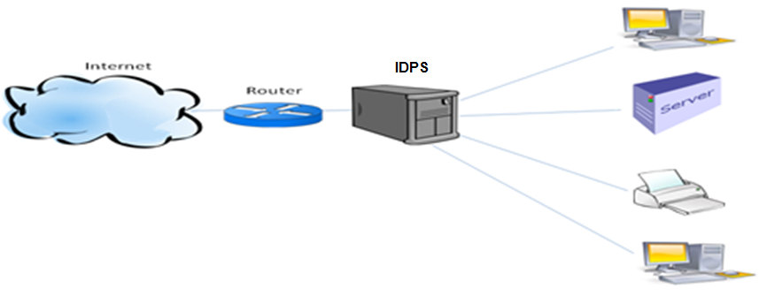
1.3.6 INTRUSION DETECTION PREVENTION (IDPS) SYSTEM
TECHNOLOGICAL SUPPORT
Three popular types of IDPS products:
Network-Based IDPS: Reveal intruders by capturing and analyzing network packets.

Slide 48
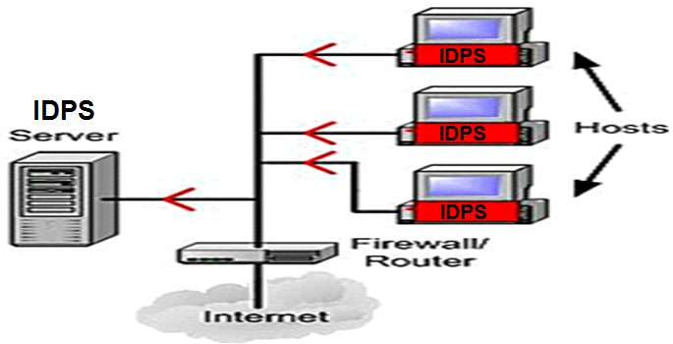
1.3.6 INTRUSION DETECTION PREVENTION (IDPS) SYSTEM
Host-Based IDPS. Operate on data gathered from inside an individual hardware system.

Slide 49
1.3.6 INTRUSION DETECTION PREVENTION (IDPS) SYSTEM
Application-Based IDPS. A special subset of host-based IDPS that analyzes the proceedings transpiring inside a software application.
It detects suspicious behaviors in the interaction between users, data and application.

Slide 50
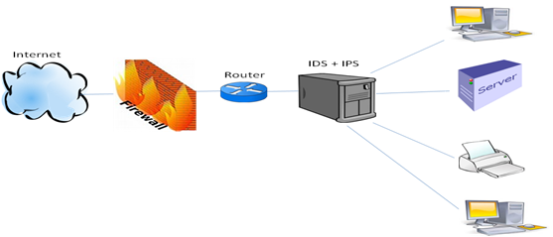
1.3.7 FIREWALLS
Firewalls: Devices or systems that control the flow of network traffic among networks or among a main computer and a network.

Slide 51
1.4 SECURITY SYSTEMS EXAMPLES
The computer security risks are divided into three parts:
Internet and network security
Standalone computer security
Data loss by accident
Natural Disaster Risks
Fires
Intentional Risks
Malicious Attackers
Assets
Unintentional Risks
Employee errors

Slide 52
1.4 SECURITY SYSTEMS EXAMPLES
The steps of accessing an account on a network are included in the following steps:
A legitimate user is accessing his/her account, i.e. (Yahoo-mail).
The firewall examines the user’s packet then it passes through (Authentication).
The access control server verifies the username and the password compares them with the previously saved into the administrator database.
The legitimate user now is authorized and can access his/her account.

Slide 53
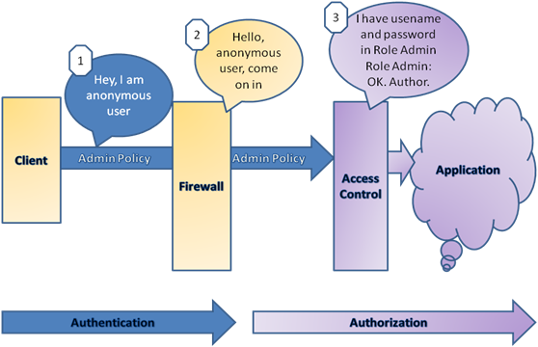
1.4 SECURITY SYSTEMS EXAMPLES
The steps of accessing an account on a network

Slide 54
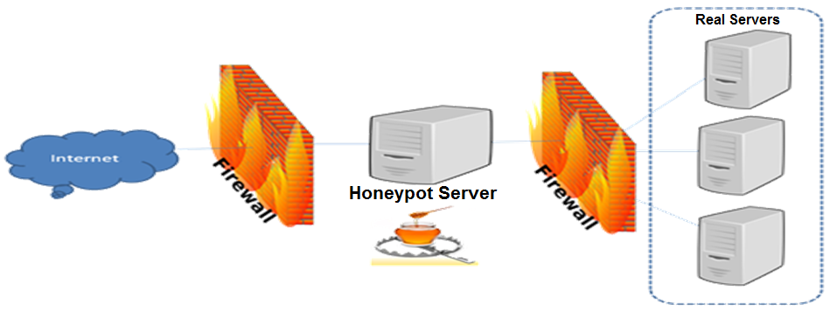
1.4 SECURITY SYSTEMS EXAMPLES
Honeypot is a faked network that contains a false database, unused IP addresses, encrypted files…etc, usually located between a firewall of a network and the real network itself. The purpose of a honey pot network is to lure the attackers into believing it is a legitimate system.

Slide 55
Summary
Have considered:
Definition of computer security.
Description of the triad security requirements of confidentiality, integrity and availability.
Understanding terminologies used in computer security.
Description of computer security principles.
Description of honeypot security network

