Slide 1
Computer Maintenance
Chapter Six
Hard Drive
Dr. Mohammad AlAhmad

Slide 2
Chapter Six Hard Drive
“Technically, Windows is an ‘operating system,’ which means that it supplies your computer with the basic commands that it needs to suddenly, with no warning whatsoever, stop operating.”
(Dave Barry)

Slide 3
Chapter Six Hard Drive
Objectives
The learning objectives of this chapter are:
Definition of a hard drive.
Understanding basic of hard drives terminologies.
Understanding basic of hard drives specifications such as: interface and throughput, form factor and speed.
Installing and uninstalling operating systems.

Slide 4
Chapter Six Hard Drive
6.1 How a Hard Drive Works
The hard drive is one of your PC’s most vital and crucial components. The reason behind this fact is simply straightforward to understand which is, “damaging in your hard drive might cost you losing your data”. Also, without hard drive in a system means we cannot have an operating system to run the hardware. That means, you would have no place to store your document, photos, media files and other data.

Slide 5
Chapter Six Hard Drive
6.1 How a Hard Drive Works
All hard drives are composed of three main parts:
A rotating disk or platters (often more than one disk) and is divided into concentric areas called tracks.
A read/write head that floats just above the surface and perform the actual read of data from/ and writing data to the disk or platter (two heads per platter).
An actuator arm on which read/write head moves back and forth. The arm itself is controlled by a servo motor. All incased in a sealed case to prevent from outside contamination

Slide 6
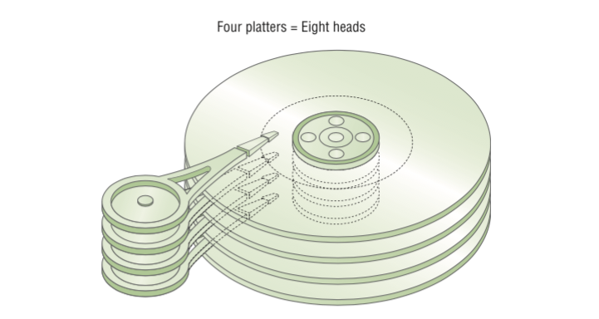
Chapter Six Hard Drive
6.1 How a Hard Drive Works

Slide 7
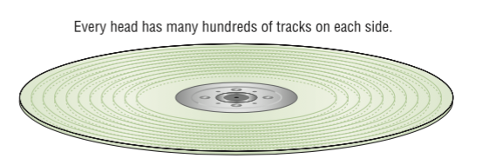
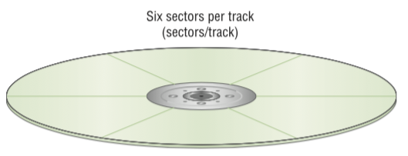
Chapter Six Hard Drive
6.1 How a Hard Drive Works
Here’s the basic procedure the hard drive follows when it needs to write data to the disk (platter):
1- The CPU locates a free storage location (called sector and group of sectors forms one track) on the disk and passes the information to be written to the hard drive.

Slide 8
Chapter Six Hard Drive
6.1 How a Hard Drive Works
2-The hard drive actuator arm moves the read/write head over the track that contain the free sector. The time it takes the hard drive to allocate the free sector called seek time.
3-The hard drive allocates the free sector by rotating the disk using the read/write arm. The time it takes the hard drive to rotate this disk to allocate the free sector called latency (or sometimes rotational latency).
4-The writing mechanism is started now by the read/write head to the free sector. The time it takes to write on the free sector called write time.

Slide 9
Chapter Six Hard Drive
6.1 How a Hard Drive Works
The reading process is very much the same as the writing process with considering the hard is reading in the above steps instead of writing.
Data in hard drives are stored in a binary form. We can visualize the place where these binary numbers are stored in the hard drive as a magnetized spot representing one and non-magnetized spot representing zero. Hard drives store data in a tiny magnetic fields

Slide 10
Chapter Six Hard Drive
6.2 Essentials
Around 1990, an interface called ATA appeared and now virtually monopolizes the hard drive market. ATA hard drives referred to as integrated hard drive electronics (IDE) drives. One other drive which is also popular called small computer system interface (SCSI), has any relevance to the hard drives. ATA hard drives are subcategorized into two kinds: parallel ATA (PATA) and serial ATA (SATA). PATA hard drives are the older version of ATA hard drives and consists of 40- or 80- wire data cable. PATA hard drives lasted for one decade and replaced with SATA hard drives.

Slide 11
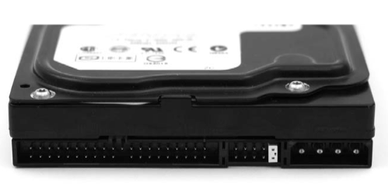
Chapter Six Hard Drive
6.2 Essentials
SATA hard drives sends data serially using only one wire for data transfer. The leap to shift from PATA to SATA went through so many stages as follows:
ATA-1: the first ATA is connected with computer with 40-pin ribbon cable that plugged into the drive and to the hard drive controller

Slide 12
Chapter Six Hard Drive
6.2 Essentials
ATA-2: it is enhanced IDE (EIDE) that included a new powerful features over IDE such as: higher capacities, support for non-hard drive storage devices, support for two more ATA devices, for a maximum of four and improved of input.
ATA-7: as stated, ATA hard drives went through multiple stages, ATA-1, ATA-2……ATA-7. ATA-7 runs at speed of 133 MBps which was the beginning of introducing SATA hard drives.

Slide 13
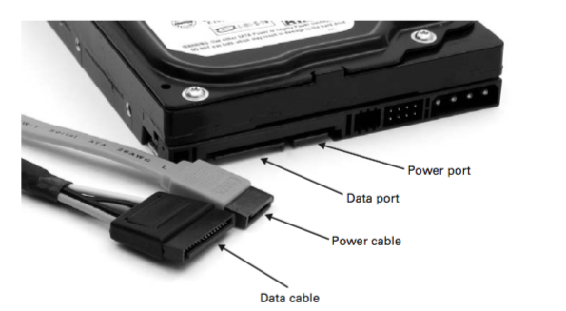
Chapter Six Hard Drive
6.2 Essentials
Serial ATA: for the long history of parallel ATA hard drives, they had some problems, such as, this technology has reached it limits in terms of throughput. Serial ATA (SATA) addresses this issue and resolved it. SATA sends the data serially instead of parallel in case of PATA hard drives.

Slide 14
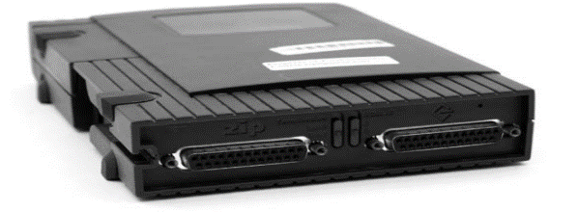
Chapter Six Hard Drive
6.2 Essentials
SCSI hard drives are still around and mainly used by many server machines as Figure 6.6 shown below. SCSI is different than ATA hard drives. By using SCSI, you can connect multiple SCSI hard drives together forming a chain. Each device of the chain is labeled with SCSI ID to distinguish between them. Lastly, the end of SCSI chain must be terminated. SCSI is an old technology dating from 1970s. It is faster than ATA hard drives but not faster than SATA hard drives. SCSI was the only good choice for anyone choosing RAID (discussed in next paragraph).

Slide 15
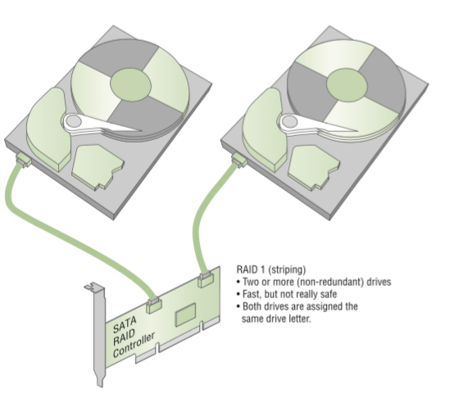
Chapter Six Hard Drive
6.2 Essentials
Redundant array of independent (or inexpensive) disk (RAID) is striping at least two hard drives (or more) together by SATA RAID controller

Slide 16
Chapter Six Hard Drive
6.2 Essentials
Connecting two hard drives together forming RAID technology enable technicians to make a spare copy of the data in the second hard drive in case of the primary hard drive damage. Using RAID, one drive is called the primary drive and the other drive called the mirror drive since it contain an identical copy of data for the primary drive. Technicians can connect more than two hard drives (three, four, five or even more) forming RAID technology. For the last 20 years, RAID has been used and hard disks manufacture’s trend towards RAID technology so, the future is RAID.

Slide 17
Chapter Six Hard Drive
6.3 Understanding Hard Drive Specifications
Knowing hard drive specifications is so crucial when buying you’re a hard drive. Let us go across one of the hard drive’s descriptions:
Seagate Barracuda ST310005NA1AS SATA 6.0Gb/s
3.5-inch internal 1 TB 7200 RPM

Slide 18
Chapter Six Hard Drive
6.3 Understanding Hard Drive Specifications
To understand what does it means, I need to explain each word as follows:
Seagate: this is the hard drive manufacture.
Barracuda: this is the manufacture’s hard drive product line.
ST310005NA1AS: this is the hard drive’s model number.
SATA: this is the hard drive’s interface.
6.0Gb/s (or Gbps): this is the hard drive’s throughput.
3.5-inch internal: this is the hard drive’s form factor.
1 TB: this is the capacity of the hard drive.
7200 RPM: this is the speed or spin rate of the hard drive.

Slide 19
Chapter Six Hard Drive
6.3.1 The Hard Drive Interface and Throughput
The hard drive interface refers to the method of connecting the hard drive to the motherboard. Where throughput (sometimes called the data transferred rate) refers to the data rate transferred per second. As discussed in the previous sections, a number of interfaces are available today, the most popular ones are PATA, SATA and USB.

Slide 20
Chapter Six Hard Drive
6.3.2 The hard Drive Form Factor
The hard drive form factor refers to the dimensions of the drive and more precisely, the approximate width of the drive. Most of hard drive’s form factors are 3.6 inches. Almost, every computer case support 3.5 inches (the actual size is approximately 4 inches wide) hard drives. The other common hard drive’s form factors are 2.5 inches (the actual size is approximately 2.75 inches wide) which are mainly used for notebooks.

Slide 21
Chapter Six Hard Drive
6.3.3 The Hard Drive Speed
The hard drive measure its speed by how fast the internal platters spin, precisely, revolutions per minute (RPM). Simply, the higher RPM, the better performance. Most PATA and SATA hard drives spin at 7200 RPM. Recently, modern SATA hard drives offers a spin of 10000 RPM, but quietly expensive.

Slide 22
Chapter Six Hard Drive
6.4 Installing and Uninstalling Operating Systems
After following the practical section in 5.3, you can now install an operating system in your hard drive. Remember to change the boot sequence in the CMOS setting to have your CD-ROM drive or DVD-ROM drive is the first boot sequence (assuming your new operating system is on a CD-ROM or DVD-ROM). Before installing the operating system, you can divide your hard drive using the partitioning option. This option is reached in the startup screens when entered Windows installation using boot sequence. Technician can determine how many hard drive’s partition needed and the size for each partition. Next example explains how technician can do that

Slide 23
Chapter Six Hard Drive
6.4 Installing and Uninstalling Operating Systems
Example 6.1 a technician want to make two partitions 50% each, then he/she want to install Windows on the first partition, he/she should follow these steps:
Go to the partitioning option in the starting screens (technician need to read these screen to find partitioning option since it differs between Windows) using Windows CD-/DVD-ROM.
Create a logical partition then a primary partition specifying the size to become 50% (note that the operating system will name this partition automatically, usually C drive).
Create a second logical partition specifying the size to become 50% (usually named D drive by the operating system automatically)
Install Windows into the first partition C.

Slide 24
Chapter Six Hard Drive
Summery
Definition of a hard drive.
Understanding basic of hard drives terminologies.
Understanding basic of hard drives specifications such as: interface and throughput, form factor and speed.
Installing and uninstalling operating systems.

