Slide 1
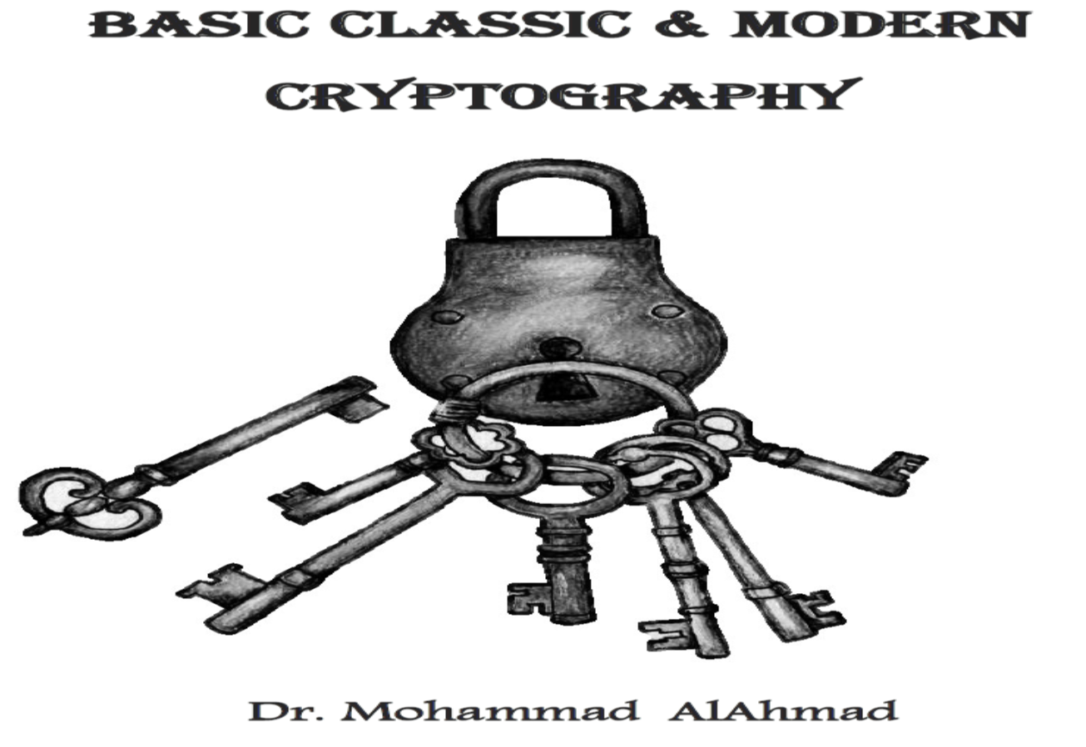
Chapter 3:
CLASSICAL CRYPTOGRAPHY (SUBSTTUTION)

Slide 2
CLASSICAL CRYPTOGRAPHY (SUBSTTUTION)
Chapter 3:
“Security and safety were the reward of dullness”
C.S.Lewis
Notes:
As a result of people being studied we need to care about security and safety.

Slide 3
Chapter 3:
CLASSICAL ENCRYPTION (SUBSTTUTION)
Objectives
The learning objectives of this chapter are:
Understand the classical substitution cryptography.
Understand the monoalphabetic ciphers.
Understand cryptanalyze the monoalphabetic ciphers.
Understand the polyalphabetic ciphers.
Understand cryptanalyze the polyalphabetic ciphers.
Understand the polygrams ciphers.
Understand cryptanalyze the polygrams ciphers.
Understand the Homophonic ciphers.
Understand cryptanalyze the Homophonic ciphers.

Slide 4
3.1 INTRODUCTION
Classical Cryptograph
Substitution Cipher
Transposition Cipher
Product Cipher

Slide 5
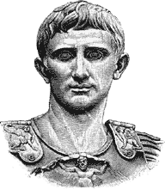
3.1 INTRODUCTION
Substitution ciphers are historical ciphers that encode unit (or units) called plaintext (letters, symbols…etc.) to replace it (or them) by another unit (or units) to produce ciphertext.
Founded by the Roman ruler Julius Caesar (100 B.C. – 44 B.C.). He used it to protect messages of military significant and to secure communication.

Slide 6
3.2 MONOALPHABETIC CIPHERS
Classical Cryptograph
Substitution Cipher
Monoalphabetic

Slide 7
3.2 MONOALPHABETIC CIPHERS
Monoalphabetic ciphers are simple algorithms that replace a single unit (letter, symbol, … etc.) by another (letter, symbol, …etc.) .
For example, if the encryption of “A” is “F” , then, every time we see “A” in the sentence, we replace it with “F”.

Slide 8
3.2.1 CAESAR CIPHER (SHIFT CIPHER)
Classical Cryptograph
Substitution Cipher
Monoalphabetic
Caesar Cipher

Slide 9
3.2.1 CAESAR CIPHER (SHIFT CIPHER)
Caesar Cipher (shift cipher). It is the first historical cipher founded by Julius twenty five hundred years ago.
We simply shift every plaintext letter by a fixed number of positions to the right to produce a ciphertext.

Slide 10
3.2.1 CAESAR CIPHER (SHIFT CIPHER)
Encoded letters of Caesar cipher associated with their numbers:
A 0 | B 1 | C 2 | D 3 | E 4 | F 5 | G 6 | H 7 | I 8 | J 9 | K 10 | L 11 | M 12
N 13 | O 14 | P 15 | Q 16 | R 17 | S 18 | T 19 | U 20 | V 21 | W 22 | X 23 | Y 24 | Z 25

Slide 11
Example 3.1: Let us encrypt “MEET ME AT TWO PM”, and the shifting is by 3. In this case key k=3
3.2.1 CAESAR CIPHER (SHIFT CIPHER)
Plaintext
Z | Y | X | W | V | U | T | S | R | Q | P | O | N | M | L | K | J | I | H | G | F | E | D | C | B | A
C | B | A | Z | Y | X | W | V | U | T | S | R | Q | P | O | N | M | L | K | J | I | H | G | F | E | D
0 | 1 | 2 | 3 | 4 | 5 | 6 | 7 | 8 | 9 | 10 | 11 | 12 | 13 | 14 | 15 | 16 | 17 | 18 | 19 | 20 | 21 | 22 | 23 | 24 | 25
Ciphertext
Message after encryption is “PHHWPHDWWZRSP”

Slide 12
3.2.1 CAESAR CIPHER (SHIFT CIPHER)
Caesar cipher is expressed in the following mathematical relationship:
$$C=E\left(P_{i}\right)=\left(P_{i}+k\right) mod \left(26\right) for encryption$$
$$P=D\left(C_{i}\right)=\left(C_{i}−k\right) mod \left(26\right) for decryption$$
Where C is the ciphertext, P is the plaintext and k is the key.

Slide 13
3.2.1 CAESAR CIPHER (SHIFT CIPHER)
Example 3.2:
Using the mathematical expression, encrypt “ATTACK STARTS AT NOON” and the shifting is 15. In this case key k=15.
Plaintext
Z | Y | X | W | V | U | T | S | R | Q | P | O | N | M | L | K | J | I | H | G | F | E | D | C | B | A
0 | 1 | 2 | 3 | 4 | 5 | 6 | 7 | 8 | 9 | 10 | 11 | 12 | 13 | 14 | 15 | 16 | 17 | 18 | 19 | 20 | 21 | 22 | 23 | 24 | 25
Message after encryption is ……………………..

Slide 14
3.2.1 CAESAR CIPHER (SHIFT CIPHER)
We can decrypt Caesar cipher by inverse alphabet shift (shift every ciphertext letter by a fixed number of positions to the left to produce a plaintext).
Example 3.3: Decrypt the message “PMTTWBPMZM”, and the inverse alphabet shift is 8 (in this case the inverse key k⁻¹ = 8)

Slide 15
Solution:
3.2.1 CAESAR CIPHER (SHIFT CIPHER)
Plaintext
Z | Y | X | W | V | U | T | S | R | Q | P | O | N | M | L | K | J | I | H | G | F | E | D | C | B | A
H | G | F | E | D | C | B | A | Z | Y | X | W | V | U | T | S | R | Q | P | O | N | M | L | K | J | I
0 | 1 | 2 | 3 | 4 | 5 | 6 | 7 | 8 | 9 | 10 | 11 | 12 | 13 | 14 | 15 | 16 | 17 | 18 | 19 | 20 | 21 | 22 | 23 | 24 | 25
Ciphertext
Now, it is easy to decrypt the message above to become,
“HELLO THERE”

Slide 16
3.2.2 ROT13 CIPHER
Classical Cryptograph
Substitution Cipher
Monoalphabetic
Caesar Cipher
ROT13 Cipher

Slide 17
3.2.2 ROT13 CIPHER
ROT13 is another simple monoalphabetic substitution cipher that rotates/shifts the alphabet by 13 letters.
It is an example of Ceasar cipher developed in ancient Rome.

Slide 18
3.2.2 ROT13 CIPHER
Example 3.4:
Using ROT13 cipher, encrypt the message “MEET ME AT TWO PM”.
Z | Y | X | W | V | U | T | S | R | Q | P | O | N | M | L | K | J | I | H | G | F | E | D | C | B | A
Plaintext
0 | 1 | 2 | 3 | 4 | 5 | 6 | 7 | 8 | 9 | 10 | 11 | 12 | 13 | 14 | 15 | 16 | 17 | 18 | 19 | 20 | 21 | 22 | 23 | 24 | 25
Message after encryption is ……………………..
Notes:
In the decryption process we use its own inverse because letters are 26 (2 x 13).

Slide 19
3.2.2 ROT13 CIPHER
Example 3.5:
Using ROT13 cipher, decrypt the message “URYYBGURER”.
Plaintext
Z | Y | X | W | V | U | T | S | R | Q | P | O | N | M | L | K | J | I | H | G | F | E | D | C | B | A
0 | 1 | 2 | 3 | 4 | 5 | 6 | 7 | 8 | 9 | 10 | 11 | 12 | 13 | 14 | 15 | 16 | 17 | 18 | 19 | 20 | 21 | 22 | 23 | 24 | 25
Message after decryption is ……………………..

Slide 20
3.2.3 ATBASH CIPHER
Classical Cryptograph
Substitution Cipher
Monoalphabetic
Caesar Cipher
ROT13 Cipher
Atbash Cipher

Slide 21
3.2.3 ATBASH CIPHER
Atbash Cipher is originally Hebrew alphabet and modified to English alphabets. The letters of the alphabet are reversed.
Plaintext
Z | Y | X | W | V | U | T | S | R | Q | P | O | N | M | L | K | J | I | H | G | F | E | D | C | B | A
A | B | C | D | E | F | G | H | I | J | K | L | M | N | O | P | Q | R | S | T | U | V | W | X | Y | Z
Ciphertext

Slide 22
3.2.3 ATBASH CIPHER
Example 3.6
Using Atbash cipher encrypt “MEET ME AT TWO PM”. What do we know about the key k?
Plaintext
Z | Y | X | W | V | U | T | S | R | Q | P | O | N | M | L | K | J | I | H | G | F | E | D | C | B | A
A | B | C | D | E | F | G | H | I | J | K | L | M | N | O | P | Q | R | S | T | U | V | W | X | Y | Z
Ciphertext
Message after encryption is “NVVGNVZGGDLKN”

Slide 23
3.2.3 ATBASH CIPHER
We can decrypt Atbash Cipher by inverse alphabet shift .
Example 3.7
Using Atbash cipher decrypt “SVOOLGSVIV”.
Z | Y | X | W | V | U | T | S | R | Q | P | O | N | M | L | K | J | I | H | G | F | E | D | C | B | A
Plaintext
Message after encryption is ……………………..

Slide 24
3.3 CRYPTANALYSIS OF MONO ALPHABETIC CIPHERS
Are the monoalphabetic substitution ciphers secure in the presence of up to date CPUs? The answer is NO.
Proof: Performing a brute force attack (claiming that we have no idea about the monoalphabetic cipher used).
We have 26 letters ➔ $26!≈4×{10}^{26}$ possible keys.
So, breaking any monoalphabetic algorithm can be performed in seconds based on today's CPUs speed.

Slide 25
3.3 CRYPTANALYSIS OF MONO ALPHABETIC CIPHERS
Letter frequency analysis is another practical attack.
The brute force attack treats the cipher as a black box.
Letter frequency attack analyze the internal structure of the cipher (we call it analytical attack as well).

Slide 26
3.3 CRYPTANALYSIS OF MONO ALPHABETIC CIPHERS
Disadvantages of monoalphabetic ciphers:
Letter maps to the same letter each time.
The ciphertext will gain the English language redundancy characteristics.
All the human languages have letter frequency redundancy but they are varies.

Slide 27
3.3 CRYPTANALYSIS OF MONO ALPHABETIC CIPHERS
Fig. below shows that letters E, T, A, O,…etc has more redundancy than others.

Slide 28
3.3 CRYPTANALYSIS OF MONO ALPHABETIC CIPHERS
Cryptanalysists can break monoalphabetic ciphers by:
Count relative letter frequencies in the ciphertext.
Replacing the most frequent one (say X) with letter E.
Check how many shifts between E and X (the key).
Apply the decryption using the key founded in step (3).
If you didn’t get meaningful sentence use the second most frequent letter used and so on.
Structural attack technique

Slide 29
3.3 CRYPTANALYSIS OF MONO ALPHABETIC CIPHERS
Example 3.8
Use frequency analysis to encrypt the given ciphertext:
UFIMEPUEOXAEQPKQEFQDPMKFTMFEQHQDMXUZRADYMXNGFPUDQOFOAZFMOFETMHQNQQZYMPQIUFTBAXUFUOMXDQBDQEQZFMFUHQEARFTQHUQFOAZSUZYAEOAI

Slide 30
3.3 CRYPTANALYSIS OF MONO ALPHABETIC CIPHERS
Q is the most used letter.
Assume that letter Q encoded from letter E.
Number of shifts between E and Q is 12
Thus the key k=12
Apply decryption process with key =12.
Results:
It was disclosed yesterday that several informal but direct contacts have been made with political representatives of the vietcong in moscow
Letter | Repetition | Percentage
Q | 16 | 13.33%
F | 14 | 11.67%
M | 10 | 8.33%
U | 10 | 8.33%
E | 9 | 7.50%
A | 8 | 6.67%
O | 7 | 5.83%
D | 6 | 5.00%
Z | 6 | 5.00%
P | 5 | 4.17%
X | 5 | 4.17%
H | 4 | 3.33%
T | 4 | 3.33%
I | 3 | 2.50%
Y | 3 | 2.50%
B | 2 | 1.67%
K | 2 | 1.67%
N | 2 | 1.67%
R | 2 | 1.67%
G | 1 | 0.83%
S | 1 | 0.83%

Slide 31
3.3 CRYPTANALYSIS OF MONO ALPHABETIC CIPHERS
Can we use brute force attack to decrypt the previous message?
We need to try all 26 key shifts.
Check meaningful sentence for every decrypted message.
If we start from shift by 1 then we need to carry 12 attempts.
This can give you the difference in performance between structural attack and brute force attack.

Slide 32
3.4 POLYALPHABETIC CIPHER
Classical Cryptograph
Substitution Cipher
Monoalphabetic
Caesar Cipher
ROT13 Cipher
Atbash Cipher
Polyalphabetic

Slide 33
3.4 POLYALPHABETIC CIPHER
Polyalphabetic cipher is a method to improve the drawbacks of monoalphabetic ciphers.
In polyalphabetic one letter can be mapped to different cliphertexts, where monoalphabetic maps one letter to the same cliphertexts every time.

Slide 34
3.4.1 SIMPLE SHIFT VIGENERE CIPHER
Classical Cryptograph
Substitution Cipher
Monoalphabetic
Caesar Cipher
Polyalphabetic
Atbash Cipher
ROT13 Cipher
S.H. Vigenere
Cipher

Slide 35
3.4.1 SIMPLE SHIFT VIGENERE CIPHER
It shifts the first letter of the plaintext by n numbers.
Then, it shifts the second letter of the plaintext by s number.
It continues this process until it shift all the plaintext letters by different shifts values producing a ciphertext.
The key length is key k used to indicate the shifting value for each letter.

Slide 36
3.4.1 SIMPLE SHIFT VIGENERE CIPHER
Example 3.9:
Using the keys and plaintext table below, encrypt the message “STAY ALIVE” using simple shift vigenere cipher.
Plaintext | S | T | A | Y | A | L | I | V | E
Key Length | 5 | 10 | 2 | 9 | 13 | 5 | 4 | 3 | 0
Ciphertext

Slide 37
3.4.1 SIMPLE SHIFT VIGENERE CIPHER
The first letter s is encrypted by shifting by 5 ➔ x
Then, we encrypt the second letter t by shifting by 10 ➔ d
We continue this process until we finish the sentence.
Plaintext | S | T | A | Y | A | L | I | V | E
Key Length | 5 | 10 | 2 | 9 | 13 | 5 | 4 | 3 | 0
Ciphertext | X | D | C | H | N | Q | M | Y | E

Slide 38
3.4.1 SIMPLE SHIFT VIGENERE CIPHER
We can decrypt simple shift Vigenere cipher by using the frequency analysis (as explained earlier in section 3.3) in case if we do not know the key length.
Example 3.10: Decrypt the message “XJXLIOP” using the key length “5 9 2 7 1 6 3”.
Ciphertext | X | J | X | L | I | O | P
Key Length | 5 | 9 | 2 | 7 | 1 | 6 | 3
Plaintext

Slide 39
3.4.2 FULL VIGENERE CIPHER
Classical Cryptograph
Substitution Cipher
Monoalphabetic
Caesar Cipher
Polyalphabetic
Atbash Cipher
ROT13 Cipher
S.H. Vigenere
Cipher
Full Vigenere
Cipher

Slide 40
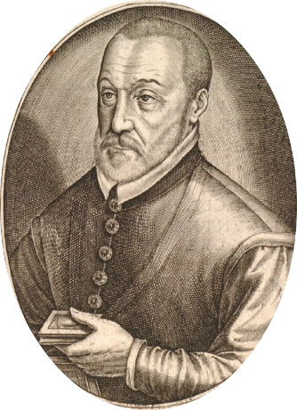
3.4.2 FULL VIGENERE CIPHER
Full Vigenere cipher is a polyalphabetic substitution cipher considered as multiple Caesar ciphers adding the usage of a keyword and a table called tableau.
Proposed by Blaise de Vigenere from the Henry III of France in the 16th century.

Slide 41
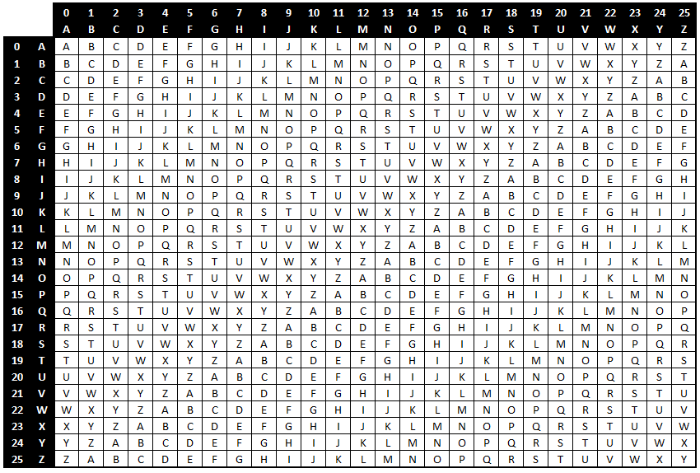
Tableau

Slide 42
3.4.2 FULL VIGENERE CIPHER
The first row is Caesar Cipher shift of 0, the second row is shift by 1, and the last row is shift by 25.
Example 3.11
Encrypt “BE THERE ON TIME” using the keyword is “DECEPTIVE”.
Step1. write the keyword “DECEPTIVE” a long the row of the table.
E | C | E | D | E | V | I | T | P | E | C | E | D | Keyword
E | M | I | T | N | O | E | R | E | H | T | E | B | Plaintext

Slide 43
3.4.2 FULL VIGENERE CIPHER
Step2. find the first letter of the keyword in the first column of Tableau.
Step3. find the first letter of the plaintext in the first row of Tableau.
Step4. find the intersection between them (this is the ciphertext).
E | C | E | D | E | V | I | T | P | E | C | E | D | Keyword
E | M | I | T | N | O | E | R | E | H | T | E | B | Plaintext
I | O | M | W | R | J | M | K | T | L | V | I | E | Ciphertext

Slide 44
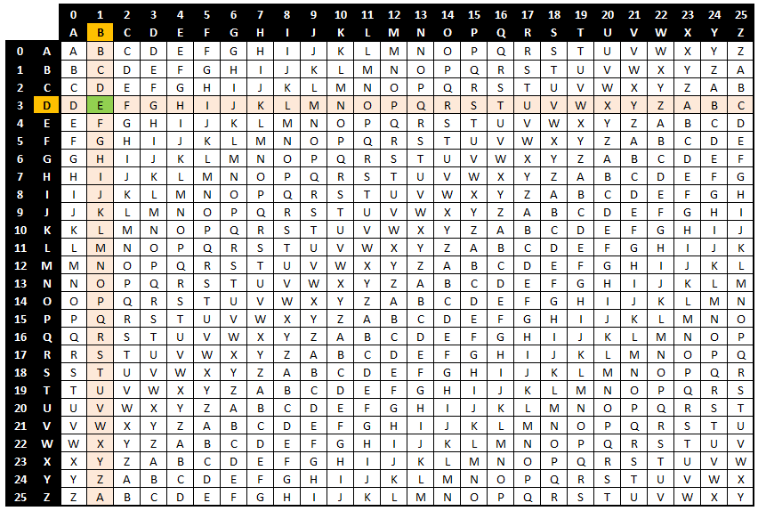
Tableau

Slide 45
3.4.2 FULL VIGENERE CIPHER
Full Vigenere cipher can be decrypted by using the frequency analysis method in case if we do not know the keyword.
Steps to decrypt the full Vigenere cipher using the Vigenere tableau:
Step1. write the keyword a long the row of the table.
Step2. use the keyword letter to pick a column of the Tableau.
Step3. trace down the column to the row containing the ciphertext letter.
Step4. the index of that row is the plaintext letter.

Slide 46
3.4.2 FULL VIGENERE CIPHER
Example 3.12
Decrypt the message “UVRSVVLQ” using the keyword “CODE”.
E | D | O | C | E | D | O | C | Keyword
Q | L | V | V | S | R | V | U | Ciphertext
M | I | H | T | O | O | H | S | Plaintext

Slide 47
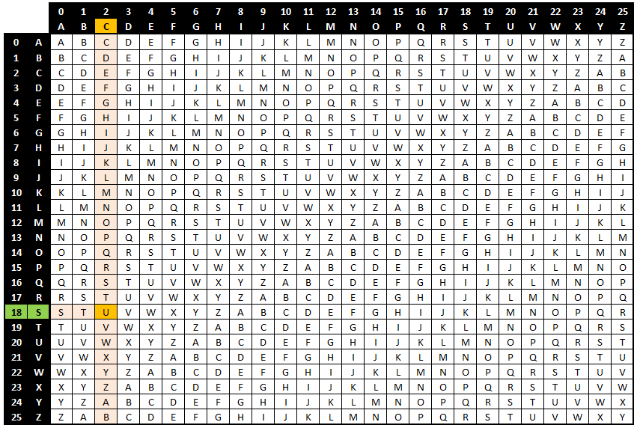
Tableau

Slide 48
3.4.3 AUTO-KEY VIGENERE CIPHER
Classical Cryptograph
Substitution Cipher
Monoalphabetic
Caesar Cipher
Polyalphabetic
Atbash Cipher
ROT13 Cipher
S.H. Vigenere
Cipher
Full Vigenere
Cipher
Auto-key Vigenere Cipher

Slide 49
3.4.3 AUTO-KEY VIGENERE CIPHER
Auto-keyword Vigenere cipher
It was invented by Blasie de Vigenere.
It is identical method of full Vigenere cipher but uses different scheme of obtaining the ciphertext.
The keyword should be known previously by the two end parties.
The keyword structure is illustrated below:
Keyword letters
OR
Keyword letters + First letters of the message

Slide 50
3.4.3 AUTO-KEY VIGENERE CIPHER
Example 3.13:
Encrypt the message “WELCOME”, using the keyword “KNOW”, we will obtain the following table:
L | E | W | W | O | N | K | Keyword
E | M | O | C | L | E | W | Plaintext
P | Q | K | Y | Z | R | G | Ciphertext

Slide 51
3.4.3 AUTO-KEY VIGENERE CIPHER
Auto-key Vigenere cipher can be decrypted using the frequency analysis method in case if we do not know the keyword.
It also can be decrypted using the Vigenere table (in case if we know the keyword) as we did with Full Vigenere Cipher.
In case the ciphertext is longer than the keyword:
First, decrypt part of the ciphertext until obtaining some letters from the plaintext.
Then, add the decrypted letters to the plaintext to complete the table.

Slide 52
3.4.3 AUTO-KEY VIGENERE CIPHER
Example 3.14:
Decrypt the message “WPVXHK” using the keyword “DIE”, note that, you have to use the first plaintext you have decrypted to complete the keyword, looking at the 3.2 Table, the following table is obtained:
R | H | T | E | I | D | Keyword
K | H | X | V | P | W | Ciphertext
T | A | E | R | H | T | Plaintext

Slide 53
3.4.4 RUNNING KEY VIGENERE CIPHER
Classical Cryptograph
Substitution Cipher
Monoalphabetic
Caesar Cipher
Polyalphabetic
Atbash Cipher
ROT13 Cipher
S.H. Vigenere
Cipher
Full Vigenere
Cipher
Auto-key Vigenere Cipher
Running Key Vigenere Cipher

Slide 54
3.4.4 RUNNING KEY VIGENERE CIPHER
The running key Vigenere cipher has the same internal working as the Vigenere cipher (difference lies in the keyword used).
It uses very long keyword chosen previously by the two end parties.
The keyword should not be repeated and is used only one time, making the cryptanalysis more difficult.
E.g., a sentence is chosen only one time from a public book.

Slide 55
3.4.4 RUNNING KEY VIGENERE CIPHER
Example 3.15:
Encrypt the message “GET READY”, using the keyword “MOHAMMAD PEACE BE UPON HIM”
Referring to Vigenere Tableau we get:
D | A | M | M | A | H | O | M | Keyword
Y | D | A | E | R | T | E | G | Plaintext
B | D | M | Q | R | A | S | S | Ciphertext

Slide 56
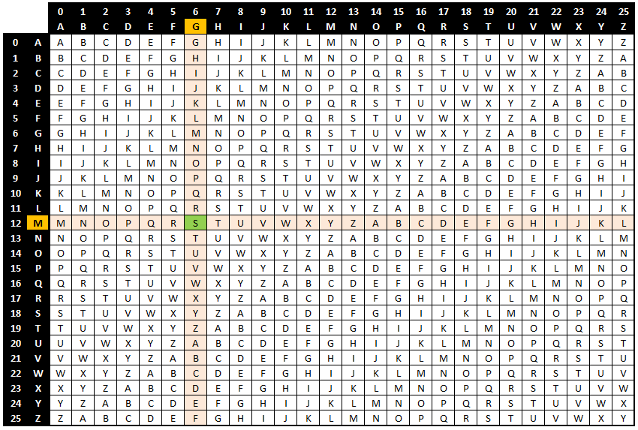
Tableau

Slide 57
3.4.4 RUNNING KEY VIGENERE CIPHER
Decryption of the running key Vigenere cipher can be done using:
Frequency analysis (in case if we do not know the keyword).
The Vigenere table (in case if we know the keyword).
Example 3.16:
Decrypt the message “HHPDQOFHD” using the keyword “How dose the duck know that? Said victor”.

Slide 58
3.4.4 RUNNING KEY VIGENERE CIPHER
H | T | S | E | O | D | W | O | H | Keyword
D | H | F | O | Q | D | P | H | H | Ciphertext
W | O | N | K | C | A | T | T | A | Plaintext

Slide 59
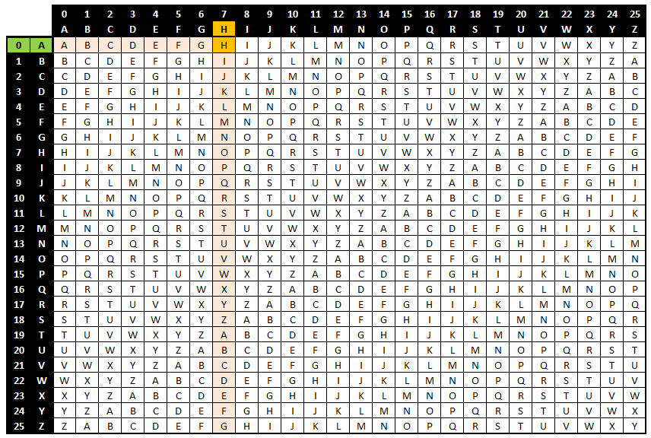
Tableau

Slide 60
3.5 CRYPTANALYSIS OF POLYALPHABETIC
The security and complexity are increased using polyalphabetic ciphers compared to monoalphabetic cipher.
Brute force and letter frequency analysis attacks are applicable to any cipher.
It takes more time to attack polyalphabetic cipher than monoalphabetic cipher using the above techniques.

Slide 61
3.6 POLYGRAM CIPHERS
Classical Cryptograph
Substitution Cipher
Monoalphabetic
Caesar
Polyalphabetic
Atbash
ROT13
S.H. Vigenere
Full Vigenere
Auto-key Vigenere
Running Key Vigenerer
Polygram

Slide 62
3.6 POLYGRAM CIPHERS
Polygrams ciphers (or polygraphic ciphers) are a uniform substitution ciphers that encrypt a block of letters.
Sequences of two plaintext characters (digrams/digraphs) can be replaced by other digrams/digraphs.

Slide 63
3.6.1 THE PLAYFAIR CIPHER
Classical Cryptograph
Substitution Cipher
Monoalphabetic
Caesar
Polyalphabetic
Atbash
ROT13
S.H. Vigenere
Full Vigenere
Auto-key Vigenere
Running Key Vigenere
Polygram
Playfair

Slide 64
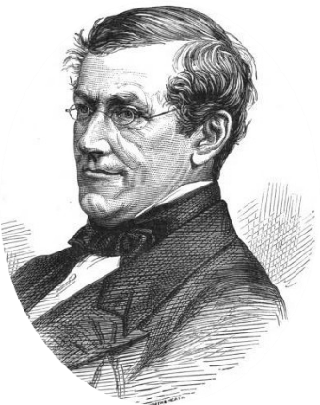
3.6.1 THE PLAYFAIR CIPHER
The Playfair cipher is the first digraph substitution cipher, It encrypts pairs of letters (digraph) instead of single letter.
Invented in 1854 by Charles Wheatstone and named after his friend Baron Playfair.

Slide 65
3.6.1 THE PLAYFAIR CIPHER
The encryption technique:
Break the message into two letters (pair) chunks.
For each pair separate repeated letters by an X and regroup.
If odd number of letters, append extra X to the last pair.
Create a 5 x 5 array including a keyword k.
Encrypt the message using the created array.
Notes:
to reduce the alphabet to fit you can either omit "Q" or replace "J" with "I“
E.g., the message “hello” would be rewritten in the form “HE LX LO”, noting that the two repeated L letters are separated by X.

Slide 66
3.6.1 THE PLAYFAIR CIPHER
How to create the 5 x 5 array:
Remove duplicated letters from the keyword k to be k_{new}.
Fill the array with the keyword k_{new} starting from top left to right.
For the rest of the entries in the array, add the remaining letters of the alphabet in sequence.
Note: to reduce the alphabet to fit the array you can either omit "Q" or replace "J" with "I“.

Slide 67
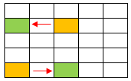
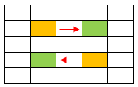
3.6.1 THE PLAYFAIR CIPHER
How to use the array to encrypt the message:
Each pair of letters is encrypted based on which of the following is applicable:
Case-1: The two letters are not in the same row or column of the array ➔ replace each letter with the letter in its row that is in the column of the other letter.

Slide 68
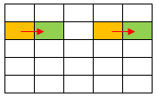
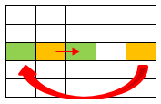
3.6.1 THE PLAYFAIR CIPHER
Case-2: The two letters are in the same row ➔ replace each letter with the letter to its immediate right.
If the letter is on most right ➔ cycle back to the beginning of the row.

Slide 69
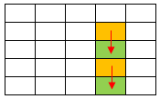
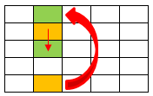
3.6.1 THE PLAYFAIR CIPHER
Case-3: The two letters are in the same column ➔ replace each letter with the letter immediately below it.
If the letter is last on the bottom ➔ cycle back to the top of the column.

Slide 70
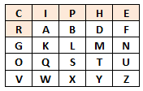
3.6.1 THE PLAYFAIR CIPHER
Example 3.17:
Encrypt the message “target”, using the keyword “cipher”.
Table creation

Slide 71
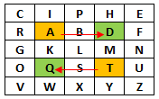
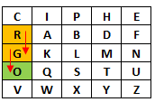
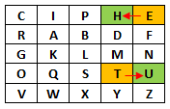
3.6.1 THE PLAYFAIR CIPHER
Breaking the message “TARGET”:
TA RG ET
The ciphertext is “QDGOHU” for the word “TARGET”

Slide 72
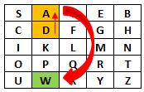
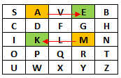
3.6.1 THE PLAYFAIR CIPHER
The decryption technique:
Follow the same process but using the opposite move directions for case-2 and case-3.
Example 3.18:
Decrypt the message “ADMA” using the keyword “SAVE”.
Decrypted message “WAKE”
Notes:
to reduce the alphabet to fit you can either omit "Q" or replace "J" with "I“
E.g., the message “hello” would be rewritten in the form “HE LX LO”, noting that the two repeated L letters are separated by X.
To encode the word "MITTWOCH" e.g., the following pairs of characters would be generated first: "MI TT WO CH". The characters TT occur twice. This is not covered by any of the three cases mentioned above. Characters occurring twice therefore have to be removed. This is done by inserting an X. An additional character is also inserted at the end of the text if the text to be encoded is composed of an unequal number of characters. "MITTWOCH" is therefore split into "MI TX TW OC HA" before the encoding happens. The X divided the doubly occurring characters and the A at the end leads to an even number of characters.
Resource:“Kippenhan, Rudolf: "Verschlüsselte Botschaften", Nikol, 2006, P. 130ff“

Slide 73
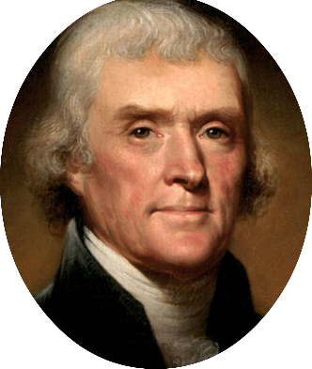
3.6.2 JIFFERSON CYLINDER (THE BAZERIES CYLINDER)
Invented by Thomas Jefferson in 1795, the wheel cipher, better known as the bazeries cylinder, was one of the first forms of a cryptographic machin.
Invented by Thomas Jefferson in 1795, the wheel cipher, better known as the bazeries cylinder, was one of the first forms of a cryptographic maching.

Slide 74
3.6.2 JIFFERSON CYLINDER (THE BAZERIES CYLINDER)
The structure of the Bazeries Cylinder is very basic.
A randomized alphabet is printed on the outside edge of a circular disk.

Slide 75
3.6.2 JIFFERSON CYLINDER (THE BAZERIES CYLINDER)
Every individual disk is marked as a specific number that indicates which order the letters appear.
Each disk is then stacked upon a center, usually iron, axle (barr).
The order in which these disks is then stacked is up to the discretion of the person who is encrypting the message.
These rotatable disks are then free to form whatever message the beholder has as long as the message’s length dose not exceed the number of disk on the cylinders (Bruff, 2010).

Slide 76
3.7 CRYPTANALYSIS OF POLYGRAM CIPHERS
Polygram ciphers proved to be much more secure than monoalphabetic and polyalphabetic ciphers.
It is an improved scheme over monoalphabetic and significantly easier in usage over polyalphabetic.
The digraph substitution ciphers (ex, Playfair cipher) are susceptible to frequency analysis attack, where the trigraph, quadgraph and more pairs of letters ciphers thwart the frequency analysis attack.

Slide 77
3.8 HOMOPHONIC CIPHERS
Classical Cryptograph
Substitution Cipher
Monoalphabetic
Caesar
Polyalphabetic
Atbash
ROT13
S.H. Vigenere
Full Vigenere
Auto-key Vigenere
Running Key Vigenere
Polygram
Playfair
Homophonic

Slide 78
3.8 HOMOPHONIC CIPHERS
Homophonic ciphers are substitution ciphers in which a single letter of the plaintext can be replaced with, for example, 5 different letters, numbers, symbols or combination of them.
A table of homophones is required for both sender and receiver in order to encrypt and decrypt the message.
The characters with higher frequency appearance can have several possible replacements.

Slide 79
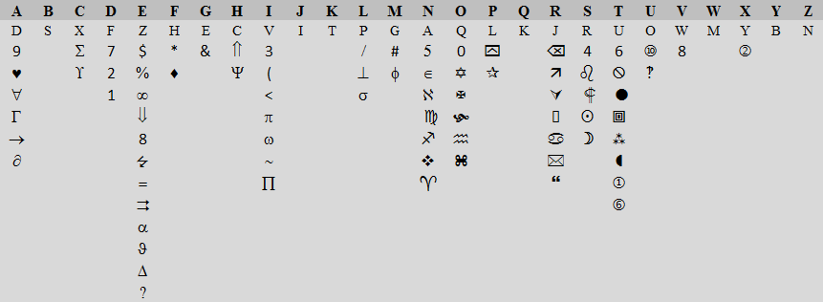
3.8 HOMOPHONIC CIPHERS
The following represents a sample table of homophones.

Slide 80
3.8 HOMOPHONIC CIPHERS
Example 3.19
Encrypt the message “SAVE ME” using the homophones table.
Solution: we find that “S” has many choices of encryption, for example “R” and “4”, we can choose any one.
- Continue the same process for all letters, the ciphertext is:
E | M | E | V | A | S | plaintext
$ | # | Z | 8 | D | 4 | ciphertext

Slide 81
3.8 HOMOPHONIC CIPHERS
We can decrypt the homophonic cipher by reversing the steps of the encryption process.
Example 3.20:
Decrypt the message below using homophonic cipher.
What is the plaintext?
W 3 a s 4 F ? U 8 X X ϑ F
Notes:
The answer is “virus detected”

Slide 82
3.9 CRYPTANALYSIS OF HOMOPHONIC CIPHERS
Breaking the homophonic cipher is very difficult if the number of the cipher alphabet for each letter is high.
We need to know how many letters, symbols and numbers are mapped to each letter which is called hill climbing.
By hand, it takes long time to break. Using computers, it may take few minutes or second depends on how many letters, symbols and numbers are mapped to each letter.

Slide 83
3.9 CRYPTANALYSIS OF HOMOPHONIC CIPHERS
This is handled creating two nested hill climbing layers .
The outer layer determine how many letters, symbols and number are mapped to each letter and inner layer to determine the correct and exact letter, symbol or number that is mapped to that letter particularly.

