Slide 1
Computer Maintenance
Chapter Five BIOS and CMOS
Dr. Mohammad AlAhmad

Slide 2
Chapter Five BIOS and CMOS
“People who are really serious about software should make their own hardware”
(Alan Kay)

Slide 3
Chapter Five BIOS and CMOS
Objectives
The learning objectives of this chapter are:
Understand the essentials of BIOS and CMOS systems.
Understand the POST option.
Configure the proper CMOS setting.

Slide 4
Chapter Five BIOS and CMOS
5.1 Essentials
BIOS stands for Basic Input/output System. It is a startup system that helps the CPU to communicate with devices when the PC is powered on. BIOS will recognizes the devices on the system upon startup. Operating system supports all the devices installed on the system. But the question raises here, how can a new device installed on the system can be recognized by the PC? And what about the brand new systems? The PC needs to access another system other than operating system that makes the CPU eligible to communicate with other devices upon startup.

Slide 5
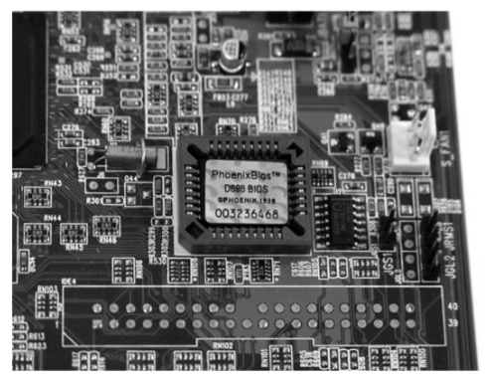
Chapter Five BIOS and CMOS
5.1 Essentials
That means, the PC must have an access to BIOS to communicate with keyboard, monitor, CD-ROM drive, hard drive, USB ports, optical devices and RAM. As a result, BIOS cannot be stored on a hard drive or a CD-ROM drive since the CPU needs immediately to communicate with other devices when startups. This means, BIOS is stored on the motherboard’s chip for faster and practical access by the CPU and other devices. This chip is called BIOS chip

Slide 6
Chapter Five BIOS and CMOS
5.1 Essentials
BIOS chip is a permanent storage place where BIOS system is stored in it. Permanent storage means that the BIOS system will remain stored on that chip even after turning off the PC. Now, we can visualize the complete picture of how is a keyboard can communicate with the CPU upon startup. When the CPU wants to talk to the keyboard controller it goes to the flash memory chip (or BIOS chip) to access the proper program. Technicians call the program stored on BIOS chip of any sort firmware.

Slide 7
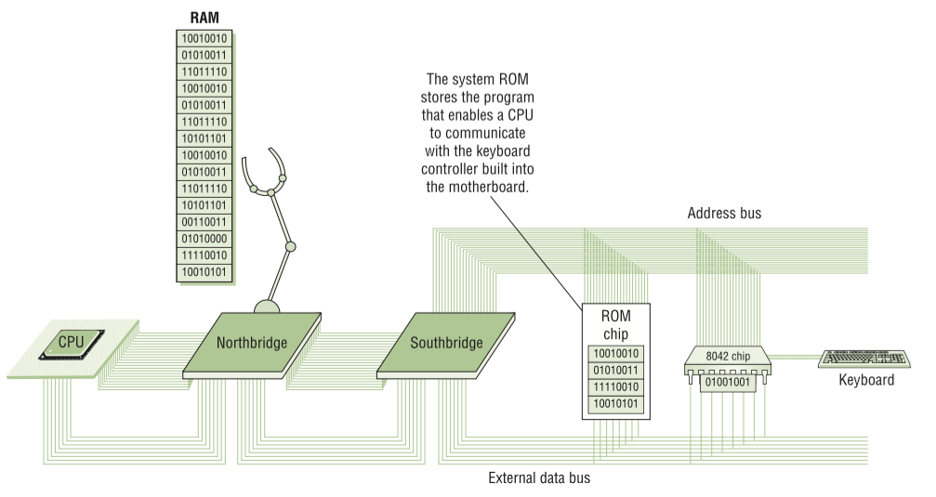
Chapter Five BIOS and CMOS
5.1 Essentials

Slide 8
Chapter Five BIOS and CMOS
5.1 Essentials
Another separate memory chip to store information that describes specific device parameters called complementary metal-oxide semiconductor or CMOS. CMOS and BIOS systems work together to complete the program needed to talk to changeable hardware. Also, CMOS stores and keeps the current time and the date of the PC in case of shuts down. Today, CMOS is built onto the Southbridge. Most CMOS chips stores around 64 KB of data, but the PC needs only a small amount- around 128 bytes- to store all the necessary information on the changeable hardware.

Slide 9
Chapter Five BIOS and CMOS
5.2 Power On-Self-Test (POST)
BIOS is not the only program stored on system ROM. When the system is restarted, it initiates a special program called Power On-Self-Test (POST). POST is very necessary and useful program that checks out the system every time the PC is boots. To perform this task, the POST program sent a message to all devices on the PC saying “check yourself out and run diagnostic”. All the devices will run a test based upon the people who made out that particular device.

Slide 10
Chapter Five BIOS and CMOS
5.2 Power On-Self-Test (POST)
For example, if the keyboard controller chip runs a diagnostic and determines that is not working properly. POST program will either display a text message to the user’s monitor indicating this issue or uses beep codes.

Slide 11
Chapter Five BIOS and CMOS
5.2.1 Beep Codes
As mentioned earlier, the computer tests all the standard devices including the video card. In early PCs, you would hear a series of beeps indicating an error occurred in your system called beep codes. Sometimes, video card cannot communicate with the user, hence, the computer cannot display any text messages on the screen since it is off. As a result, a beep code sound (could be one or two beeps) is heard from the POST system stored on your motherboard’s chip indicating there is something wrong with your video card. Beep codes are different due to the difference in motherboards manufactures. Most modern motherboards have a single beep code, which is for bad or missing video card- one long beep followed by three short beeps.

Slide 12
Chapter Five BIOS and CMOS
5.2.1 Beep Codes
When this issue is fixed, the PC will produce one or two beeps upon startup indicating everything is well. Also, most systems will produce a strange noise of beep when RAM is missing or damaged. Unlike other beep codes, this strange noise will keeping beeping then the system will shut down itself automatically (cannot proceed without running RAM in your system). Sometimes, beeping heard after a while since your computer is turned on, which means, your CPU is over heated and again the system will shut down itself automatically

Slide 13
Chapter Five BIOS and CMOS
5.2.1 Beep Codes
Table 5.1 describes some beep codes taken from a generic motherboard (for AWARD BIOS chip):
Beep Codes | Description
1 long, 2 short | Indicates a video error and the BIOS cannot initialize the video screen to display any additional information
1 long, 3 short | Video card not detected or bad video card
Beep repeats endlessly | RAM problem
Repeated high frequency beeps while PC is running | Overheating processor (CPU)
Repeated beeps alternately, high and Low frequency | Issue with processor (CPU), possible damaged

Slide 14
Chapter Five BIOS and CMOS
5.2.2 Text Errors
After the PC checking its video card, any POST errors will be displayed on the screen as a text error. If you get a text error, usually, the text error message is self-explanatory As Figure 5.3 shown below. Text error messages is more useful than beep codes since the just read-off the message from the screen rather than referring to the motherboard’s manual in case of beep codes. Text errors can determine which of the standard devices

Slide 15
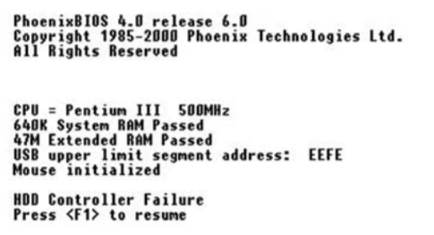
Chapter Five BIOS and CMOS
5.2.2 Text Errors
for ex.: hard drive, CD ROM drive, floppy drive, RAM, mouse and keyboard detection…etc., installed on the PC is having problem. Based text error message, the technician can fix the problem.

Slide 16
Chapter Five BIOS and CMOS
5.2.3 The Boot Process
All the PCs need a process to start with upon powering on. Bootstrap or boot itself is the first process run by the POST program. It initiates the hardware, firmware and software of the PC. More technically, when the PC is turned on, the first component that wakes up is the CPU. As soon as the PC realizes that it has the proper voltage, the CPU send a special good wire called power good wire. If this wire has a certain voltage, then, the CPU realizes that it has enough power to run the boot process. Then, the CPU sends a built-in memory address to the memory (or RAM) through address bus (this is happening since 8086’s CPU until today’s modern CPUs). This address is the first line of the POST program on the system ROM, hence, that is how the system starts the POST.

Slide 17
Chapter Five BIOS and CMOS
5.2.2 Text Errors
The task now is how the system can find the operating system. That is done after finishing POST program, and exactly the last line of POST program which is the bootstrap process is loaded. Bootstrap’s task and job is to find the operating system. The bootstrap reads CMOS information to tell it where to look for the operating system. Your CMOS setup utility has an option to configure which device to enter when system is rebooted. Usually, user choose the device, for ex. hard drive, where the operating system is installed on.

Slide 18
Chapter Five BIOS and CMOS
5.2.2 Text Errors
Boot order is very useful tool for technician, so they can maintain their PCs without entering the primary operating system

Slide 19
Chapter Five BIOS and CMOS
5.3 CMOS Settings
BIOS and CMOS are areas that users do not use very often. BIOS itself is invisible and the real clue about it, is the existence of POST program. CMOS is the utility where users can manage their PC’s components very easy and without the need to open up the computer case. But, you need to be caution while using the CMOS setup utility. You can damage or screw up your PC’s components very badly by playing with the setting that you do not understand.

Slide 20
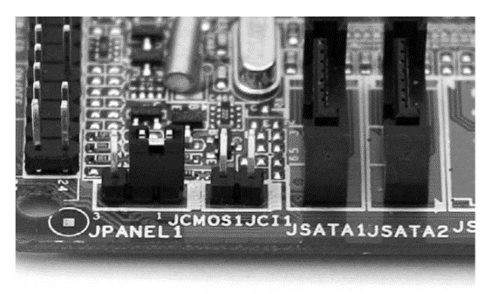
Chapter Five BIOS and CMOS
5.3 CMOS Settings
Also, you might lose your CMOS setting because of running out of charge (refer to Figure 3.14, CMOS’s battery). It is so important to write down the CMOS setting in a paper and kept in a save place for this situation. Some examples that point out loss of CMOS setting are: CMOS configuration mismatch, CMOS time/date not set, no boot device is available and CMOS battery states low. Also, as a technician, you can reset or clear the CMOS setup utility by finding the CMOS reset or clear option respectively. Another tip is, when you assign a CMOS password and you forget that password.

Slide 21
Chapter Five BIOS and CMOS
5.3 CMOS Settings
Every motherboard has a CMOS jumper (you may need to refer to the motherboard’s manual to know this jumper) to clear the CMOS and erase all the saved setting to its factory’s setting which erases the forgotten password as well. One of the most important tool in CMOS utility is the CMOS boot order as Figure 5.4 shown earlier. Sometimes, technicians need to change the boot sequence (as some CMOS setup utility calls it) to

Slide 22
Chapter Five BIOS and CMOS
5.3 CMOS Settings
for ex. CD ROM drive, in order to install a new fresh operating system to the PC’s hard drive. After finishing the installation, the technician needs to change the boot sequence to, for ex. hard drive, so every time the PC starts, it will load the operating system from the hard drive. Also, technicians can change or adjust the time/date for the system from CMOS setup utility time/date option. Another great option CMOS offers which is overclocking CPU clock speed. For example, if the CPU’s speed is 2 GHz, user can use an option on CMOS utility to increase the CPU’s speed to 2.2 GHz. Usually, CMOS offer a limited range of increasing CPU’s speed to protect the CPU from damaging and overheating (usually, 10% of the CPU’s speed). This fancy option will short down the CPU’s age, think again, do you really need overclocking your CPU?

Slide 23
Chapter Five BIOS and CMOS
Summery
Understand the essentials of BIOS and CMOS systems.
Understand the POST option.
Configure the proper CMOS setting.

