Slide 1
Computer Maintenance
Chapter Four
Central Processing Unit (CPU)
Dr. Mohammad AlAhmad

Slide 2
Chapter Four Central Processing Unit (CPU)
“I am not interested in excuses. Fix it.”
(Colonel Tigh, Battlestar Galactica)

Slide 3
Chapter Four Central Processing Unit (CPU)
Objectives
The learning objectives of this chapter are:
Definition of Central Processing Unit.
Understand the CPU core components.
Know the processor family.
Understand CPU(s) specifications.
Installing and uninstalling all parts of a PC.

Slide 4
Chapter Four Central Processing Unit (CPU)
4.1 Understanding What the CPU Does
Central processing unit, CPU, microprocessor or simply processor is the brain of the computer system. The human brain processes all the signals coming from the body then react based on that signal, for ex, lifting weights or talking to someone…etc. CPU inside the computer does the same thing as the human brain does. It processes all tasks (also called processes) coming from the computer components and react based upon this process by either saving the file to the hard drive or may send a piece of a process to display it in a monitor.

Slide 5
Chapter Four Central Processing Unit (CPU)
4.1 Understanding What the CPU Does
With a few exceptions, no matter what happens on your computer, the CPU has a hand in it somehow. For example, if you strike a key in your keyboard, the signal goes through motherboard’s keyboard into the printed circuit board in the back of the motherboard until it reaches the CPU. This signal is processed inside the CPU then send back through the operating system to be displayed into the monitor to show the stroked key by the user

Slide 6
Chapter Four Central Processing Unit (CPU)
4.1 Understanding What the CPU Does
Another example, if a program you’re using needs to send data to a network location, it hands off that data to the operating system, which send it to the CPU, which then routes the data to the motherboard for transmission via the network card. The major exception to the CPU’s micromanaging is with most of today’s graphic cards, which is usually have a dedicated graphics processing unit (GPU) that handles much of the graphics chores so the CPU can work on other processes on that time.

Slide 7
Chapter Four Central Processing Unit (CPU)
4.2 CPU Core Components
Although the CPU might act quite intelligently than a human brain, but in fact, comparing the CPU to a human brain hugely overstates its capabilities. CPU can be described as very powerful calculator. That means, CPU can add, subtract, multiply, divide and move billions of binary numbers in fraction of a second.

Slide 8
Chapter Four Central Processing Unit (CPU)
4.2 CPU Core Components
This calculation’s speed made the CPU looks intelligent, but again, it’s the speed of the CPU rather than an actual intelligence. As a result, the speediness of the CPU makes the user to access the internet, playing graphical games and writing a report simultaneously. A good PC technician needs to understand some basic CPU functions in order to support PCs. So, we will take a tour inside a CPU architecture to understand its components.

Slide 9
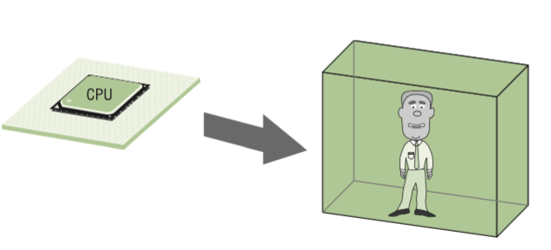
Chapter Four Central Processing Unit (CPU)
4.2 CPU Core Components
We will go back to the late of 1970s, when the famous 8088 Intel CPU was invented (note that, modern CPUs contains the same basic parts used in 8088 Intel’s CPU). Let us visualize the CPU as a clever man in box who can perform any mathematical function very quickly

Slide 10
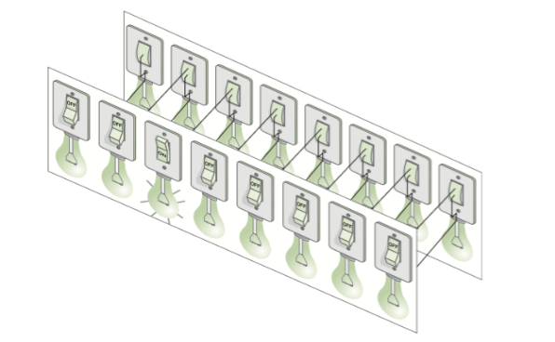
Chapter Four Central Processing Unit (CPU)
4.2 CPU Core Components
The main problem with this man is how to communicate with him and exchange information so we can work together. Now, imagine we install a 16 light bulbs, 8 of them inside the box and the rest 8 outside the box. Each one of the 8 inside bulbs is connected directly to each one of the 8 outside bulbs. Each pair of light bulbs (one from inside and one from outside) is either on or off. You can control the 8 pairs of bulbs using a set of 8 switches controlled by the man in the box. This light bulb communication device is called the external data bus (EDB)

Slide 11
Chapter Four Central Processing Unit (CPU)
4.2 CPU Core Components
we can see how we can communicate with the man in the box. Assuming that a certain sequence of having the light to be on and off means something specific for both, us and the man in the box. For example, in Figure 4.2, we can see the third light from left is on where the rest is off. Now, we write Figure’s 4.2 sequence as “off-off-on-off-off-off-off-off”.

Slide 12
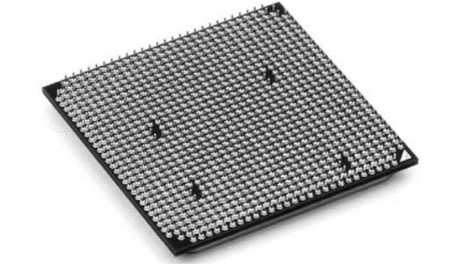
Chapter Four Central Processing Unit (CPU)
4.2 CPU Core Components
Again, this sequence means something specific to us and the man in box which is previously we agreed on together. To accomplish this, we need to have a “codebook” that assigns meaning to different patterns of lights that external data bus might display. CPUs is acting on the same manner. See the little wires as Figure 4.3 shown below. If we apply a voltage to one of the CPU’s wire, that means we flipped the switch. Get the idea? So, if the wire inside the CPU is supplied with power, the bulb will glow otherwise it will not glow

Slide 13
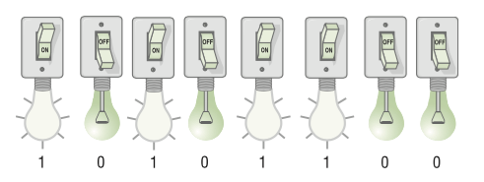
Chapter Four Central Processing Unit (CPU)
4.2 CPU Core Components
In computer language, we will transform the sequence “off” to “0” and “on” to “1”. This is called binary or digital system. It’s really very simple language, when the voltage goes through the wire that means it’s “1” otherwise it’s “0” as Figure 4.4 shown below.

Slide 14
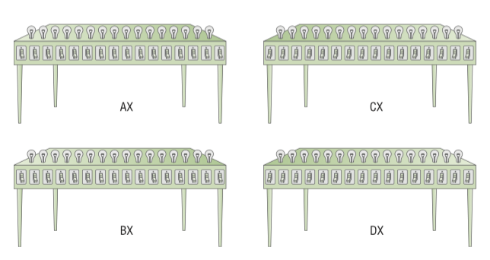
Chapter Four Central Processing Unit (CPU)
4.2.1 Registers
As of now, we know how we can communicate with the man in the box, but, the man in the box needs a worktable in order to complete his job. In fact, he needs 4 worktables, where each worktable contain 16 bulbs

Slide 15
Chapter Four Central Processing Unit (CPU)
4.2.1 Registers
Each bulb is controlled by a single switch operated by the man in the box. Now, the man in the box can operate on four worktables that contain 16 bulbs each to create EDB patterns exactly as discussed in the previous section. In real computers, these worktables are called registers. Remember, registers give the man in the box a workplace to perform on the problems given by us. These registers are existed by modern CPUs but with larger numbers of them. But for the moment, let us concentrate with general four registers named by Intel corp.: AX, BX, CX and DX. We are almost ready to start working with the man in the box, but, one tiny thing left.

Slide 16
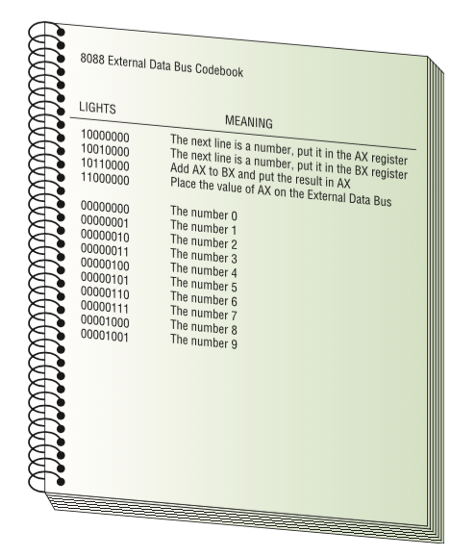
Chapter Four Central Processing Unit (CPU)
4.2.1 Registers
Remember the codebook I mentioned earlier in previous section? We need two copies of the codebook, one of them is kept with the man in the box and the second one is kept with us

Slide 17
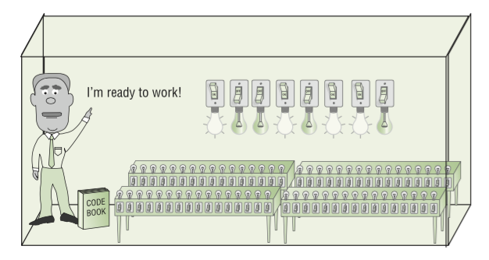
Chapter Four Central Processing Unit (CPU)
4.2.1 Registers
In this codebook, 10110000 means, add AX to BX and put the result in AX. These commands are called microprocessor’s machine language. By placing these commands on the external bus, we can instruct the man in the box to perform a specific task. Figure 4.7 below shows the complete picture of our discussion, the man in the box is ready now to work with as he got the worktables (registers), data bus and codebook.

Slide 18
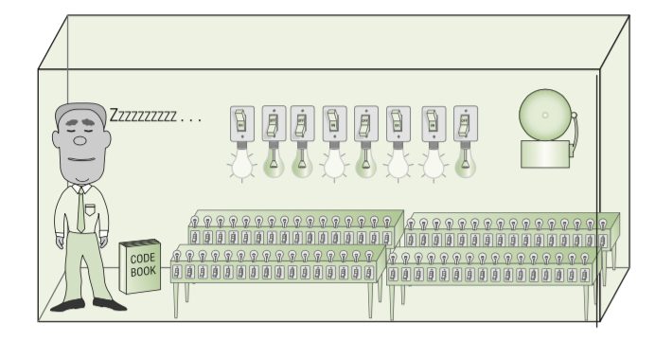
Chapter Four Central Processing Unit (CPU)
4.2.2 Clock
Clock is special wire on the CPU that tells the CPU it’s ready for the next piece of information to receive. As we know that the man in the box can receive information (also called instruction sets) from us then perform a specific command based on the binary number send by us according to the codebook that we both have. The next command is sent by us needs to be based on the charge of clock wire (most diagrams call clock signal with CLK) inside the CPU. That means, the CPU does nothing until is activated by the clock wire as

Slide 19
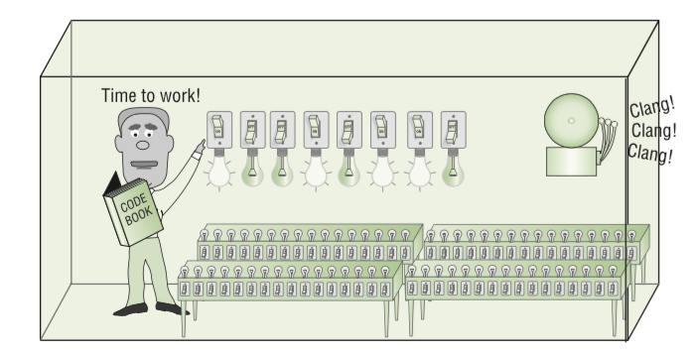
Chapter Four Central Processing Unit (CPU)
4.2.2 Clock
The CPU does nothing until a minimum voltage is applied to CLK wire. Minimum voltage is defined by two clock cycle. Which means, the CPU needs minimum two clock cycles (usually more) of its burst time in order to execute any command. In fact, a CPU requires a hundred of cycles to clock cycles to execute some commands

Slide 20
Chapter Four Central Processing Unit (CPU)
4.2.2 Clock
The maximum number of clock cycles that CPU can handle in a specific time (usually one second) is called clock speed. The clock speed is the fastest speed of the CPU that can operate on determined by its manufacture. For example, Intel 8088 processor can operate on 4.77 MHz (maximum speed), which means, it can perform 4.77 million cycles per second. It is very slow compared by the today’s CPU speed, but it is very fast compared to using a pencil on a paper, remember when compared the CPU with human brain! CPUs today can run in speeds 3 GHz that means, this CPU can execute 3 billion cycles per second.

Slide 21
Chapter Four Central Processing Unit (CPU)
4.2.2 Clock
The CPU clock cycle unit is Hertz and can be measured as follows:
1 hertz (1 Hz) = | 1 cycle per second
1 megahertz (1MHz) = | 1 million cycle per second
1 gigahertz (1 GHz) = | 1 billion cycle per second

Slide 22
Chapter Four Central Processing Unit (CPU)
4.3 The Processor Family
The processor’s family name is an umbrella term that contain a series of related processor that use the same underlying architecture. Intel corp. and AMD corp. are the two well-known competing CPU’s manufactures. They have a set of family processors that are divided based on the low, mid and high end ranges

Slide 23
Chapter Four Central Processing Unit (CPU)
4.3 The Processor Family
Range | Families | Description
Low | Intel Celeron, AMD Athlon II | Inexpensive, low power and low performance
Mid | Intel Pentium, Core i3, AMD Phenom II | Mid-price, better performance than low range processors
High | Intel Core i5, i7, AMD FX | Expensive, high performance

Slide 24
Chapter Four Central Processing Unit (CPU)
4.4 Understanding CPU Specifications
If you decide to buy a new CPU and come across one of them with the following specifications:
Intel Core i5-3570 3.4 GHz Quad Core LGA 1155
6MB L3 cache lvy Bridge 22nm

Slide 25
Chapter Four Central Processing Unit (CPU)
4.4 Understanding CPU Specifications
To understand what does it means, I need to explain each word as follows:
Intel: it is clearly the company name
Core i5: is the broad brand name under which the processor’s family belong to within Intel. Precisely means, four co-processors in one single chip operates in multitasking (more than one process or command) at the same time.
3570: is the exact name of the processor.
3.4 GHz: is the processor clock speed as discussed earlier.

Slide 26
Chapter Four Central Processing Unit (CPU)
4.4 Understanding CPU Specifications
Quad Core: means the CPU has four cores.
LGA1155: this is the motherboard socket the processor fit into.
MB L3 cache: this is the CPU’s level 3 cache. Level 3 cache is a memory area to store frequently accessed data by the CPU for better performance (less access obtained if stored in CPU cache rather than memory or hard drive).
lvy Bridge: this is the type pf processor uses.
22nm: this is the CPU manufacturing process.

Slide 27
Chapter Four Central Processing Unit (CPU)
4.5 Installing and Uninstalling All Parts of a PC
Based on the practical part done in the previous chapters, now, you can install and uninstall all the system unit’s internal and external components in a frame time given by your instructor. At this stage, be sure, you are eligible to perform all steps in section 3.5. Also, installing and uninstalling CPU is remarkably straightforward process.

Slide 28
Chapter Four Central Processing Unit (CPU)
4.5 Installing and Uninstalling All Parts of a PC
To uninstall the CPU, you need to take out the fan and the heat sink assembly, then, remove the CPU. To install the CPU, be sure to place the CPU on its socket based on the CPU edges or corners. Precisely, when you look at the CPU chip, you will find one of the corners is different than the other. Consequently, matching this corner with corresponding one from the CPU socket side will install the CPU successfully in your motherboard. Lastly, snap the fan and the heat sink assembly back on.

Slide 29
Chapter Four Central Processing Unit (CPU)
Summery
Definition of Central Processing Unit.
Understand the CPU core components.
Know the processor family.
Understand CPU(s) specifications.
Installing and uninstalling all parts of a PC.

