Slide 1
Computer Maintenance
Chapter Three
Motherboards
Dr. Mohammad AlAhmad

Slide 2
Chapter Three Motherboards
“It would appear that we have reached the limits of what it is possible to achieve with computer technology, although one should be careful with such statements, as they tend to sound pretty silly in five years.”
(John Von Neumann, 1949)

Slide 3
Chapter Three Motherboards
Objectives
The learning objectives of this chapter are
Understand motherboards.
Understand the motherboard’s form factors
Define the motherboard chipsets.
Differentiate between motherboard’s components.
Installing and uninstalling motherboards

Slide 4
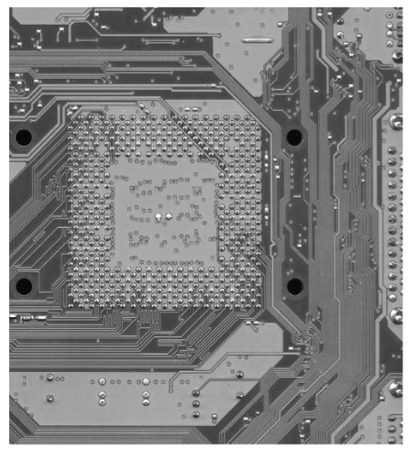
Chapter Three Motherboards
3.1 Understanding Motherboard
Motherboard provides the foundation of personal computer. Without motherboard, literally, you have no PC. It’s the platform through which all computer components communicate. Computer components like CPU, memory, disk drives and expansion devices communicate with each other through motherboard. Communications in the motherboard performed through wires called traces. Traces are the printed circuit board (PCB) where can be seen in the back of the motherboard.

Slide 5
Chapter Three Motherboards
3.1 Understanding Motherboard
Mainly, modern motherboards are differentiated based on three factors: form factor, chipset and components (all discussed in the next sections).

Slide 6
Chapter Three Motherboards
3.2 Motherboard Form Factor
Motherboard form factor determines locations of components and ports into the motherboard as well as the size of the motherboard. Motherboard manufactures and industries standardize their sizes to make them fit inside computer cases and works with power supplies. So, technician cannot, arbitrary, install any motherboard inside any case and connect it with power supply. Based on the motherboard form factor, motherboards need to match the computer case size in order to fit the ports and slot opening in the back of the motherboard correctly

Slide 7
Chapter Three Motherboards
3.2 Motherboard Form Factor
Motherboard form factors are categorized as follows:
AT form factor
ATX form factor
Micro ATX form factor
Flex ATX form factor
ITX form factor
BTX form factor

Slide 8
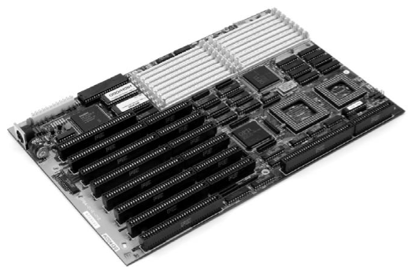
Chapter Three Motherboards
3.2 Motherboard Form Factor
AT form factor: IBM invented the AT form factor in the early 80s and lasted through mid-90. AT currently obsolete. It has large keyboard socket, split power socket (P8/P9) as Figure 3.2 shown below. Baby AT was smaller version of AT form factor.

Slide 9
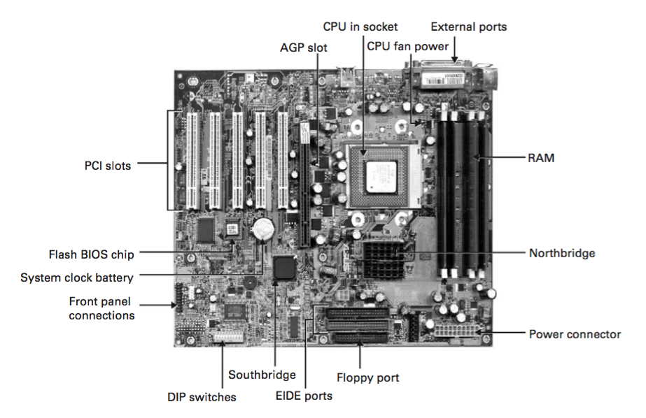
Chapter Three Motherboards
3.2 Motherboard Form Factor
ATX form factor. It stands for Advanced Technology Extended. It is the improved version of AT motherboard as Figure 3.3 below shows all the details of ATX motherboard. These improvements including the I/O ports built directly into the side of the motherboard, CPU positioned near by the power supply fan to help cool it, and the ability for the PC to turn off/on via a software.

Slide 10
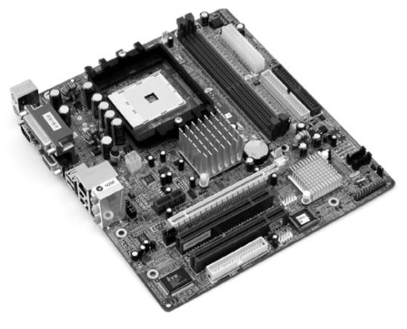
Chapter Three Motherboards
3.2 Motherboard Form Factor
Micro ATX form factor: released in 1997 for smaller and cheaper systems as Figure 3.4 shown below. Maximum size of Micro ATX motherboard is 244 mm square compared to 305 mm × 244 mm for a standard ATX motherboard

Slide 11
Chapter Three Motherboards
3.2 Motherboard Form Factor
Flex ATX form factor: in 1999, Intel created a variant of micro ATX called Flex ATX. It is 9 by 7.5 inches which makes them the smallest size on ATX standards.
ITX form factor: the ITX motherboards like mini ITX, Nano ITX and Pico ITX were proposed by VIA technology. The mini ITX fits into the same case as micro ATX motherboard which uses low power and has one expansion slot. The Nano ATX is even smaller than mini ATX which used into smaller places. Finally, the Pico ATX is half the size of the Nano ITX and uses daughter cards to supply additional functionality.

Slide 12
Chapter Three Motherboards
3.2 Motherboard Form Factor
BTX form factor: it stands for Balanced Technology Extended. BTX defines three subtypes: standard BTX, Micro BTX and Pico BTX. They are designed to replace: ATX, Micro ATX and Flex ATX respectively. Due to uniqueness to a specific company, they do not follow the standards and difficult to support, BTX has not yet make much impact in the industry to completely replace ATX motherboards.

Slide 13
Chapter Three Motherboards
3.3 Chipsets
The chipset is the set of controller chips that monitors and directs the traffic between motherboard’s components. It determines the type of the CPU (or processor) that motherboard accepts, type and capacity of RAM and the internal and external devices that motherboard can support. Due to the previous facts I can say, “Good technicians should know their chipsets”.

Slide 14
Chapter Three Motherboards
3.3 Chipsets
It usually consists of two main chipsets:
Northbridge chipset
Southbridge chipset

Slide 15
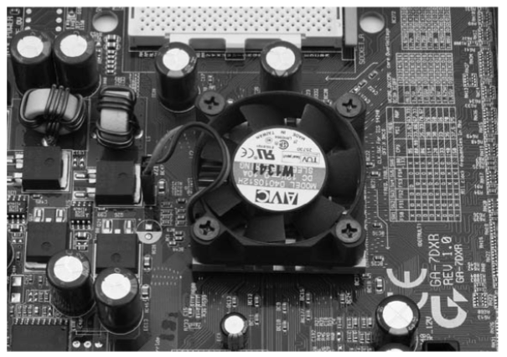
Chapter Three Motherboards
3.3 Chipsets
Northbridge chipset: it connects the system bus to the other relatively fast buses like AGP and PCIe. Northbridge usually handles communications between the CPU, RAM as Figure 3.5 shown below. More precisely, in Intel based motherboards, Northbridge chip helps the CPU with RAM. Where, in AMD based motherboards, the Northbridge provides communications with video card rather than memory because the memory controller is built into the CPU.

Slide 16
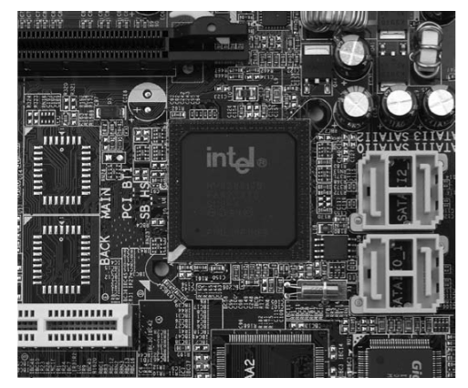
Chapter Three Motherboards
3.3 Chipsets
Southbridge chipset: it handles some expansion devices and mass storage drives such as ISA, IDE, USB, audio, serial, BIOS, the ISA bus, the IDE channels and the interrupt controller. Southbridge chipset handles all the computer’s I/O functions. Most Southbridge chipsets do not need extra cooling

Slide 17
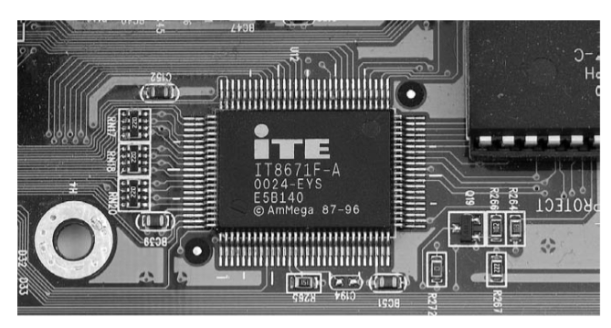
Chapter Three Motherboards
3.3 Chipsets
Due to the many technologies that Southbridge supports such as floppy drives, infrared connections parallel port and modems, as of now, modern motherboards manufactures added a third chip to support these chores and called the Super I/O chip

Slide 18
Chapter Three Motherboards
3.3 Chipsets
Chipsets makers do not always use the terms Northbridge and Southbridge. Chipset for AMD based motherboards tends to use the same name, where Intel prefer to use the term Memory Controller Hub (MCH) for Northbridge and I/O Controller Hub (ICH) for the Southbridge. But usually, technician commonly use the terms Northbridge and Southbridge. Figure 3.8 visualize the complete relationship between the Northbridge and Southbridge in Intel based motherboards.

Slide 19
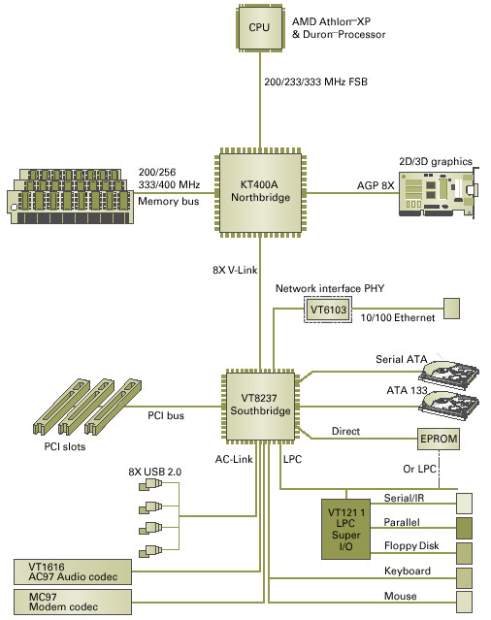
Chapter Three Motherboards
3.3 Chipsets

Slide 20
Chapter Three Motherboards
3.4 Motherboard Components
Motherboards varies due to the components they mounted on them. These common motherboard components are:
Expansion slots
RAM slots
CPU socket
Jumpers
CMOS battery
Power connection
Front panel connectors
Side panel connectors
IDE connectors

Slide 21
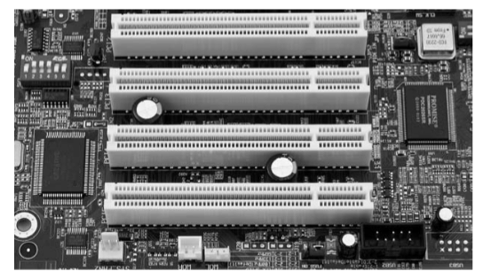
Chapter Three Motherboards
3.4 Motherboard Components
Expansion slots: they exist to allow for addition of new interfaces to new technologies without the need of replacing the motherboard. These interfaces are called Peripheral Component Interconnect (PCI) bus, PCI eXtented (PCI-X), PCI Express (PCIe) and mini PCI. PCI is fast (33 MHz), wide (32-bit or 64-bit) expansion bus was modern standard in motherboards for general purpose

Slide 22
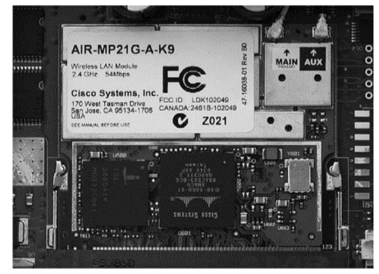
Chapter Three Motherboards
3.4 Motherboard Components
PCI-X is the double wide version of the 32-bit PCI local bus and it has been replaced with PCIe. PCIe uses network of serial interconnects that operates at high speed. It is based on the PCI systems. Lastly, mini PCI functions as the PCI but has a much smaller form factor. Basically, it is designed to utilize the laptop and other portable devices expansion slot

Slide 23
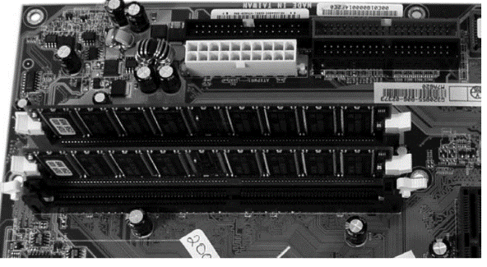
Chapter Three Motherboards
3.4 Motherboard Components
RAM slots: it contain memory chips. There are many types of memory that PC can hold

Slide 24
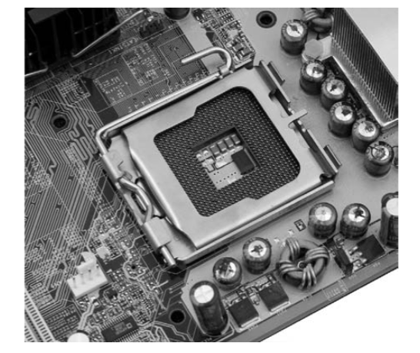
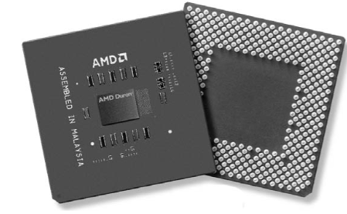
Chapter Three Motherboards
3.4 Motherboard Components
CPU socket: the CPU slot allows to attach the CPU itself to the motherboard in order to use the other components of the system

Slide 25
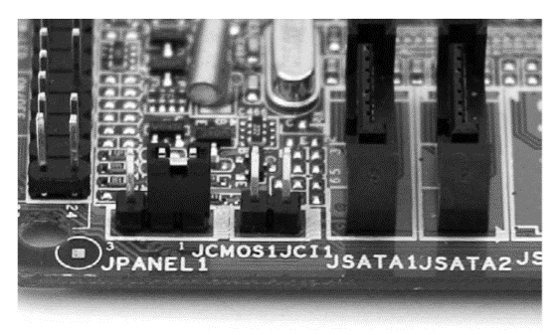
Chapter Three Motherboards
3.4 Motherboard Components
Jumpers: jumpers and dual inline package (DIP) are used to configure various hardware options on motherboard such as overclocking CPU speed (forcing the CPU to operate more than manufacture speed). Figure 3.13 shows CMOS jumper that allows to clear the CMOS setting.

Slide 26
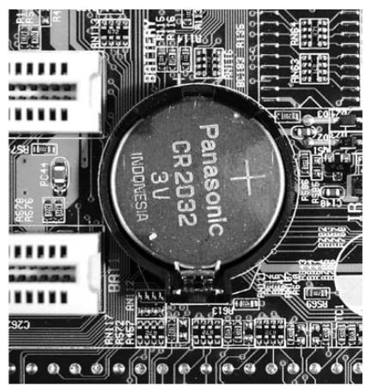
Chapter Three Motherboards
3.4 Motherboard Components
CMOS battery: CMOS chip must have a source power to keep its setting when the PC is switched off and that achieved by using CMOS battery

Slide 27
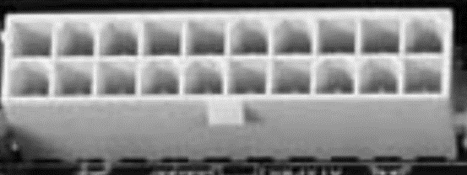
Chapter Three Motherboards
3.4 Motherboard Components
Power connection: it allows the motherboard to be connected to the power supply

Slide 28
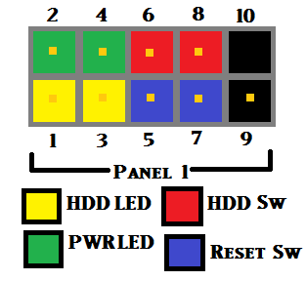
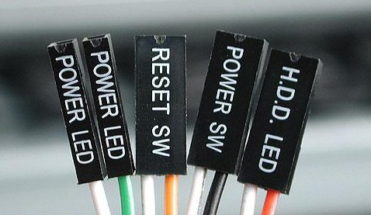
Chapter Three Motherboards
3.4 Motherboard Components
Front panel connectors: there are a number of interfaces, buttons and audio jacks in the front panel that must be connected to the motherboard for power and functionality. Front panel connectors are Universal Serial Bus (USB), audio, power button, power light, drive activity light and reset button. USB is 10-pin connector located on the motherboard. Audio must be connected if the integrated sound card. Power button or power switch is located in the front panel connector

Slide 29
Chapter Three Motherboards
3.4 Motherboard Components
Power button or power switch is located in the front panel connector to communicate with the computer case to turn on and off the PC. Power light or power led is also located in the front panel connector and it lights the PC power button indicating the computer is on. Where drive activity lights or H.H.D led is located on the front panel connector as Figure 3.16 shown below and it indicates when the hard drive is either being read or written to the hard drive. Reset button or reset switch is a button to restart the PC and it is located on the front panel connector.

Slide 30
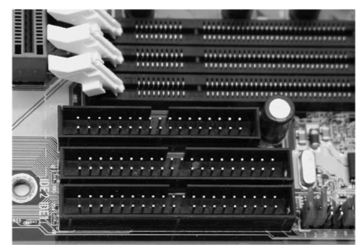
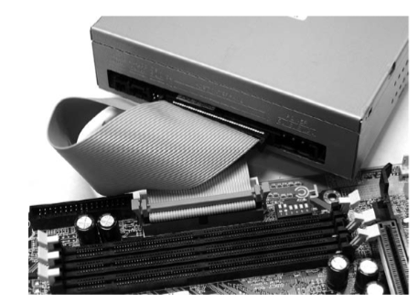
Chapter Three Motherboards
3.4 Motherboard Components
Side panel connectors: discussed earlier in section 1.5.1.
IDE connectors: hard drive, CD drive and floppy drive are connected via bus cables into the motherboard into primary and secondary Advanced Technology Packet Interface (ATAPI)

Slide 31
Chapter Three Motherboards
3.5 Installing and Uninstalling Motherboard
If you are going to remove your motherboard, follow these steps:
begin with removing all cards from your motherboard
disconnect your IDE and SATA cables
disconnect your power supply connectors from the motherboard, hard disk, CD drive and floppy drive
disconnect your front panel and CPU fan connectors
unscrew all bolts from the motherboard edges and centers then lift the motherboard carefully
remove your CD-ROM drive, hard drive and Floppy drive
Installing the motherboard, simply, by reversing the steps above.

Slide 32
Chapter Three Motherboards
Summery
Understand motherboards.
Understand the motherboard’s form factors
Define the motherboard chipsets.
Differentiate between motherboard’s components.
Installing and uninstalling motherboards

