Slide 1
Computer Maintenance
Chapter Two
Power Supply
Dr. Mohammad AlAhmad

Slide 2
Chapter Two Power Supply
“I meant to kill a turkey, and instead, I nearly killed a goose.”
(Benjamin Franklin on Shocking Himself While Trying to Kill a Turkey(

Slide 3
Chapter Two Power Supply
Objectives
The learning objectives of this chapter are
Definition of computer case.
Describe how power supply works.
Describe the power supply connectors.
Installing, uninstalling and testing power supply

Slide 4
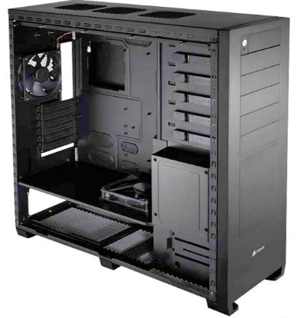
Chapter Two Power Supply
2.1 Computer Cases
Computer cases sometimes incorrectly referred to CPU or hard disk. Alternatively, computer case is also called computer chassis, tower system, cabinet case unit or simply case. It contains most of the computer components, for ex. motherboard, CPU, expansion cards, front and side panel connectors. Usually, Case’s materials manufactured from steel or aluminum

Slide 5
Chapter Two Power Supply
2.1 Computer Cases
Sometime, it is manufactured from wood, plastic and Lego blocks. Cases sizes are based on the motherboard form factor. Chapter Three discusses the motherboard form factors and their kinds in more details.

Slide 6
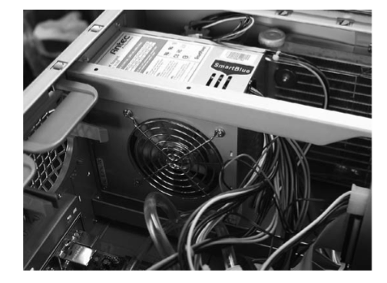
Chapter Two Power Supply
2.2 How Power Supply Works
Power supply or power supply unit (PSU) is simply supplies the PC components with electricity as Figure 2.2 shows a typical power supply inside the case.

Slide 7
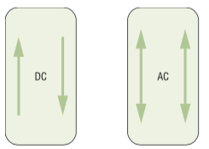
Chapter Two Power Supply
2.2 How Power Supply Works
It takes the electricity from the wall jack and transforms it into electricity to run the motherboard and other internal components. More precisely, your pc uses DC voltage. Electricity is subdivides into two kinds: direct current (DC) and alternating current (AC). DC flows in one direction around continuous circuit. Where, AC flows back and forth simultaneously in a circuit as Figure 2.3 shows below.

Slide 8
Chapter Two Power Supply
2.2 How Power Supply Works
Since the PC uses DC voltage, conversion will take a place inside the power supply unit to convert the high AC power supplied from the electricity company through the wall socket. The first step when power the PC is to get a proper power from the AC power. Secondly, the PSU converts the AC power to a proper DC power in order to pass it to the motherboard and peripherals. Finally, power supply unit needs to control the heat generated by itself to keep providing the DC power to the PC.

Slide 9
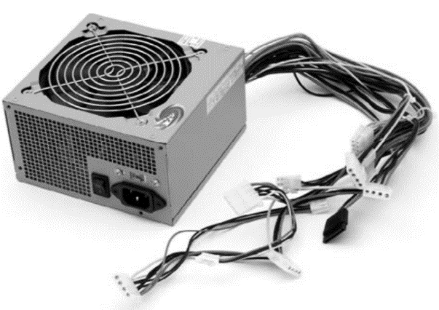
Chapter Two Power Supply
2.3 Power Supply Connectors
desktop power supply unit dispatched from a system unit. All the wires dangling out of the PSU connect to the motherboard and peripherals. Power supplies have various shapes and sizes, but, the most common size is the standard 150 mm × 140 mm × 86 mm as shown in Figure 2.4.

Slide 10
Chapter Two Power Supply
2.3 Power Supply Connectors
The PC uses the 12.0-volt current to power motors on devices such as hard drive and CD-ROM and it uses a 5.0-volt and 3.3-volt current for support onboard current

Slide 11
Chapter Two Power Supply
2.3 Power Supply Connectors
Power supplies also uses standard connectors for the motherboard and interior devices as follows:
P1 power connector
Power to peripherals

Slide 12
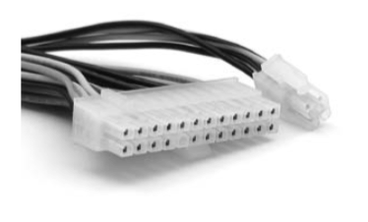
Chapter Two Power Supply
2.3 Power Supply Connectors
P1 power connector: modern motherboards uses 20 or 24-pin. Some motherboards may use extra power connection in addition to P1 power connector (also called motherboard power connector) as Figure 2.5 shown below.

Slide 13
Chapter Two Power Supply
2.3 Power Supply Connectors
Power to peripherals: devices inside the computer case require power. These include CD-ROM drive, DVD drive, floppy drive, Zip drive and fans. There are three different types of power connectors that plug into peripherals: Molex, mini and SATA. The most common type is Molex connector which needs 5 or 12-volts of power and can connects CD-ROM drive, DVD drive and hard drive connectors (if they are Molex type connectors). Mini connector is used by floppy disk drive in modern systems and supplies 5 to 12-volts. SATA connector is used by the modern SATA hard drives. It is 15-pin connectors that support 3.3, 5 and 12-vollts devices.

Slide 14
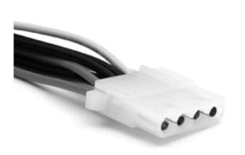
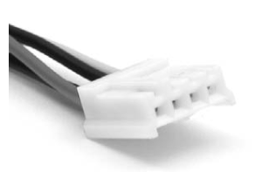
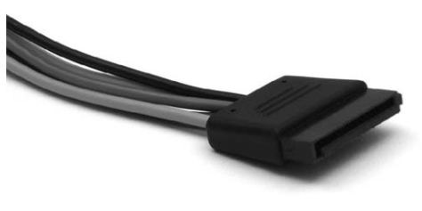
Chapter Two Power Supply
2.3 Power Supply Connectors

Slide 15
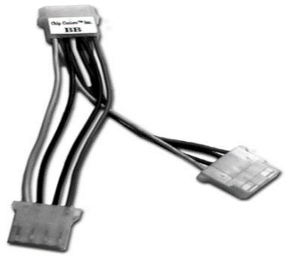
Chapter Two Power Supply
2.3 Power Supply Connectors
If you find yourself without enough connectors, you may use splitters to create more connectors that include Molex, mini and SATA connectors as Figure 2.7 shown below.

Slide 16
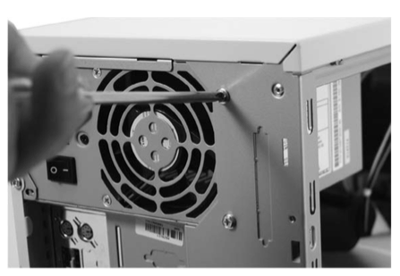
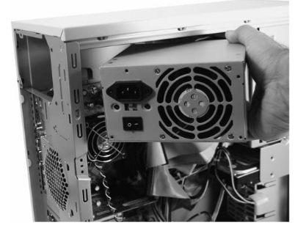
Chapter Two Power Supply
2.4 Installing and Uninstalling Power Supply
A typical power supply is installed in the back of the back of the case mounted with four screws. Unscrew the four screws and lift out the power supply easily.
Installing power supply unit is exactly the reverse steps of uninstalling power supply.

Slide 17
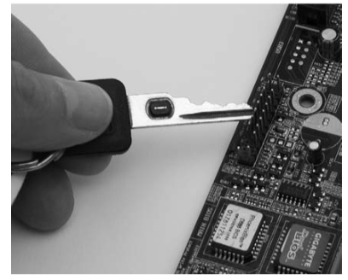
Chapter Two Power Supply
2.5 Testing Power Supply
You can test your power supply functioning in two ways. The first one is to connect your power supply to the motherboard, (does not matter if your PSU inside the system unit or removed, but rather to be removed) then connect your wall socket to the power supply and switch on the power supply. Lastly, use your car key to touch the front panel pins in your motherboard as Figure 2.10 shown below, then, your power supply should switch on indicating that PSU is working well.

Slide 18
Chapter Two Power Supply
2.5 Testing Power Supply
The second approach is to wire pin 13 and 14 with a wire of the motherboard connector from the power supply side. Then, plug in the power supply the wall socket. Lastly, switch on the power supply using the back switch, now, your power supply should be working indicating your PSU works well.

Slide 19
Chapter Two Power Supply
Summery
Definition of computer case.
Describe how power supply works.
Describe the power supply connectors.
Installing, uninstalling and testing power supply

