Slide 1
Computer Maintenance
Chapter Eight
Video and Sound Cards
Dr. Mohammad AlAhmad

Slide 2
Chapter Eight Video and Sound Cards
“Show me, Do not tell me”
(My supervisor, professor King, University of the Pacific, 2000)

Slide 3
Chapter Eight Video and Sound Cards
Objectives
The learning objectives of this chapter are:
Understand the essentials of video and sound cards.
Understanding the video and sound card specifications.
Installing third party applications.

Slide 4
Chapter Eight Video and Sound Cards
8.1 Essentials of Video Cards
“Seeing” what is going on in your machine is handled by the video card and monitor.
Video card or sometimes called video adapter is a system component which generates a frequent output to a display (computer monitor). Monitor resolution is always shown in the number of horizontal pixels multiplied by the number vertical pixels. For example, a resolution of 640 × 480 indicates a horizontal resolution of 640 pixels and a vertical resolution of 480 pixels. If you multiply these two values together 640 × 480 = 307,200 pixels per screen. That means, the whole screen’s pixels are 307,200. The higher pixels your image have, the higher resolution your image is

Slide 5
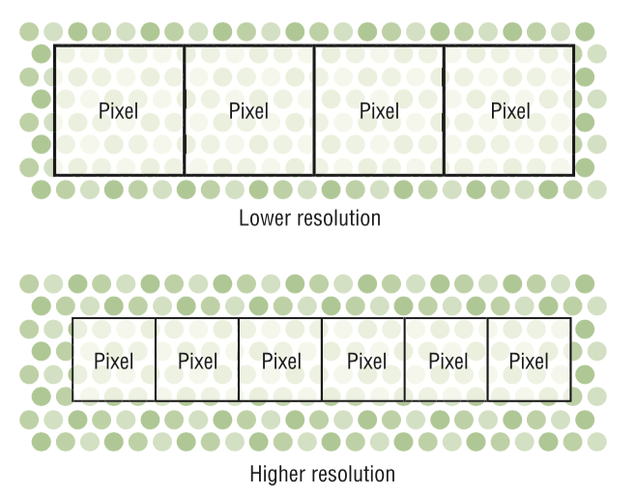
Chapter Eight Video and Sound Cards
8.1 Essentials of Video Cards

Slide 6
Chapter Eight Video and Sound Cards
8.1 Essentials of Video Cards
Some common resolutions for monitors that shaped like monitors screen are 640 × 480, 800 × 600, 1024 × 768, 1280 × 960, 1280 × 1024, and 1600 × 1200. Note that the ratio relationship between the horizontal and vertical in all these resolution is 4:3 ratio. This is called the ratio aspect. Many other monitors are called wide screens monitors Have a 16:9 or 16:10 ratio which are originally 1366 × 768 and 1920 × 1200 pixels resolution respectively. Where, liquid crystal display (LCD) are the most technology used today for PCs. Compared to the crystal ray tube monitors, LCD are thinner, consume less power, virtually flicker free and don’t potentially harmful radiation.

Slide 7
Chapter Eight Video and Sound Cards
8.1 Essentials of Video Cards
LCDs have a native resolution such as: 1680 × 1050, enabling them to display the sharpest picture possible. Since the pixels are fixed, you cannot run an LCD monitor at a resolution higher than the native one. Where the strength of the back lights of LCD monitor determines the brightness of the monitor.

Slide 8
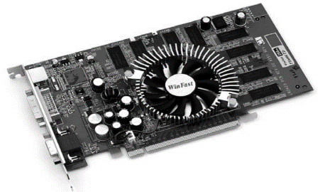
Chapter Eight Video and Sound Cards
8.1 Essentials of Video Cards
Video card processes the information from the CPU and send it out to the monitor. The basic video card is composed of two major pieces: RAM and the basic video processor circuitry. The video processing circuitry takes the information from the video RAM and shoot it out to the monitor. Modern video cards are a little complicated than that, how? They have their own CPUs which is called GPU or graphic processor unit. This dedicated GPU has its own cooling fan

Slide 9
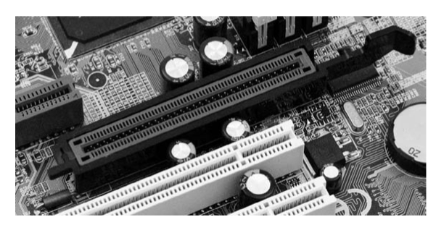
Chapter Eight Video and Sound Cards
8.1 Essentials of Video Cards
Altogether, your video card and monitor are capable of showing Windows in a fixed number of different resolutions and color depths. Any single combination and color depth you set is called a mode. IBM introduces the video graphic array (VGA) standard. This standard offered 16 colors at a resolution of 640 × 480 pixels. VGA can be installed in PCI’s motherboard slot. Due to the PCI limited bandwidth, video card manufactures moved to accelerated graphic port (AGP) for higher bandwidth. AGP is dedicated port only for the video card

Slide 10
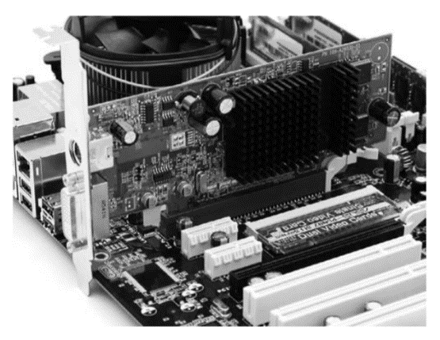
Chapter Eight Video and Sound Cards
2.1 Computer Cases
AGP is connected directly the Northbridge unlike the PCI which is connected to Southbridge. The feature of having the AGP connected to the Northbridge chipset is to speed up the rendering process on the monitor. In the last years, PCI Express (PCIe) video cards are replaced with the AGP ones due to their high cost. PCIe video cards are incredibly fast using a serial communication method. All PCIe Video cards use the PCIe × 16 connector

Slide 11
Chapter Eight Video and Sound Cards
8.1 Essentials of Video Cards
Graphic processing unit or GPU handles a heavy lifting commands from the CPU and translate them into coordinates and colors that the monitor understand and displays. Your choice of graphic processor is a big decision when buying your own. Also, video memory is crucial to the operation in the PC. It is the hardest working set on the PC, really! Video memory keep updating constantly to reflect every changes that takes a place on the screen. Video memory proved to be a serious bottleneck when working with heaving processing applications such as games.

Slide 12
Chapter Eight Video and Sound Cards
8.1 Essentials of Video Cards
Now, we can illustrates the basic process works of a video card as follows:
The software alerts the processor to let it know the program has something to display in the monitor.
The processor contacts the graphic adapter’s device driver and passes along the instructions.
The driver contacts the video card and send along the instructions from the processor.

Slide 13
Chapter Eight Video and Sound Cards
8.1 Essentials of Video Cards
4. The video card builds the new screen and stores it in the video memory
5. The video card converts the digital signal to analog signal (in case of analog monitor) that monitor understand.
6. The monitor displays the screen image by converting the incoming signal into the colors that are displayed using individual screen pixels.

Slide 14
Chapter Eight Video and Sound Cards
8.2 Understanding Video Card Specifications
Like other system components, you might see the following description of video card specifications:
XFX PVT73EYARG GeForce 7300GT 533 MHz 512 MB GDDR2, PCI Express × 16, SLI Ready, DVI, VGA, HDTV

Slide 15
Chapter Eight Video and Sound Cards
8.2 Understanding Video Card Specifications
These video card description is discussed in details as follows:
XFX: this is the name of the video card manufacture.
PVT73EYARG: this is the manufacture model number for the video card.
GeForce 7300GT: this is the name of the graphics processing unit (GPU) chipset.
533 MHz: the speed of the memory clock.
512 MB: amount of memory on the card.

Slide 16
Chapter Eight Video and Sound Cards
8.2 Understanding Video Card Specifications
These video card description is discussed in details as follows:
GDDR2: type of memory on the card.
PCI Express × 16: motherboard’s interface slot type used by the card.
SLI ready: this tells you can combine this video card with second video card using SLI dual GPU technology.
DVI: the video card comes with a DVI connector.
VGA: the video card comes with VGA connector.
HDTV: the video card comes in HDTV connector.

Slide 17
Chapter Eight Video and Sound Cards
8.3 Essentials of Sound Cards
Setting up and optimizing sound for a PC have become an integral skill for all computer technicians. Also, setting up and optimizing sound in PCs need few quite skills from technicians in order to install the sound card, choose high quality speakers, install/update sound driver, work with an API sound and troubleshoot the sound card. PCs must be capable to convert the audio file in a form to enable it to be recorded and be played. Computer specialists call these two operations capture and output respectively. Today, every computer comes with four sound components in order to perform these two operations: sound card, speakers, microphone and recording/playback software. Computers capture (record) an electronic information through a process called sampling.

Slide 18
Chapter Eight Video and Sound Cards
8.3 Essentials of Sound Cards
Sampling measured in thousands of cycles per second, or kilohertz (kHz). More samples means the better quality of reproduction of this sound. Most sounds in PCs are recorded in the range from 11 kHz (low quality rate, like telephone service) to the higher ultra-rate 192 kHz (better than human ear). Sounds vary according to their loudness (amplitude), their sound quality (frequency) and the quality of the same note played in different instruments (timbre). The number of characteristics of a particular sound captured during sampling is measured by bit depth of the sample. As a result, the greater bit depth of a particular captured sound,the more characteristics of this sound can be stored and thus re-created.

Slide 19
Chapter Eight Video and Sound Cards
8.3 Essentials of Sound Cards
The granddaddy of all sound formats is pulse code modulation (PCM). With just minor changes to fit in the PCs, PCM format is still alive and well, and it is named WAV format as it is called PC specialists. One the main drawbacks of WAV files is its size. Especially, when sampled at high frequency and depth. A 4-minutes audio file at 44.1 KHz and 16-bit stereo, weighs in at whopping 40-plusMB. The human ear cannot perceive anywhere near a subtle variations of sound recorded at 44.1 KHz and 16-bit stereo, interesting fact.

Slide 20
Chapter Eight Video and Sound Cards
8.3 Essentials of Sound Cards
Clever programmers have written algorithms to store a full WAV files as compressed files, discarding unnecessary audio bits of that file. These algorithms are basically, compressing and decompressing audio files and called codecs. The most famous codecs programs is the Fraunhofer MPEG-1 Layer 3 or simply by its file extension, MP3. Every sound card plays the audio files saved into PCs. It comes with a second processor that interprets standardized musical instrument digital interface (MIDI) files. It is important to understand that MIDI files are not independent musical files like MP3 files.

Slide 21
Chapter Eight Video and Sound Cards
8.3 Essentials of Sound Cards
Other audio files are listed below:
AAC: Advance Audio Coding is the native audio format for the files downloaded from Apple iTunes library.
AIFF: Audio Interchange File Format files that is used in Macintosh computers.
ASX: it is created by Microsoft to support audio streaming files through Windows Media Player.
AU: popular Windows audio file format.
OGG: the Vorbis format is an open source format that competes with popular format such as AAC, WMA and MP3.
RM: Real Media files play either just audio or audio and video.
WMA: Windows Media Audio is a Windows compression format.
Of course, there are hundreds of audio files available today, but I have concluded the most popular ones.

Slide 22
Chapter Eight Video and Sound Cards
8.4 Understanding Sound Card Specifications
If you decide shopping for a sound card, you might come across a description of the following sound card:
Creative Labs Sound Blaster Audiology 2 ZS 192 KHz
24-bit 7.1 DTS Dolby Digital S/PDIF

Slide 23
Chapter Eight Video and Sound Cards
8.4 Understanding Sound Card Specifications
The detailed descriptions of this sound card are:
Creative Labs: this is name of the sound card manufacture.
Sound Blaster: the name of the family which the sound card belongs.
Audiology 2 ZS: this the name of the sound card.
192 KHz: this is the maximum frequency supported by the sound card.
24-bit: this is the maximum sample depth supported by the sound card.
7.1: this is the maximum channels supported by the sound card.
DTS: the sound card supports DTS surround system.
Dolby Digital: the sound card supports Dolby Digital surround system.
S/PDIF: this sound card features a Sony/Philips Digital Interface Format (S/PDIF) digital audio connector.

Slide 24
Chapter Eight Video and Sound Cards
8.5 Installing Third Party Applications
After installing the Windows part done in section 7.4, technician now ready to install third party applications. It is the most common optimization performed by technicians
is adding and removing third party applications. The name “third party” is referred to non-Windows/Mac applications or programs. Each time you add/remove third party programs, you are making changes to the system in general.

Slide 25
Chapter Eight Video and Sound Cards
8.5 Installing Third Party Applications
To remove third party applications in Window, you need to follow the steps below:
Go to start button located on left down of Windows screen (usually denoted with Windows sign).
Go to the right menu, double click on control panel.
Double click on programs and features icon.
A menu of all installed programs will be shown as a list.
You can choose any programs you want to uninstall.

Slide 26
Chapter Eight Video and Sound Cards
8.5 Installing Third Party Applications
The installation process is remarkably straightforward step. Usually third party application come in a DVD. Insert this DVD in your DVD drive, then, automatically an auto run process will be performed by the application itself. Lastly, follow the wizard windows in order to complete the installation. Note that, some third party application may need to enter the key number associated originally with your purchased application.

Slide 27
Chapter Eight Video and Sound Cards
Summery
Understand the essentials of video and sound cards.
Understanding the video and sound card specifications.
Installing third party applications.

