Slide 1
Computer Maintenance
Chapter One The Path of PC Tech
Dr. Mohammad AlAhmad

Slide 2
Chapter One The Path of PC Tech
“Building a human being’s knowledge is the first step towards building a personal computer”
(Author: Mohamad AlAhmad)

Slide 3
Chapter One The Path of PC Tech
Objectives
The learning objectives of this chapter are
Definition of computer maintenance.
Describe the four operations that PC performs.
Understand the essentials skills of a computer technician.
Describe the components of a personal computer.
Understand the steps precaution steps taken of opening a computer case and identify the parts inside a PC.

Slide 4
Chapter One The Path of PC Tech
1.1 Introduction of Computer Maintenance
The people who work on computers called the information technology (IT) workforce. The workforce is intended to perform varied jobs such as computer hardware repairing, installing, uninstalling operating systems and programs, connecting computers together forming a network and protecting this network and computers themselves from all kind of threats
Computer Maintenance: is the practice of keeping the software and hardware of computers in a good state and shape

Slide 5
Chapter One The Path of PC Tech
1.1 Introduction of Computer Maintenance
In the early days, people who use personal computers (PC) needs to have special skills in order to use them. Today, a 2 years child can uses tablet personal computer such as IPAD by Apple Corp. In fact, today, personal computers are very easy use and maintain. In particular, you do not want to rely on others to fix and maintain your PC. This textbook is intended to introduce the essentials skills for PC technician. PC technician should be able to build, maintain, troubleshoot and repair PCs. PCs can be in the form of personal computers, for ex, laptop and desktop, or in the form of smart phones, for example, IPhone by Apple Corp, or in the form of tablet PC. PC technicians are very crucial for every success modern business.

Slide 6
Chapter One The Path of PC Tech
1.2 How the PC Works
You have undoubtedly seen a computer in action. Users can do various job in this machine, for ex, web browsing, playing games, printing and scanning documents, drawing, chatting…etc. In fact, computer is machine that understand only one language which is zeros and ones and translate them to a human language.

Slide 7
Chapter One The Path of PC Tech
1.2 How the PC Works
For example, if you are playing a game, the computer translates the zeros and ones to graphics where the human being can understand. That means, zeros and ones in a certain order means something specific for the machine which is meaningless for user (non-programmers). These orders of zeros and ones could represent an image of tree, or a Google search result of garlic benefits or chatting with a friend using Yahoo messenger application. More precisely, computer is a powerful calculator (central processing unit or CPU) that add, subtract, multiply, divide zeros and ones and translate into human language

Slide 8
Chapter One The Path of PC Tech
1.2 How the PC Works
At this stage, technicians need to understand the four processes that machine performs to visualize how computer works:
Input
Processing
Output
Storage

Slide 9
Chapter One The Path of PC Tech
1.2 How the PC Works
Input: to illustrate the four scene processes, let us walk through a common example of preparing your monthly merchandise expenses in Microsoft Excel sheet. You start writing your expenses, for ex, washing machine = $500, dryer machine = $400, Sony play station = $1000. These data considered inputs to your sheet. At this point, I can define input as piece of software (Excel sheet) or a device (mouse, keyboard)) accept something (your monthly merchandise expenses) from the user.

Slide 10
Chapter One The Path of PC Tech
1.2 How the PC Works
Processing: Next, the computer takes your monthly merchandise expenses in Excel sheet and add them together to be processed by the CPU. So that, processing is an interaction between software (Excel sheet) and a hardware (CPU) to execute the program.

Slide 11
Chapter One The Path of PC Tech
1.2 How the PC Works
Output: Simply adding up your monthly merchandise expenses is useless unless the computer shows the final result. This result is called the output, for ex, $1900 total. Consequently, output is outcome result shown in your (screen) output device based on a given input(s) (your monthly merchandise expenses).

Slide 12
Chapter One The Path of PC Tech
1.2 How the PC Works
Storage: Once you have seen the output in your screen, you might need to save your work into your permanent storage. The hard drive considered your permanent storage. Storage is a technology used to keep your digital data permanently in order to retain them when needed.

Slide 13
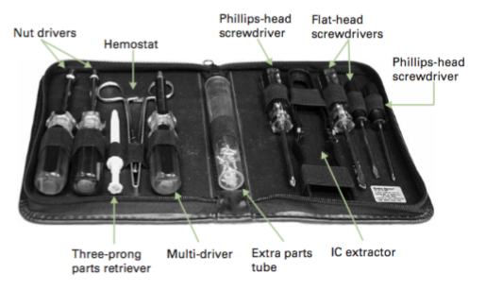
Chapter One The Path of PC Tech
1.3 Essentials
Before we begin diving into the PC, we need to know the essentials that technician need in order to become professional in PC repairing. Firstly, the typical technician tools which are, a star-headed Torx wrench, a nut driver or two, a pair of tweezers, a little grabber tool, and a hemostat to go along with Phillips-head and flat-head screwdrivers as shown in Figure 1.1.
Secondly, take precaution steps not to destroy your hardware by the electrostatic discharge. Next sections discusses these steps more deeply.

Slide 14
Chapter One The Path of PC Tech
1.3.1 Avoiding Electrostatic Discharge
If you decide to open your computer case, undoubtedly, you need to take precaution steps to stop the great killing of a PC-electrostatic discharge (ESD). ESD means the passage of static electrical charge. Have you ever shacked someone’s hand and felt the static electrical charge (or ESD) passing between both of you, of course yes. ESD will destroy the sensitive parts in your PC. So, it is essentials to take precaution steps to avoid ESD when working with PCs as next section illustrates.

Slide 15
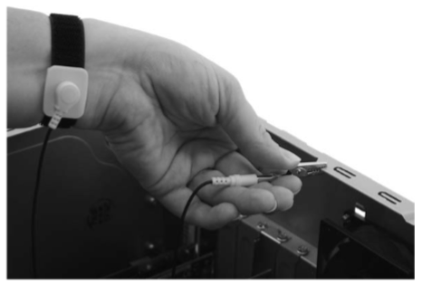
Chapter One The Path of PC Tech
1.3.2 Avoiding Electrostatic Discharge
ESD is active when two different objects that carries electrostatic discharge comes in contact. Therefore, connecting yourself by a device called anti-static wrist strap to your computer case while you are touching and maintaining your PC will stops the ESD as shown in Figure 1.2.

Slide 16
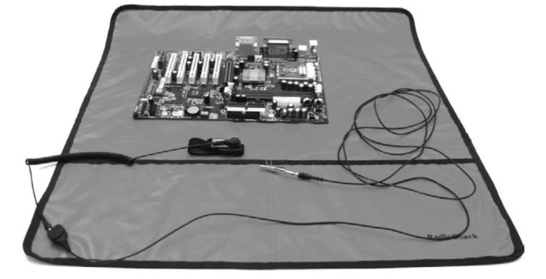
Chapter One The Path of PC Tech
1.3.2 Avoiding Electrostatic Discharge
You need to connect the alligator clip of your anti-static wrist strap to your computer case to keep you and the parts reaching the same electrical potential, hence, avoiding the electrical discharge. Another precaution steps technician needs to consider is anti-static mat as Figure 1.3 shown.

Slide 17
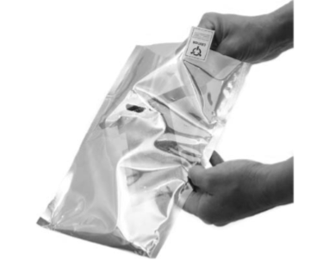
Chapter One The Path of PC Tech
1.3.2 Avoiding Electrostatic Discharge
Anti-static mat is used when electrical parts of a PC, for ex motherboard, is removed from the computer case. This part of a PC is placed over the anti-static mat along with connecting the anti-static wrist strap with a metal part, for ex a computer case, altogether to form an ideal environment against ESD for technicians. Lastly, anti-static bag is used to store the parts within of a PC preventing them any damage can be caused from ESD as Figure 1.4 shown.

Slide 18
Chapter One The Path of PC Tech
1.4 The Complete PC
A typical PC consists of multiple parts forming a complete personal computer. These parts are as follows:
System unit: the unit that contain most of PC components and usually sits beneath your desk.
Monitor: is an electronic display used to visualize the work performed in your PC.
Keyboard: is an electronic input device contains keys or buttons based on the typewriter.
Mouse: is input pointing device used to control two dimensional motion on a monitor.
Speakers: is an output device used to provide sound.
Printer: is an output device used to provide a printed papers.

Slide 19
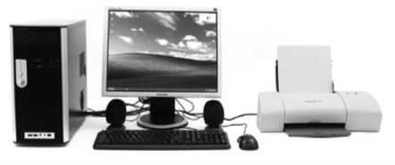
Chapter One The Path of PC Tech
1.4 The Complete PC
A typical PC has all the peripherals devices mentioned above. But there is now law that says all the completer PCs has a printer for example. PCs can be run without a printer. Figure 1.5 shows the complete PC with its peripherals.

Slide 20
Chapter One The Path of PC Tech
1.5 Opening the System Unit
Now and after taking all the precaution steps mentioned in section 1.3, let us open up the system unit to inspect the major components of a PC. Since the PC consists of thousands of components, hence, even good technician cannot name every single component inside a PC. Therefore, technician should be able to identify and recognize the major components of any PC. Before opening the computer case, let us identify the side panel connectors as explained in the next section.

Slide 21
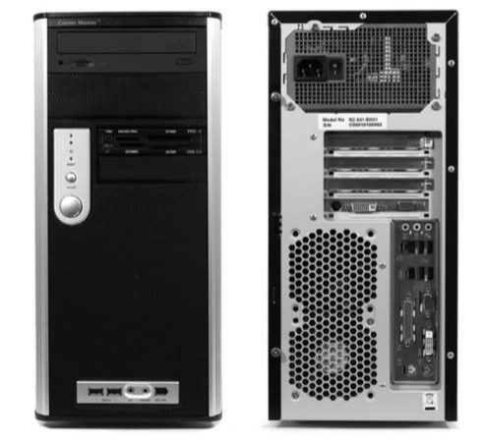
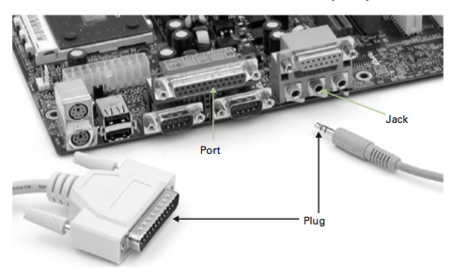
Chapter One The Path of PC Tech
1.5.1 Side Panel Connector
the computer case in front and back view
The back of the case hold the majority of the systems unit connections

Slide 22
Chapter One The Path of PC Tech
1.5.1 Side Panel Connector
PCs use different types of connections, the major and famous ones used as follows:
Mini-DIN connectors
Universal Serial Bus (USB):
DB-25 (parallel) connector
RJ connectors
Audio and video connectors
HDMI connector

Slide 23
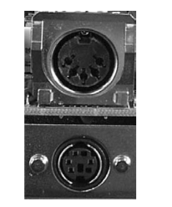
Chapter One The Path of PC Tech
1.5.1 Side Panel Connector
Mini-DIN connectors: the original DIN connectors are replaced with Mini-DIN Connectors which is used for keyboard and mouse as

Slide 24
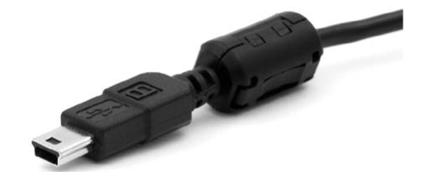
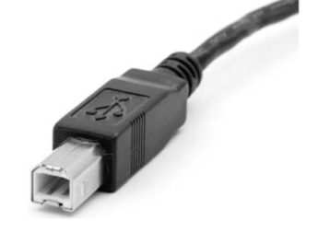
Chapter One The Path of PC Tech
1.5.1 Side Panel Connector
Universal Serial Bus (USB): industry standard used for general purpose connection. USB connection has three different sizes: “A” (very common), “B,” and “mini-B” (less common). Figure 1.9 shows USB B connector and USB mini-B connector.

Slide 25
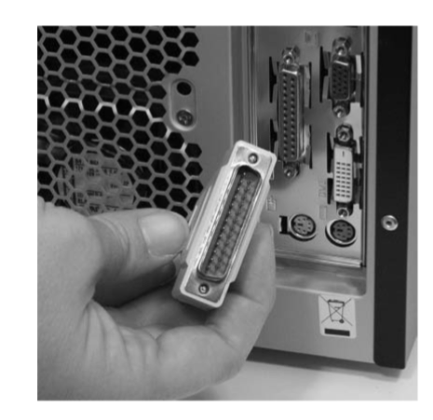
Chapter One The Path of PC Tech
1.5.1 Side Panel Connector
DB-25 (parallel) connector: is an electrical connector used to connect most of the peripherals devices, for ex printer

Slide 26
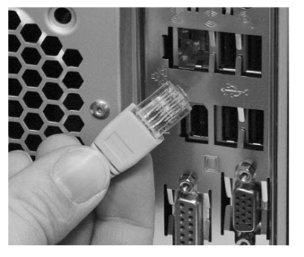
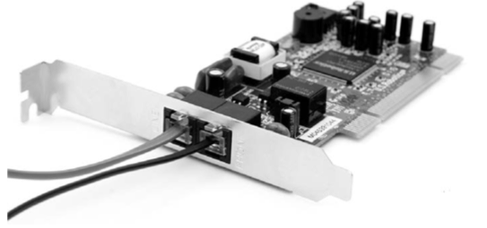
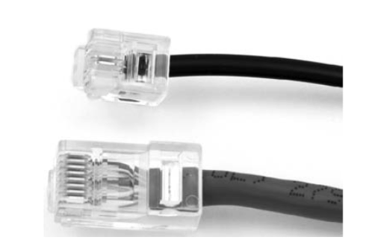
Chapter One The Path of PC Tech
1.5.1 Side Panel Connector
RJ connectors: stands for registered jack. They are used as telecommunication network interface. They are two kinds of RJ: RJ-11 is used to transfer data over a phone lines using fax modem card installed into your motherboard and RJ-45 is used for network connection for transferring data using network card installed into your motherboard

Slide 27
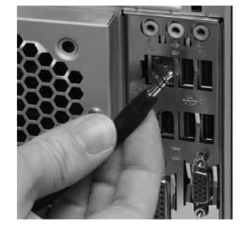
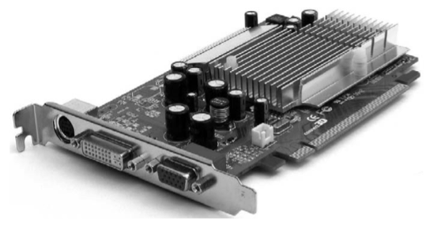
Chapter One The Path of PC Tech
1.5.1 Side Panel Connector
Audio and video connectors: speakers, headsets and microphones are connected to audio jacks into the PC. Where the monitor is connected to video connector. They are optical connector carrying audio and video signals respectively

Slide 28
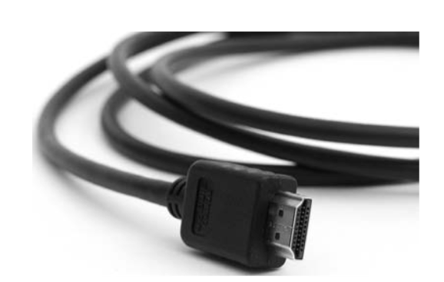
Chapter One The Path of PC Tech
1.5.1 Side Panel Connector
HDMI connector: is the next generation video connector that carries both video and audio signals with some enhancements over standard VESA, S-video and DVI ports

Slide 29
Chapter One The Path of PC Tech
1.5.2 Inside the System Unit
Computer case: contains both the internal and external components of the PC. It protects the internal components from the environment. Cases have different sizes, styles and sizes. Figure 1.6 depicts the computer case’s front and back view. Front side consists of on/off button of the PC, reset button, lights tells you the status of the system, access door to removable media such as floppy disk, CD-ROM and DVD drive. The back side (or side panel) holds the majority of the PC connectors as explained in the previous sections.

Slide 30
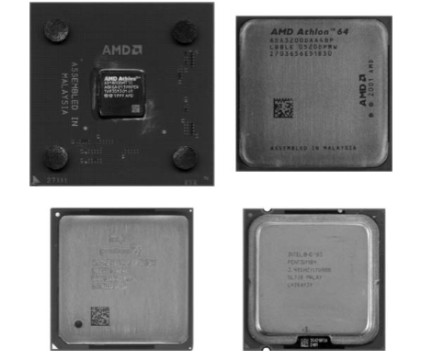
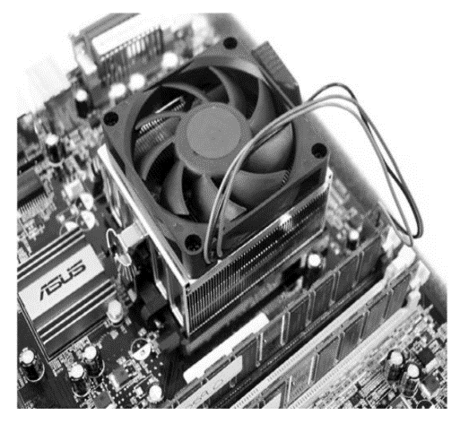
Chapter One The Path of PC Tech
1.5.2 Inside the System Unit
Central processing unit or CPU: also called the microprocessor, it is a powerful calculator that performs calculations take inside the PC. It is also called the brain of the PC since it perform and execute all the processes inside the PC. CPUs come in different sizes and speeds. Figure 1.14 shows typical CPUs used in the market today. Also, the same Figure depicts the fan used at the top of the CPU due to high heat generated by the high speediness of the CPU.

Slide 31
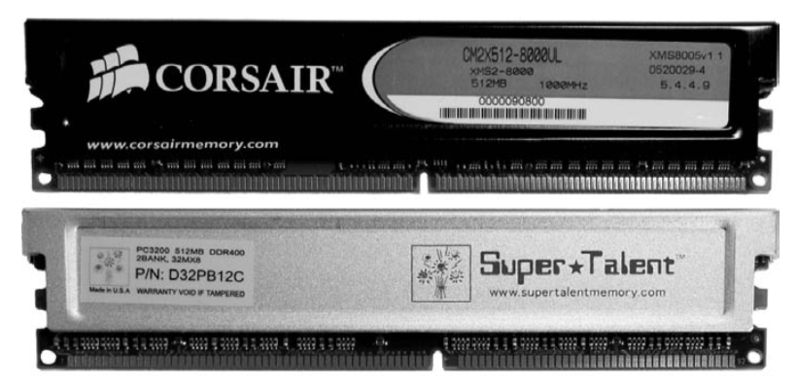
Chapter One The Path of PC Tech
1.5.2 Inside the System Unit
Random access memory or RAM: temporary data storage accessed randomly by the CPU. Each piece of RAM is called a stick as Figure 1.15 shown.

Slide 32
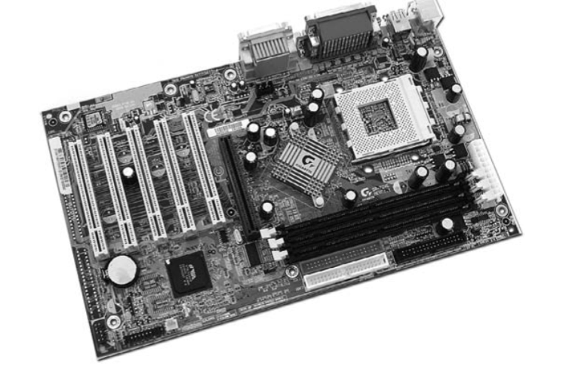
Chapter One The Path of PC Tech
1.5.2 Inside the System Unit
Motherboard: is a printed circuit board (PCB) that connected to PC components directly or indirectly, for ex, CPU, RAM, video card, sound card, keyboard, mouse….etc. Since it hold the majority of the PC components, it gains the name “motherboard”, it’s the mother components. Figure 1.16 shows a typical motherboard. Usually it comes in green colored with gold printed circuits at the back of the motherboard.

Slide 33
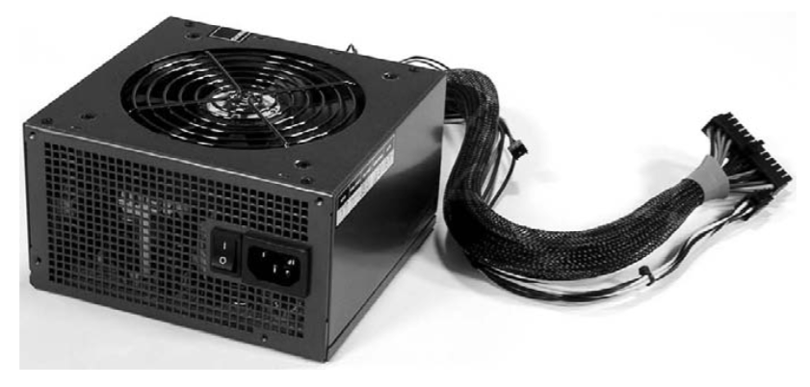
Chapter One The Path of PC Tech
1.5.2 Inside the System Unit
Power supply: as the name implies, is the components that supplies an electric energy to the PC to operate as Figure 1.17 shown. It consists of different connectors to supply some of the PC components with electrical such as, DVD drive, motherboard, hard drive…etc

Slide 34
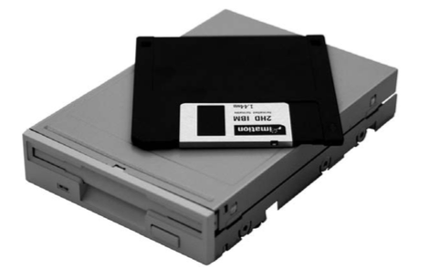
Chapter One The Path of PC Tech
1.5.2 Inside the System Unit
Floppy drive: is a disk storage uses a removable diskette. Floppy disk used today called 3.5-floppy disk

Slide 35
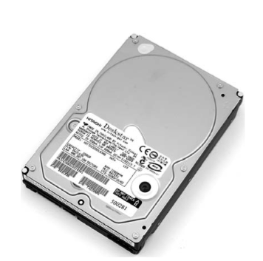
Chapter One The Path of PC Tech
1.5.2 Inside the System Unit
Hard drive: is permanent storage that keeps the files which are not currently used by the CPU. Today, hard drives can store in Terabytes and we can install more than one hard drive inside the PC

Slide 36
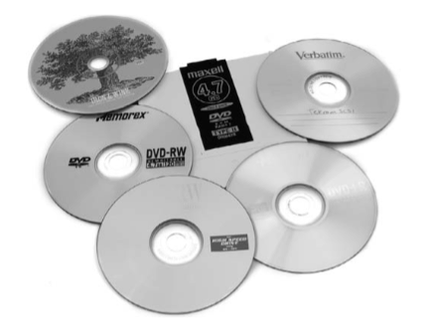
Chapter One The Path of PC Tech
1.5.2 Inside the System Unit
Optical media: it is a technology includes CDs, DVDs, mini DVDs…etc., store data in special material (often aluminum). Figure 1.20 shows a typical media discs.

Slide 37
Chapter One The Path of PC Tech
Summery
Definition of computer maintenance.
Describe the four operations that PC performs.
Understand the essentials skills of a computer technician.
Describe the components of a personal computer.
Understand the steps precaution steps taken of opening a computer case and identify the parts inside a PC.

