Slide 1
Computer Maintenance
Chapter Seven
Random Access Memory (RAM)
Dr. Mohammad AlAhmad

Slide 2
Chapter Seven Random Access Memory (RAM)
“Computers and human being’s brains, both contain a short term memories”
(Author: Mohammad AlAhmad)

Slide 3
Chapter Seven Random Access Memory (RAM)
Objectives
The learning objectives of this chapter are:
Definition of Random Access Memory.
Distinguish between RAM types.
Understand the memory specifications.
Installing and uninstalling Windows drivers

Slide 4
Chapter Seven Random Access Memory (RAM)
7.1 Essentials
If you find your PC running slow, the easiest and fastest way to boost your system is to add more random access memory (RAM) to your PC. RAM is a collection of integrated circuits that stores data and programs temporally as patterns 0s and 1s in the chip as. When a user double click on a program, the program is copied from the mass storage, for ex. hard drive, to the RAM. RAM is a small storage compared to the hard drive’s mass storage. The small size storage (RAM) features less seeking time, hence, faster access time than mass storage (hard drive). The idea of having RAM into our systems is to enable the CPU accesses a faster storage which is RAM, than a slower storage which hard drive’s storage in this case. So, the more memory you have, the happier your system will be….really?

Slide 5
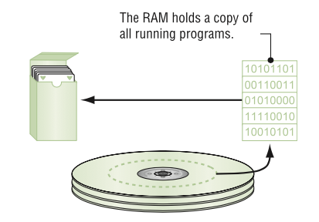
Chapter Seven Random Access Memory (RAM)
7.1 Essentials

Slide 6
Chapter Seven Random Access Memory (RAM)
7.1 Essentials
The program itself is stored on the hard drive. Theoretically, you can build a system that makes the programs to be sent to the CPU directly when double clicked. Practically, the overall process will be very slow due the slow speed of the hard drive. Modern CPUs crank out billions of lines per second, so, the hard drive cannot keep up with this speed. Consequently, RAM is placed between the hard drive and the CPU for better performance and match the CPU’s fast speed.
As stated before, RAM stores programs and data. The CPU needs to access this RAM in order to write on and read from. Also, the CPU needs to jump to any line of code that this RAM stores. So, let us look at a simplified RAM as a spread sheet like the one generated in Microsoft Excel

Slide 7
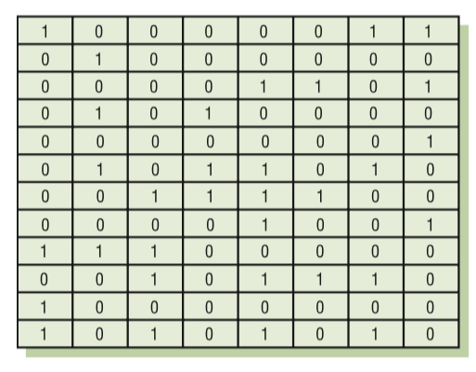
Chapter Seven Random Access Memory (RAM)
7.1 Essentials

Slide 8
Chapter Seven Random Access Memory (RAM)
7.1 Essentials
Each cell can stores either o or 1. Each cell is called a bit. Each row in the spread sheet is 8 bits across to match the external data bus of 8088’s CPU. Where, each row of 8 bits forms 1 byte. In PC world, RAM stores data and programs in bytes forms. Therefore, RAM arranges data in byte-sized rows.

Slide 9
Chapter Seven Random Access Memory (RAM)
7.1 Essentials
Here are the terms when talking about bits forms:
Any individual 0 or 1 = a bit
4 bits = a nibble
8 bits = byte
16 bits = a word
32 bits = a double word
64 bits = a paragraph or quad word

Slide 10
Chapter Seven Random Access Memory (RAM)
7.1 Essentials
The number of bytes varies from PC to PC. Today, modern systems have billions of bytes of RAM. Electronically, RAM looks as a spread sheet, but, in reality, RAM is made of group of semiconductor chips that are soldered together into on card

Slide 11
Chapter Seven Random Access Memory (RAM)
7.1 Essentials
Since the CPU access any row byte as fast as any other row, that explain the “random access” part of the RAM. Computers use Dynamic RAM for the main memory. DRAM need a constant electrical charge and periodic refresh of the circuit, otherwise it loses data. That makes the RAM “dynamic” rather than static in content.

Slide 12
Chapter Seven Random Access Memory (RAM)
7.2 Types of RAMs
Developments of modern CPUs forced the DRAM manufactures to invent new DRAMs in order to match the high speed offered by the new modern CPUs. New DRAMs have to optimize and keep track of data flowing into and out of the CPUs. There many types of DRAMs. They differ in their speed, form factor, their ability to identify errors and their bandwidth. In the next sections, types of DRAMs are discussed extensively

Slide 13
Chapter Seven Random Access Memory (RAM)
7.2 Types of RAMs
SDRAM
RDRAM
DDR SDRAM
DDR4

Slide 14
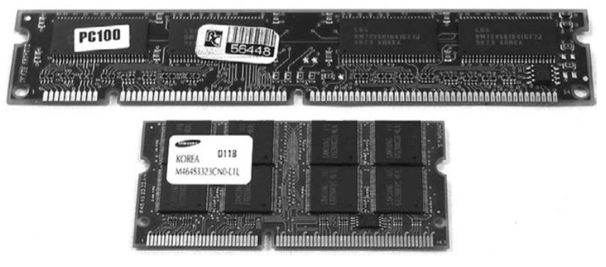
Chapter Seven Random Access Memory (RAM)
7.2.1 SDRAM
Most modern CPUs uses synchronous DRAM. Synchronous DRAM is still DRAM but it is synchronous in terms of data transfer. Particularly, synchronous is tied to the clock system, so the memory controller chip (MMC) which is part of RAM stick, knows in advance when data is ready to be grabbed from SDRAM. It is been made in 1996 on a stick called dual inline memory module (DIMM). The most common pin sizes found on desktops were 168-pin. Laptops came in 68-pin and 144-pin

Slide 15
Chapter Seven Random Access Memory (RAM)
7.2.1 SDRAM
Except SO-DIMM 144-pin, all SDRAM memory types deliver 64-bit wide data to match the 64-bit data bus for every CPU since Pentium. To take the advantage of using SDRAM, your PC needs to support this type of RAM. You can add RAM stick(s) if you have empty slots in your motherboard. As stated before, SDRAM is tied to the system clock, so that, it matches the speed of the front side bus. Commonly speaking, five speeds were SDRAM offered: 66, 73, 83, 100 and 133 MHz.

Slide 16
Chapter Seven Random Access Memory (RAM)
7.2.2 RDRAM
When Intel developed Pentium 4, they knew that SDRAM is not going to match the front side CPU’s 400 MHz data bus. Rambus DRAM or simply RDRAM was announced by Intel to solve this issue.

Slide 17
Chapter Seven Random Access Memory (RAM)
7.2.2 RDRAM
RDRAM could handle up to 800 MHz which give Intel corp. plenty of room to improve Pentium 4 processor. Improvements of RDRAM rapidly went down during the next few years after it’s launched. The reason behind that is due to the significant delays in developments and RDRAM’s price many times as SDRAM. One stick of RDRAM called RIMM. RDRAM RIMM came in two sizes: 184-pin for desktops and 160-pin for laptops. Also, RDRAM has a speed rating: 600 MHz, 700 MHz, 800 MHz
or 1066 MHz. RDRAM requires a RIMM slots in motherboards in order to install them in. Rambus corp. and Intel made a completely closed deal in producing RDRAM memory. At that time, AMD was out of luck due to this deal. Clearly, CPU industries, for ex. AMD, as well as memory industries searched for another high speed RAM solution.

Slide 18
Chapter Seven Random Access Memory (RAM)
7.2.3 DDR SDRAM
Double data rate SDRAM is the high speed RAM that AMD corp. and other memory industries invested on. DDR SDRAM doubles the speed of SDRAM. It synchronizes its data by making two processes for every cycle. Even though, DDR SDRAM could not run as RDRAM (since the SDRAM offers less front side bus speed than RDRAM) but the cost of DDR SDRAM is slightly more than SDRAM and cheaper than RDRAM which reflects a positive impact on memory market. DDR SDRAM comes in a 184-pin size DIMMs and it matches the size of SDRAM 168-pin DIMM in physical size and not in compatibility

Slide 19
Chapter Seven Random Access Memory (RAM)
7.2.3 DDR SDRAM
SDRAM and DDR SDRAM have the same size but different notches, making them impossible to insert either one of them in another one’s slot. DDR SDRAM for laptops comes in 200-pin SO-DIMM or 172-pin micro DIMMs. DDR sticks use interesting naming convention which is based on the data rate throughput per second RAM can handle. To determine bytes per second, take the MHz speed then multiply it by 8 bytes which the width of all the chips mounted in RAM stick. Also, add the abbreviation “PC” to the multiplication result. For Example, 400 MHz multiply by 8
is 3200 bytes per second. Adding the abbreviation “PC” to become PC 3200. Following the lead of AMD corp. and VIA corp. manufactures the PC adopted DDR SDRAM as a standard for RAM system and win the battle against Intel corp.

Slide 20
Chapter Seven Random Access Memory (RAM)
7.2.4 DDR4
DDR SDRAM went through a revolutionary stages. As noted in the previous section, DDR SDRAM’s birth changes the direction trend of memory market. DDR2, DDR3 and DDR4 are the consecutive RAM technologies launched in the market. DDR2 is faster than DDR while using less power. DDR2 uses a 240-pin DIMM that is not compatible with DDR. Where DDR3’s primary benefit over its predecessors (DDR and DDR2) is the ability to transfer data at twice the rate. DDR3 uses 240-pin DIMM and is not compatible with DDR nor DDR2.

Slide 21
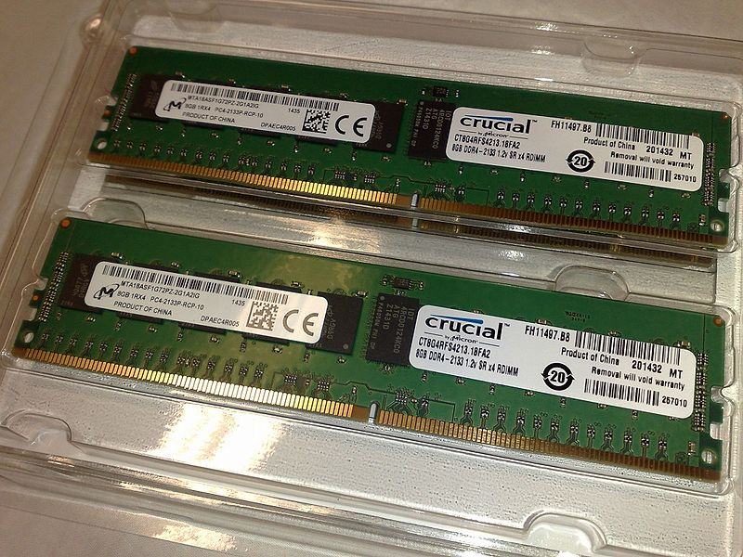
Chapter Seven Random Access Memory (RAM)
7.2.4 DDR4
DDR4 is the last and fourth generation of DDR SDRAM which is launched in 2014. It offers higher speed successor to the DDR, DDR2 and DDR3. DDR4 allows for DIMMs of up to 512-GB compared to DDR3 which allows only up to 128-GB. It operates at low voltage of 1.2 V with a frequency between 800 and 1600 MHz compared to the frequencies between 400 and 1067 MHz and voltage requirements of 1.5 or 1.65 V used in DDR3. DDR 4 comes in 244-pin DIMM module similar to DDR3 240-pin DIMMs. Also, DDR4 SO-DIMMs have 240-pin rather than DDR3 SO-DIMMs of 204-pin used for laptops.

Slide 22
Chapter Seven Random Access Memory (RAM)
7.3 Understanding Memory Specifications
Memory comes packaged in a special component called memory module or sometimes a memory stick. To understand more about memory modules, let us go through the following example:
Corsair Vengeance 8GB PC3-12800 DDR3 1600 240-pin

Slide 23
Chapter Seven Random Access Memory (RAM)
7.3 Understanding Memory Specifications
These memory module’s descriptions can be discussed in details as follows:
Corsair: this is the name of memory module’s manufacture.
Vengeance: this is the name of family line of memory product in which module fall in company hierarchy.
8GB: this is the capacity that the module can contain.
PC3-12800: this is the code used to specify the type of memory standard used by the module.
DDR3: this specifies the memory type (refer to the previous sections for more details).
1600: this is the effective speed of memory chips in megahertz (MHz).
240-pin: this is the number of pins the memory module uses.

Slide 24
Chapter Seven Random Access Memory (RAM)
7.4 Installing and Uninstalling Windows Drivers
After installing Windows as you have done in section 6.5, now you need to install all drivers that is not recognized by the installed Windows. Follow the following steps in order to install the needed drivers:
On Windows desktop, right click on computer icon, then, choose properties.
On the left side, choose device manager under control panel option.
Inside the device manager, look for the devices that marked with a yellow “question mark”.

Slide 25
Chapter Seven Random Access Memory (RAM)
7.4 Installing and Uninstalling Windows Drivers
Choose one of these devices, then, right click on them, select update driver option.
At this stage, you may need to search online for all the yellow “question marked” devices in order to go back to step 4 and update driver using the downloaded one.
Also, sometimes you may need to open up the computer case in order to identify the unrecognized device by Window, write down its model number and manufacture name. For example, components name: creative sound blaster sb0680, search online by writing the exact name of the components followed by “driver” word, download its driver then go back to step 4.

Slide 26
Chapter Seven Random Access Memory (RAM)
Summery
Definition of Random Access Memory.
Distinguish between RAM types.
Understand the memory specifications.
Installing and uninstalling Windows drivers

