Slide 1
Computer Maintenance
Chapter Nine
Laptops
Dr. Mohammad AlAhmad

Slide 2
Chapter Nine Laptops
“The great thing about a computer notebook is that no matter how much you stuff into it, it doesn’t get bigger or heavier.”
(Bill Gates, Business, The Speed Of Thought)

Slide 3
Chapter Nine Laptops
Objectives
The learning objectives of this chapter are:
Understanding laptop’s hardware and components.
Managing and maintaining laptops
Installing and configuring laptop’s hardware and components.

Slide 4
Chapter Nine Laptops
9.1 Laptop Hardware and Components
You can call them laptops, notebooks, tablets, or something different is mostly a matter with semantics. Laptop’s components are very much the same as desktop’s components with some variations. In the next sections I will focus on these variations since the common characteristics components are already discussed in details in the previous Chapters.

Slide 5
Chapter Nine Laptops
9.1.1 Expansion Options
Laptop must provide the same functionality as the desktop does. Actually, laptop provides more than desktop does, such as: laptop withstands travel, runs in the absence of AC power and much smaller and compact. In reality, laptops is more difficult to dissemble, different in form factors of motherboards, memory and hard drives. Options to expand the functionality of a laptop is available such as: ExpressCard/34, ExpressCard/54, PCMCIA, and SoDIMM.

Slide 6
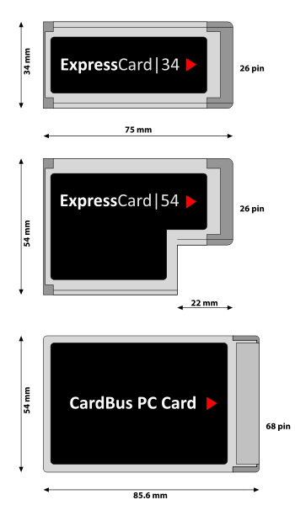
Chapter Nine Laptops
9.1.1 Expansion Options
ExpressCard/34 is a high performance serial version of the PC card (PCMCIA cards). ExpressCard/34 cards are plug and play card. That means, they do not need to neither installed or configure in order to operate. They tend to replace the PC cards. The ExpressCard/34 is 34 mm wide with a connector that runs the full width of the card. The card is 75 mm long and 5 mm thick. ExpressCard slot may be either 34 or 54 mm wide

Slide 7
Chapter Nine Laptops
9.1.1 Expansion Options
ExpressCard/54 is another form factor of a high performance serial version of the PC cards. They are also plug and play cards. ExpressCard/54 is 54 mm wide in an L-shape where the same size of ExpressCard/34 connector shown below.
PCMCIA cards stands for Personal Computer Memory Card International Association are the expansion card for laptops. Technicians often use the PC Card term rather than PCMCIA card. They are plug and play cards. PCMCIA also called CardBus PC card

Slide 8
Chapter Nine Laptops
9.1.1 Expansion Options
There are different sizes of PCMCIA cards where each typical size has its uses. Table summarizes these usages.
Type | Length | Width | Thickness | Typical Use
Type I | 85.6 mm | 54.0 mm | 3.3 mm | Flash memory
Type II | 85.6 mm | 54.0 mm | 5.0 mm | I/O (Modem, NIC, and so on)
Type III | 85.6 mm | 54.0 mm | 10.5 mm | Hard drives

Slide 9
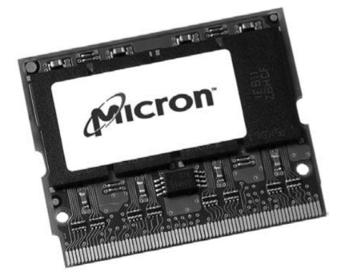
Chapter Nine Laptops
2.1 Computer Cases
For space reasoning, memory desktops cannot be used in memory laptops. Laptop memory comes in a smaller form factor version called outline DIMMs or simply SoDIMMs. Laptop memory have two versions of SoDIMM, 144-pin and 72-pin. The most common sizes of them are 512-MB and 1-GB. They are also available in 4-GB and 8-GB sizes. The speeds of these modules are ranges from 677 MHz to 1,333 MHz.
Another option is the MicroDIMM which has either 172-pin (DDR) or 214-pin (DDR2). These modules are slightly shorter than the SoDIMM and slightly wider.

Slide 10
Chapter Nine Laptops
9.2 Managing and Maintaining
Managing and maintaining laptops are not an easy job for computer technicians. Laptops manufactures built their machines so compact configured, so those manufactures know that few technicians outside the manufactures know how to maintain them. From technician standpoint, your most common work on managing and maintaining laptops is to take care of your laptop’s battery life through a proper power management, keeping the machine clean and avoid excessive heat. Everything you do to maintain PCs is also applied to laptops. For example, you need to keep your Windows updated to, the latest service packs, security patches and keep recent drivers. Also, you need to run and check disk so frequently by cleaning, defragmenting and deleting unnecessary files.

Slide 11
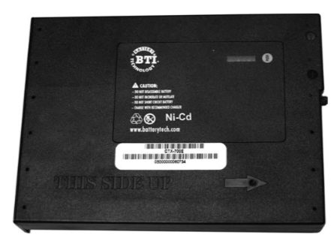
Chapter Nine Laptops
9.2.1 Batteries
Manufactures use three different kinds of laptop batteries: Nickel-Cadmium (Ni-Cd), Nickel-Metal Hydride (Ni-MH) and Lithium-Ion (Li-Ion). Each one them has its own characteristics. Ni-Cds were the first batteries used in mobile PCs as Figure 9.3 shown below. It is mainly has a problem with something called battery memory. For example, if a Ni-Cd battery in a laptop lasts for two hours, then the battery eventually only keep the same laptop for 30-minutes or less in a short period of time. To prevent this problem, users must discharge Ni-Cd battery completely before charging the battery again and that will extend the Ni-Cd battery life.

Slide 12
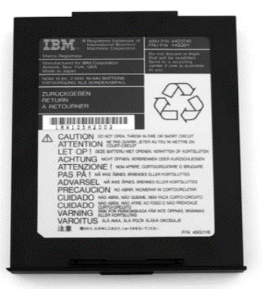
Chapter Nine Laptops
9.2.1 Batteries
Nickel-Metal Hydride (Ni-MH) were the next generation laptop batteries and still common until today as Figure 9.4 shown below. Basically, Ni-MH are Ni-Cd batteries without their flaws. Ni-MH are much less susceptible to battery memory problems, can tolerate overcharging, can take more recharging and last longer between recharging. But Ni-Cd and Ni-MH are still susceptible to heat.

Slide 13
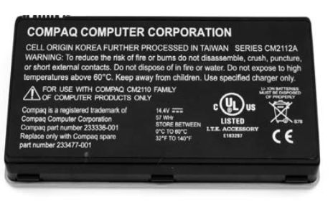
Chapter Nine Laptops
2.1 Computer Cases
Li-Ion is the most used battery today as shown below. Li-Ion batteries are very powerful, completely immune to memory problems, and at least twice long as comparable to Ni-MH on charge. Users are very pleased with this very long lifespan battery among the previous generation batteries. Li-Ion batteries are only designed with the laptops that can be used with them. These batteries prevent accidental overcharging which, again, that will extend their lifespan.

Slide 14
Chapter Nine Laptops
9.2.2 Power Management
All typical laptop components use power. The operating system instructs the laptop to shut down unused component(s) selectively. In particular, the operating system triggered that in case of reaching the maximum period of inactivity, the laptop will shut down the inactive devices. Longer period of inactivity will force the system to shut down automatically and completely, leaving the critical information to be loaded into the memory in case of awake up event occurred. Also, systems must tolerate with potential hazards such as, shutting down suddenly in the middle of writing on the hard drive.

Slide 15
Chapter Nine Laptops
9.2.3 Heat
Heat in laptop is a crucial topic that should be strictly considered by technicians. Every laptop is stacked and compact with electronic circuitry in a very small space. Unlike with desktops, laptops do not have free space in order to cool down their components with air fans. Excessive heat can cause systems to lockup hardware failure.

Slide 16
Chapter Nine Laptops
9.2.3 Heat
Some recommendations must be considered to avoid such a heat of laptops, for example:
Use power management even though if your laptop is connected to an AC outlet. This is especially when you are setting in a room with °27 Celsius.
Always use hard surface beneath your laptop and do not use a soft surface like a pillow which might cause a serious damage to the system.
Do not use a keyboard protection for a long time which might retain the heat underneath it.
Listen to your fan regularly to double check that it is working perfectly.

Slide 17
Chapter Nine Laptops
9.3 Install and Configure Laptop Hardware and Components
Due to the size limitation in laptops, replacing hardware and devices in laptops could be challenging. The best way to determine the proper disassembly method is to refer the manufacture’s documentation. Some model of laptops require a special T-8 Torx screwdriver. Don’t worry, most PC toolkit comes with T-8 Torx screwdriver.

Slide 18
Chapter Nine Laptops
9.3 Install and Configure Laptop Hardware and Components
Laptop hard drives are 2.5” rather than 3.5” compared to desktop laptops. As a result, laptop hard drives offer less capacity and speed than desktop hard drives. Moreover, 2.5” drives can operate from 5,400 to 7,200 RPM, where 3.5” drives can operate from 7,200 to 10,000 RPM. Also, 2.5” drives uses 2.5 W of power where 3.5” dives uses 5 W of power.

Slide 19
Chapter Nine Laptops
9.3 Install and Configure Laptop Hardware and Components
Memories modules in laptops can be accessed using a panel located in the bottom of the laptop. Remove any screws holding the panel in place, then, remove the panel from the laptop and set it on a side as Figure 9.6 shown below. If you are replacing the existing memory modules (in case of replacing the old RAMs with new ones) then, remove the existing modules by undoing the module clamps, gently lifting the edge of the module to a 45-degree angle, and then pulling module out the slot. Then, align the notches of the new modules with that memory slot, and gently, insert the module into the slot at 45-degree angle. Rotate the module down until you hear the clamps lock which means the new module is safely placed right. Lastly, close the panel and mount its screws.

Slide 20
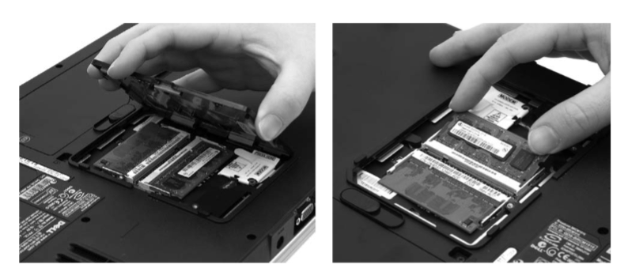
Chapter Nine Laptops
9.3 Install and Configure Laptop Hardware and Components

Slide 21
Chapter Nine Laptops
9.3 Install and Configure Laptop Hardware and Components
Where 802.11 (Wi-Fi) and Bluetooth wireless cards that are built in (attached to the motherboard) can be replaced of they go bad. Sometimes they are located near the memory, so open the panel that holds the memory. Remove any screws from the wireless card gently, then pull out the card from the slot (you may need to consult your laptop manual or documentation to determine the wireless card position). Insert the replacement card into the slot at a 45-degree angle, replace the screws, then reconnect the antenna to the adapter.

Slide 22
Chapter Nine Laptops
9.3 Install and Configure Laptop Hardware and Components
Screen, speakers, system board or motherboard, CPU, touchpad and battery of laptops can be replaced and it is highly recommended to refer to the laptop’s manual in order to determine the necessary steps to pursue that.

Slide 23
Chapter Nine Laptops
Summery
Understanding laptop’s hardware and components.
Managing and maintaining laptops
Installing and configuring laptop’s hardware and components.

